Slide 1


PROPOSED Christobel
SePTIC TANK PHASE OUT Project
“A Public Partnership between the City of Jacksonville and JEA”
July 22, 2021- 6:30 p.m.
Ribault High School Auditorium

Slide 2
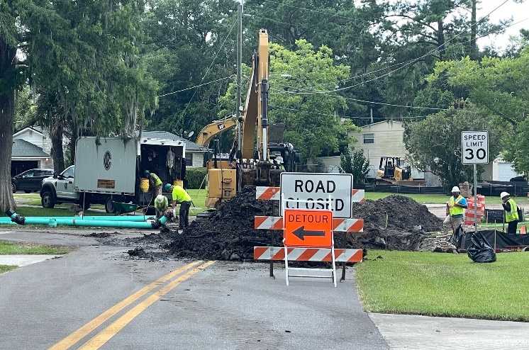



Agenda
Safety Briefing & Introductions
Program Background
Estimated Project Timeline
Program Overview
Property Owner Requirements
Customer Deposit & Credit Score
Questions & Public Comment

Slide 3


Safety Briefing
Covid-19 Precautions
Emergency Evacuation Route
Assembly Place
Hazards in the Room
Cell Phones on Silent
Restrooms
HDD Pipeline
Pipe String
Drill Work Space

Slide 4
Introductions
Greg Corcoran – JEA, Manager - Project Outreach
John Pappas – City of Jacksonville, Director of Public Works
Pete Hallock – JEA, Project Manager & Engineer
Lisa Jennings – JEA, Program Manager - Project Outreach
Leslie Nelson – JEA, Coordinator - Project Outreach
Chris Deroma – JEA, Coordinator - Project Outreach

Slide 5
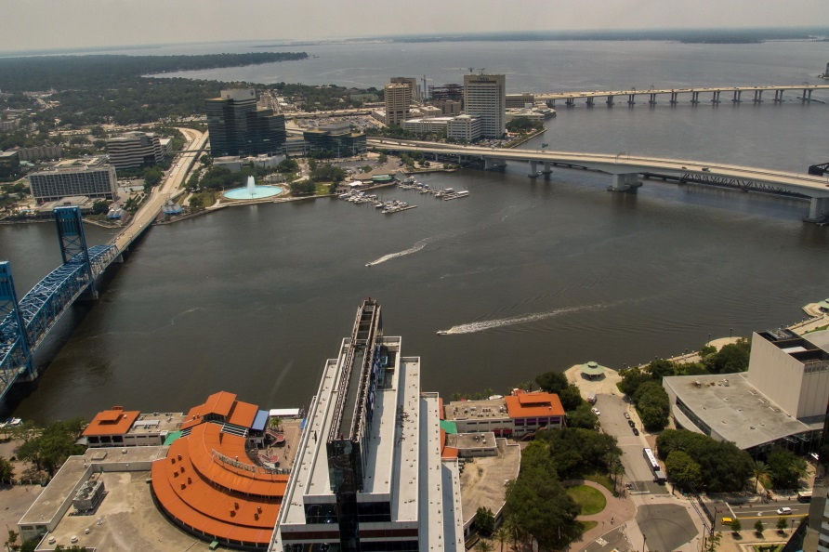
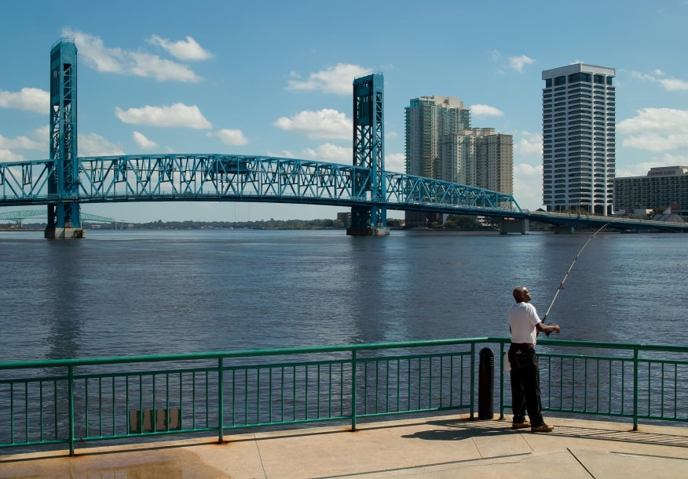
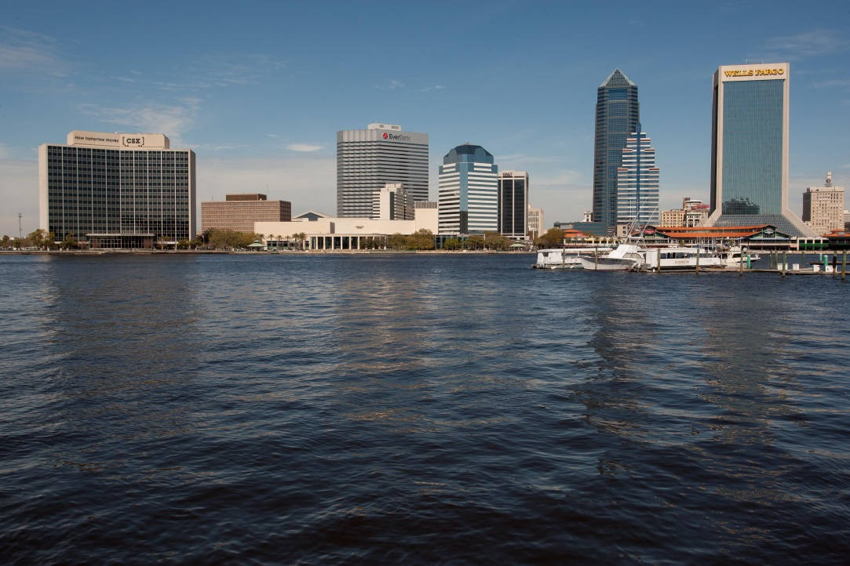
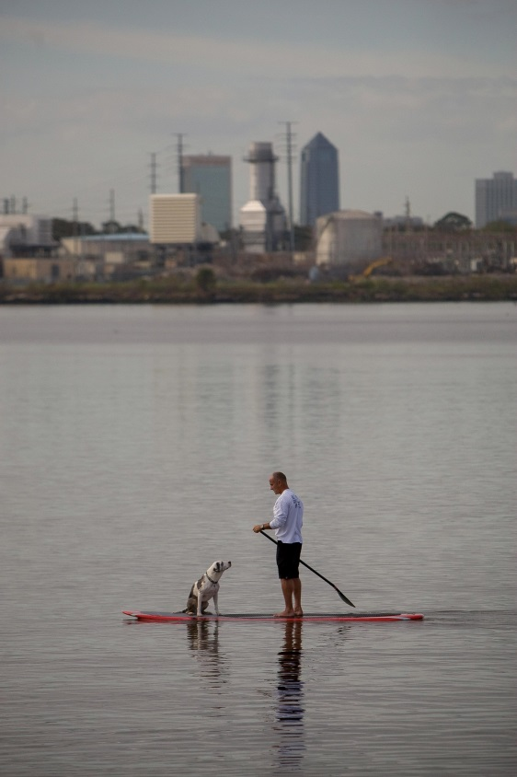


Slide 6
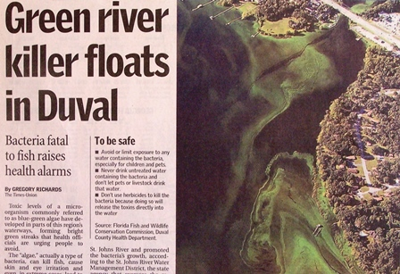
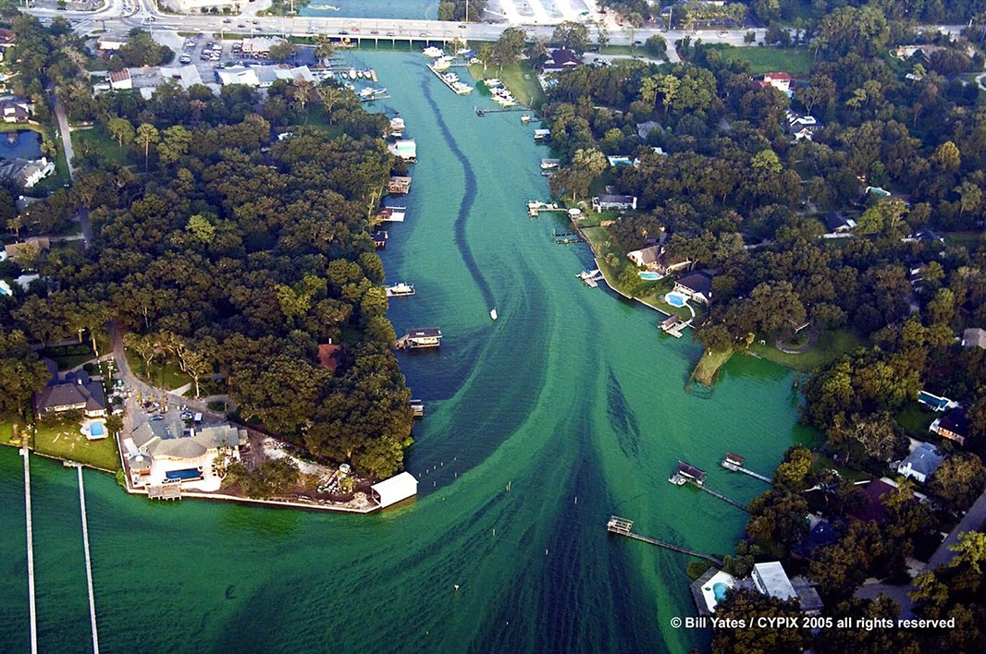
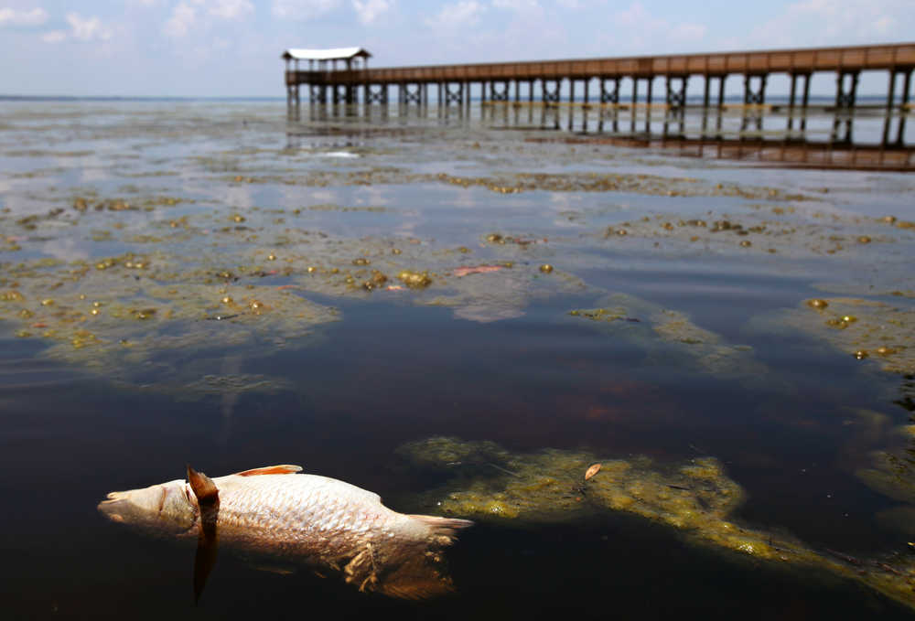
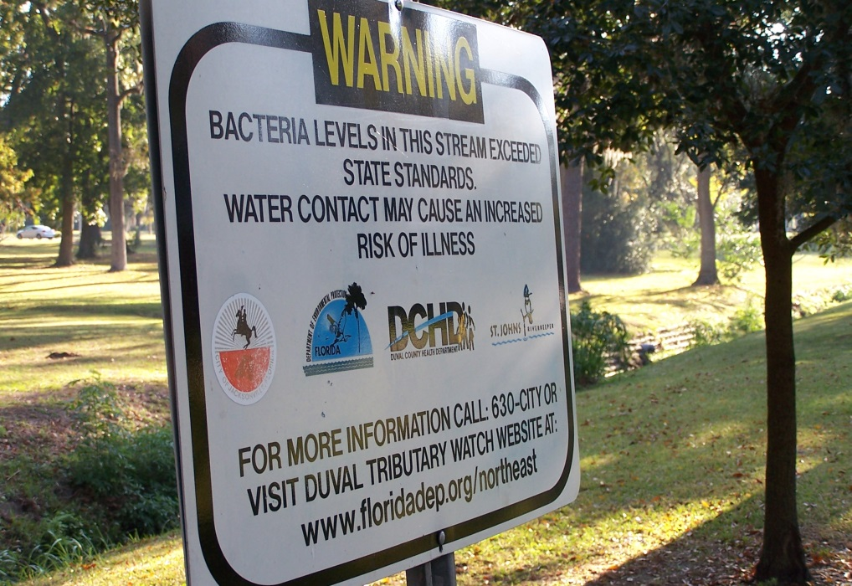
Photos courtesy of the Florida Times-Union, St. Johns RiverKeeper, Bill Yates

Slide 7
Program Background
Estimated 60,000 septic tanks in Duval County
Failing septic tanks negatively impact Jacksonville’s waterways & quality of life in your community
City’s response to citizens’ request to provide new water & sewer to established neighborhoods at no upfront cost to property owners
$54 million program ($15.9 million - COJ, $38.1 million -JEA)
City Ordinance unanimously passed by Jacksonville City Council on 8/23/16
Future program funding being discussed by Mayor & City Council
Water line upgrades to be funded by JEA

Slide 8
Program Background
HOW ARE THE PROJECT AREAS CHOSEN?
Identified 35 failure areas – Estimated 22,000 septic tanks
Scoring system created to rank each failure area
Includes environmental, health, and community considerations
Examples: # of failing tanks, soil conditions, proximity to waterway, no central water, potential economic & future development
Christobel currently ranked #3 – 3rd project of program

Slide 9
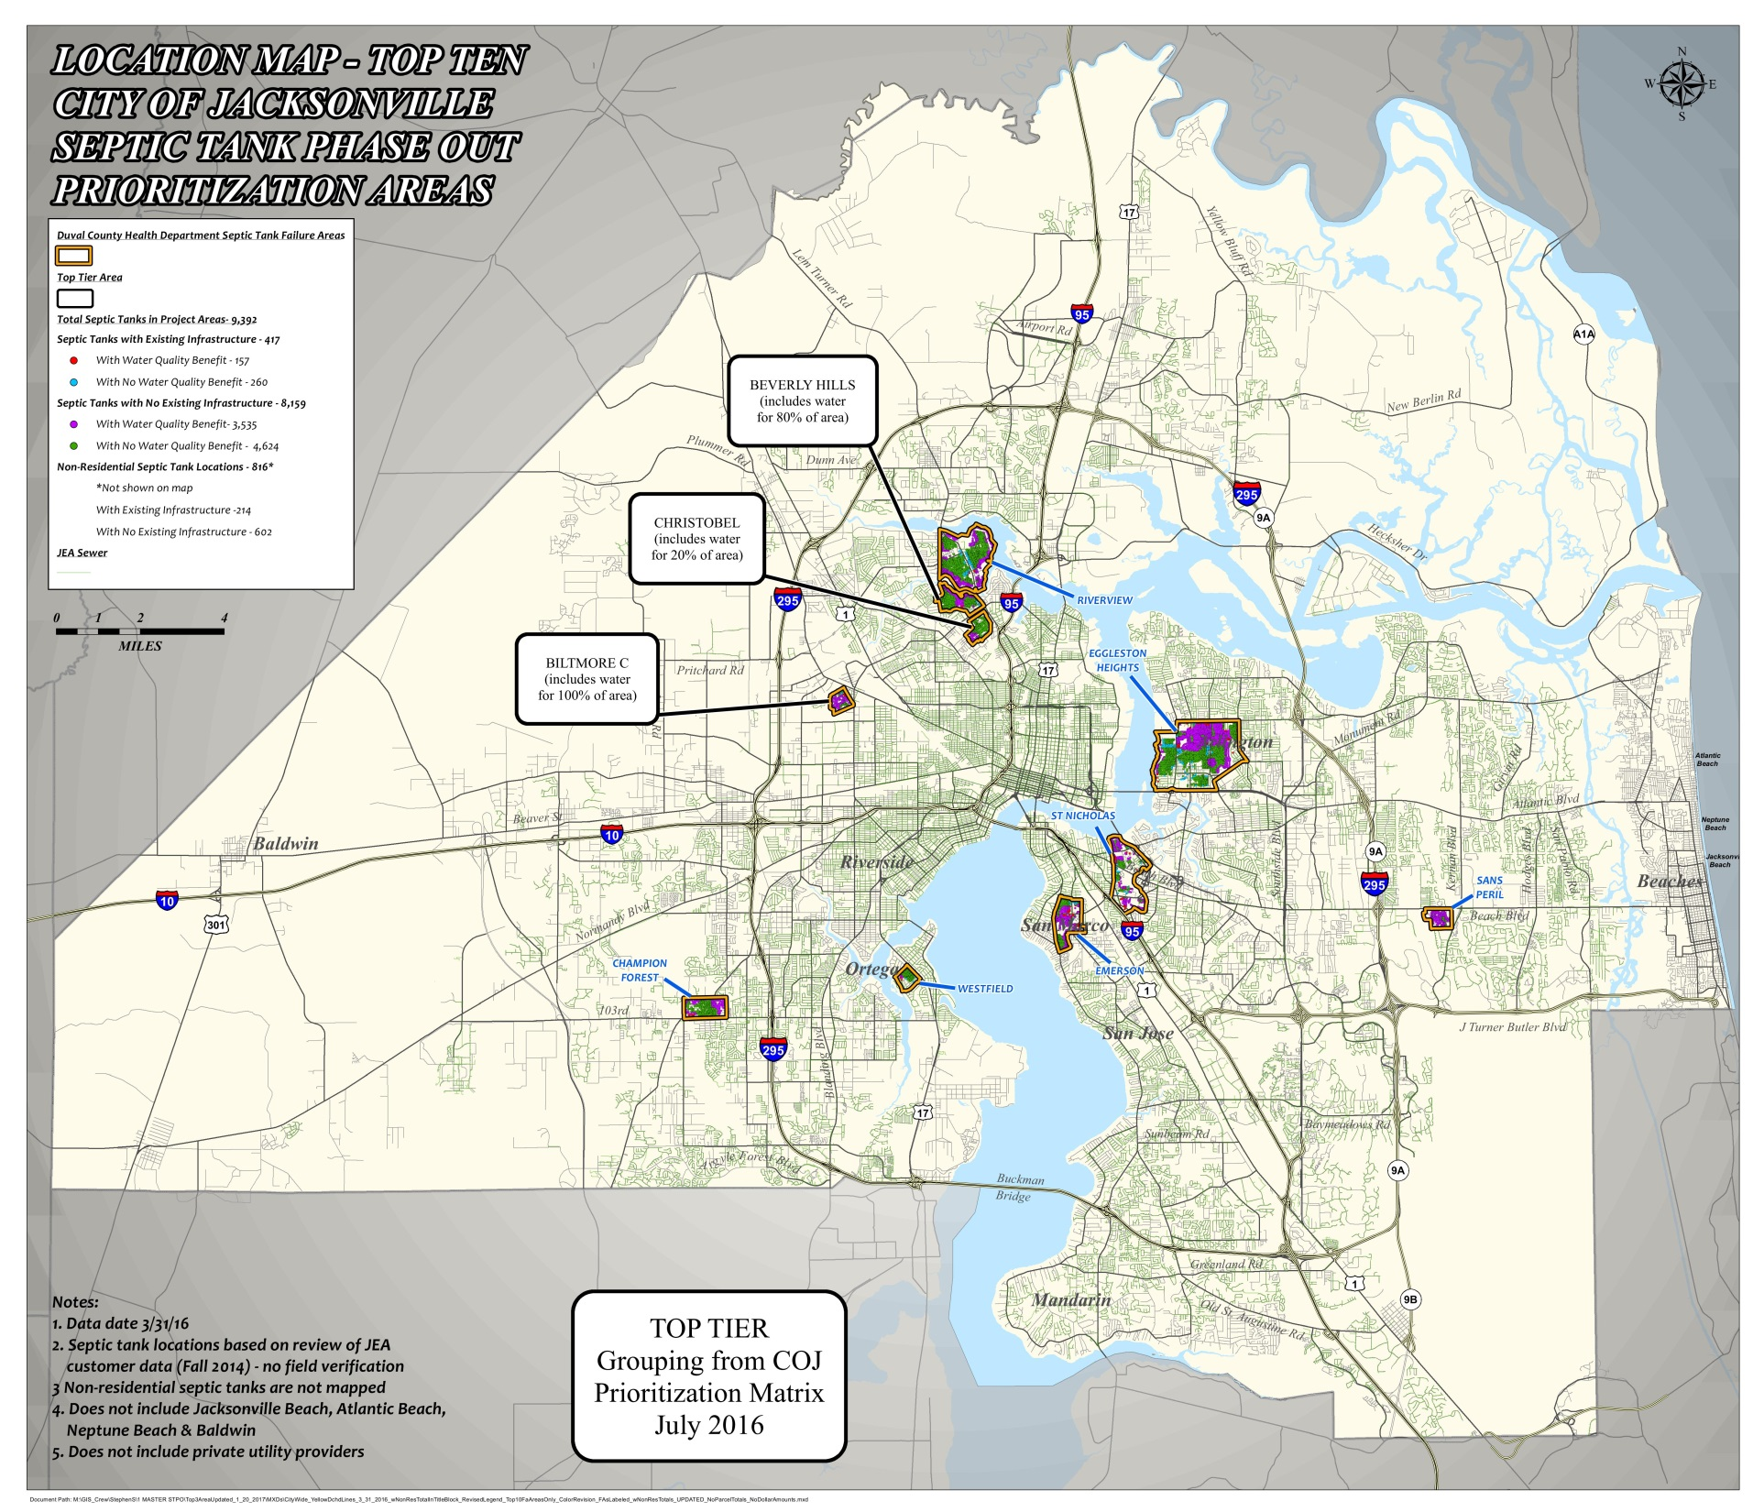
Insert identified areas map
UPDATE MAP

Slide 10
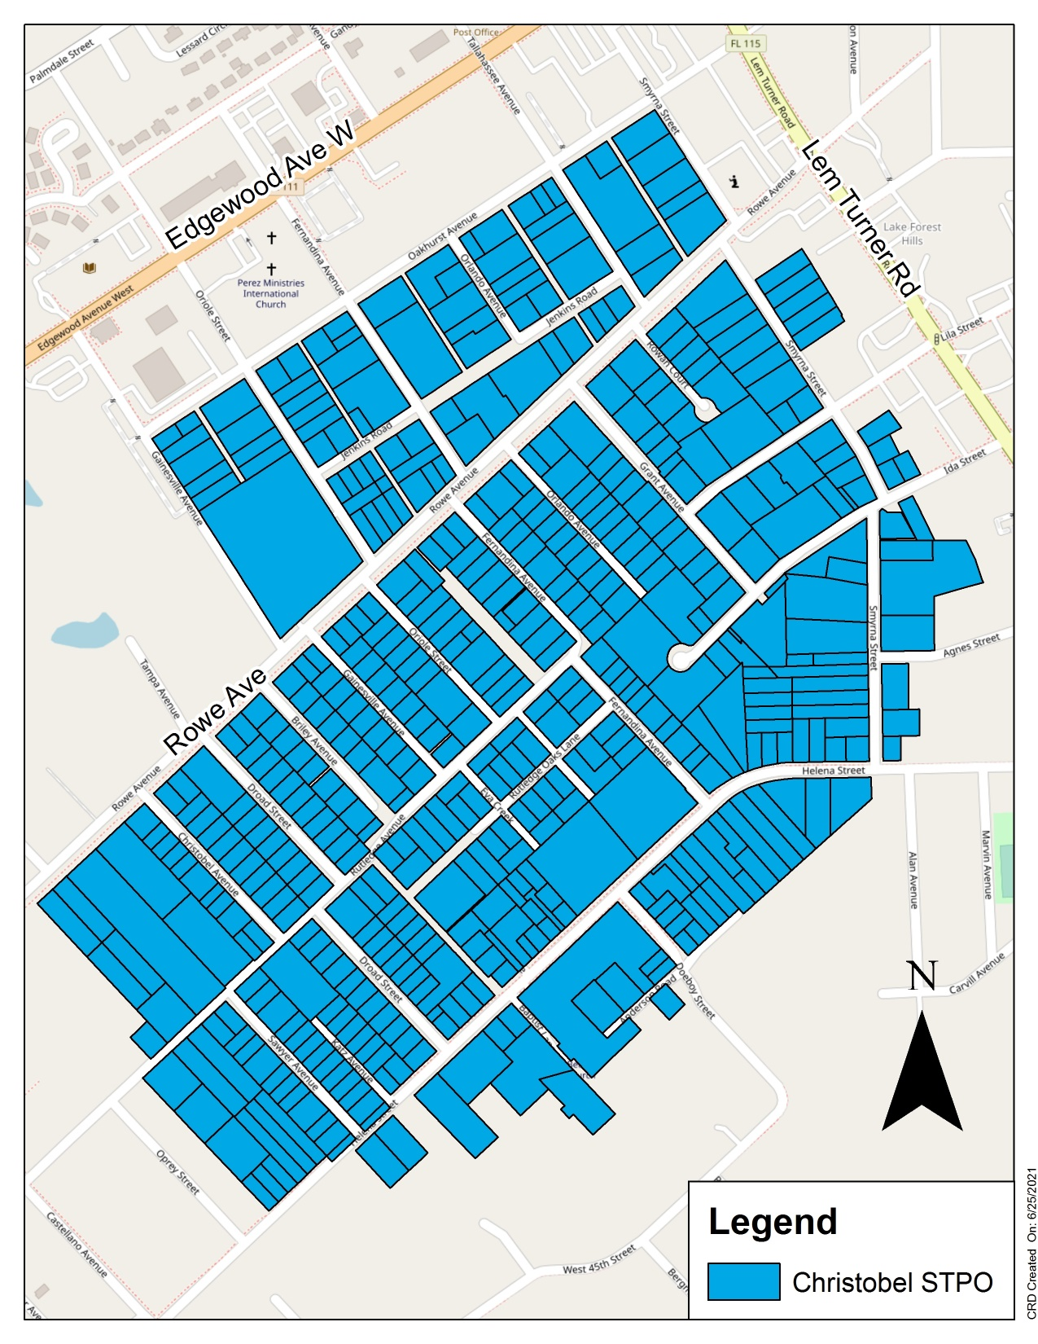
Estimated Project Cost:
$26.9 Million
Project Boundaries:
Oakhurst Avenue to the NORTH
Lem Turner Road to the EAST
Anderson Road to the South
Sawyer Avenue to the WEST
Nearby Waterways:
Ribault River
Trout River
St. Johns River

Slide 11
Program Timeline
WHAT IS THE TIMELINE FOR THE PROJECT?
1st community meeting – July 22, 2021
2nd community meeting – TBD
6 month community decision period begins
Project design period: 1 year from start**
Project bid & construction period: 2-3 years**
*Additional neighborhood meetings will be held as needed
**Duration is subject to change

Slide 12
Program Overview
HOW DOES THE PROGRAM WORK?
Voluntary Project – Community/Neighborhood decision
70%* of property owner(s) within project area must agree to project to move forward within 6 month “decision period”
Property owner(s) within each designated project area will “vote” on project moving forward
One “vote” per real estate (parcel) number as identified in the Duval County Property Appraiser records - Vote in form of “TCE” execution
All conforming properties will be counted, regardless of use or development (structure or no structure)
5 year waiting period for project reconsideration
* 70% = 358 of 511 total properties

Slide 13
Program Overview
Program pays for ALL COSTS associated with the installation of new water and sewer lines, including the connection plumbing work on private property and septic tank abandonment (not private plumbing inside home)
Program pays for ALL permit and JEA fees – NO REPAYMENT
Unimproved (empty) lots will receive a sewer connection at the property line for future connection
Private water and sewer lines will be run from the property line to the structure (If a TCE has been signed and executed)
Roads, sidewalks, and driveways impacted by construction will be rebuilt and roads repaved

Slide 14
Property Owner Requirements
Property owner(s) required to sign a notarized temporary construction easement (TCE) to participate in project
TCE will be recorded on your property deed
Property owner(s) or their tenants must also agree to sign JEA water and sewer service application and pay monthly JEA bill
Property owners that DO NOT connect will be charged “readiness to serve” fee of $21.15 per month, billed separately by JEA directly to property owners
Property owners will be notified (by mail) they have 365 days to connect once sewer system is available prior to being charged monthly fee
Revenue generated by the “readiness to serve” fee will be used by the COJ to fund future water and sewer improvement

Slide 15
Property Owner Requirements
ACTIVITY | COST ESTIMATE
Replace Existing System
New Septic Tank & Drain Field | $10k-$20k
Septic Tank Repair (Pump Out) | $200.00
Septic Tank Repair Permit (DCHD) | $585.00
TOTAL RANGE: | $10K to $21K
Install Sewer
Sewer Construction Costs (Right-of-way & Private Connection) | $50,850*

Slide 16
JEA Credit Score & Deposits
JEA Internal ONLY – Not FICO/Equifax/Experian credit score
Everyone starts with a JEA internal credit score of 1,000
If the JEA internal credit score goes too low:
  New deposit may be required
  Current deposit could increase
    Payment Arrangements May Be Available
Deposits are usually 2-times the average monthly bill for the property
No initial deposits required for new sewer service (if credit score is 850 or above)

Slide 17
JEA Credit Score – Infraction Examples
Infraction | Internal Credit Reduction | Duration of Credit Reduction
1st Dishonored Payment | -100 Points | 9 months
2nd Dishonored Payment | -200 Points | 9 months
Dishonored Deposit or Initial Payment | -300 Points | 9 months
Broken Payment Arrangement | -50 Points | 12 months
Disconnection for Non-Payment | -100 Points | 24 months
Write Off with Outstanding JEA debt | -750 Points | 7 years

Slide 18
JEA Credit Score & Deposits
Maintain Good Payment History/Work to Improve Score
  There is plenty of time
    Pay on time, no returned payments, no disconnects and no broken payment arrangements
Deposits are Returned (Applied to JEA account)
  After 2 years
    If a good JEA credit score is maintained
JEA MyWay – Pay-As-You-Go Billing - jea.com/myway
  Avoid a deposit entirely – prepay for utility services
Questions about your current JEA Credit Rating?
  See a Project Outreach Representative in attendance or call 665-7500

Slide 19
Sewer Billing
Example: Average Water/Sewer Bill:
Magnolia Gardens
Similar homes – size & build
¾ Inch meter
$22.22 Water
$38.78 Sewer
$67.97 TOTAL
Bills could be higher or lower depending on customer usage & billing cycle
Billing will not start until you are connected
Review your Bill History, use the Bill Estimator tool and find Ways to Save at jea.com.

Slide 20
Customer Meetings - Sign Documents
JEA will send TCE documents and JEA applications to property owners via email or USPS
All property owners on deed must have notarized signature on TCE
Property owners can send completed service application and original notarized TCE documents to JEA – Will be recorded on property deed
JEA will automatically start water and/or sewer service billing once property is connected and receiving service
JEA staff will contact property owners by email or phone to set-up face to face customer meetings to go over program and get forms signed/notarized
JEA septic tank phase out program office is located at the Bradham-Brooks Library – 1755 Edgewood Avenue West

Slide 21
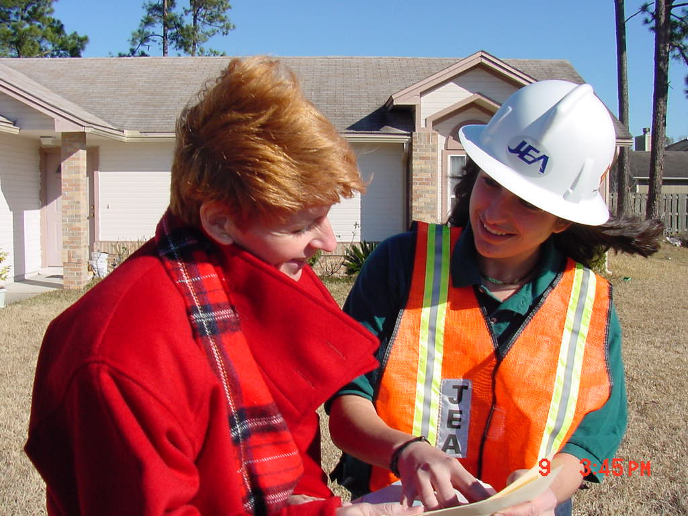
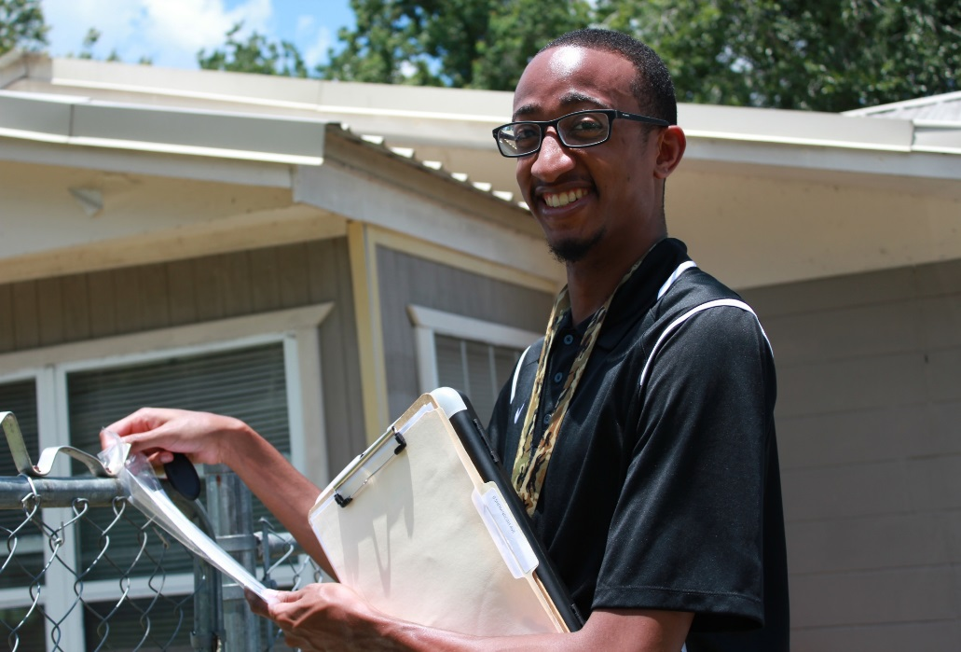
Looking for Block Captains!
We need YOUR help to make this program a success!

Slide 22


QUESTIONS & PUBLIC COMMENT
JEA Project Outreach
665-7500
Email: projectoutreach@jea.com Program web page: jea.com/septic-tank
Project web page: jea.com/christobel

Slide 23


Prioritization of Project Areas
 | Environmental, Health & Welfare (Max. 70 points) |  |  |  |  |  | Community Considerations (Max. 30 points) |  |  |  |  |  | Overall
Area | DCHD | No. of Units | No. of Units | Factor For Lots | Impaired | Environ, Health | Development | Median | Water | Elimination | Offsite Economic | Community
Designation | 2016 | Within | Within | Within The | Tributary | & Welfare | Prior to | Home Value |  | of Future | Development | Considerations | Total
 | Score | Area | 150M Buffer^{A} | 150 M Buffer | Exceedance | Score | 1968 |  |  | Proliferation | Opportunities | Score | Score
 | (60 pts)^{D} |  | (BMAP) |  | Factor^{C} |  | 10 pts | 5 pts |  | 5 pts | 5 pts
Biltmore C | 49.00 | 173 | 135 | 4 | 0.00 | 53.00 | 10 | 5 | 5 | 2.7 | 2.0 | 24.7 | 77.70
Beverly Hills | 60.00 | 695 | 279 | 2 | 1.35 | 63.35 | 10 | 4 | 0 | 0.1 | 0.0 | 14.1 | 77.45
Christobel | 49.76 | 289 | 62 | 2 | 2.20 | 53.96 | 10 | 5 | 1 | 3.8 | 2.0 | 21.8 | 75.76

Slide 24
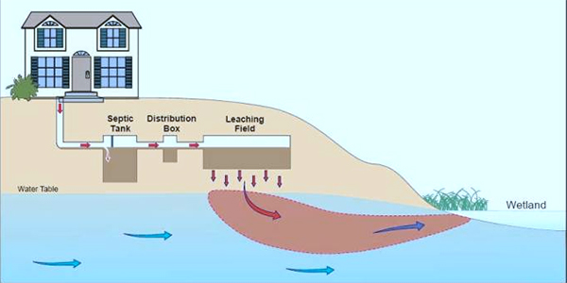
Septic System Failure

Slide 25
