Slide 1

Welcome to the
Awards Meeting
November 2, 2023, 10:00 AM EST
You have been joined to the meeting with your audio muted by default.
At the designated public comment time we will provide opportunity for you to unmute to speak.
During the meeting, public comments received via e-mail regarding any matter on the agenda for consideration will be read out. Per the Public Notice Agenda posted on JEA.com, public comments by e-mail must be received no later than 9:00 a.m. on the day of the meeting to be read during the public comment portion of the meeting.
Please contact Sarah Millsap by telephone at (904) 776-4311 or by email at millse@jea.com if you experience any technical difficulties during the meeting.

Slide 2
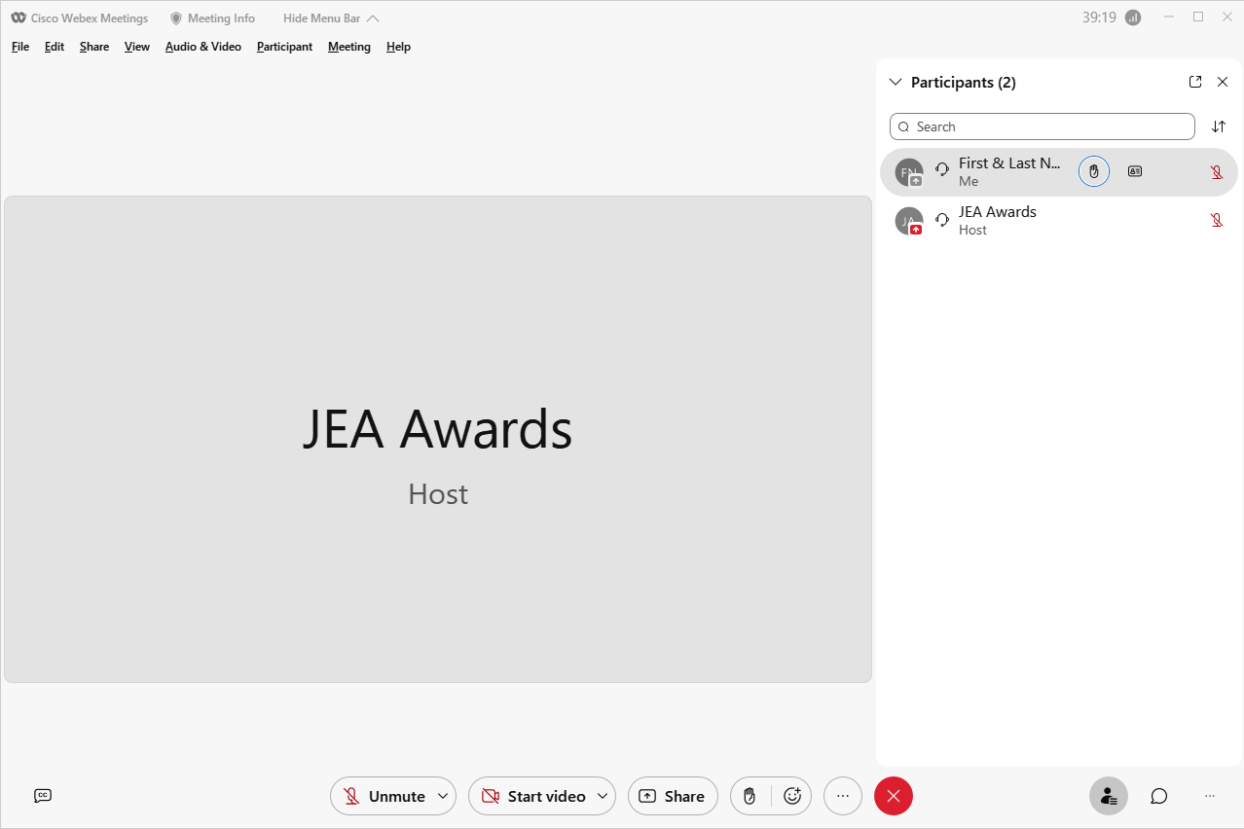



Awards Meeting – Public Comments
Controls for Public Comments
Located on the bottom-right side of you screen you will find an icon that looks like a person labeled Participants. This option will allow you to see a long list of individuals who have joined today's meeting.
At the top of this list, your name will be visible and to the right you will notice a gray icon that looks like a hand .
If you click it, it will show a slash through the hand letting us know that you would like to be recognized for comment, additionally you may click it again to lower your hand.
For those that may have called in directly, there are 2 additional ways that you can notify us that you would like to provide comment. The first is by pressing *3 on your phone, which will raise your hand. The second way you may notify us is to press *6 to unmute your line.
If you unmute your line, please state your name so that everyone may hear who is speaking before providing your comment.
Below is a summary of the meeting controls you will see at the bottom of your screen.
Audio Mute
Video
Screen Share (Off)
Raise Hand
More Options
Leave or End Meeting
View Participants
Chat

