Slide 1
Ethics Training
Presented by Ethics Office and Office of General Counsel
City of Jacksonville, Florida
Kirby Oberdorfer, Deputy Director
Lawsikia Hodges, Deputy General Counsel
Notes:
Good morning everyone! Thank you for taking time to attend and participate in this ethics training. Yes, you heard me correctly . . . “participate”--just to warn you, this training will be interactive at times, so you can’t hide ☺.
I am Kirby Oberdorfer, I serve as Deputy Director of Ethics Office and previously served on City’s Ethics Commission for 4.5 years.
Before we begin the training, I would like to share how I came to work with the City in the Ethics Office for the past 5 years . . . as a result of my lifelong passion for ethics since elementary school—safety patrol. Didn’t know that at the time because that would have been very strange, but as I look back, there is a big connection between being a safety patrol in 5th grade and my role in the Ethics Office. Both involve keeping people safe.
Now I would like to know a little more about you. In the chat, please share how long you have worked at JEA. For those who are new to JEA/government, have you been required to follow a code of conduct in business or school? Ethics laws are essentially code of conduct and just like safety patrols, ethics laws at state and local level are designed to keep taxpayers and government officials like you safe.
As you may recall from elementary school days, it was not always easy to follow the rules of the safety patrols/ambassadors. Some, perhaps one of you, would say why can’t I run? There’s actually a scientific reason for that: Research shows that people will follow rules better if they understand the purpose or reason for the rules. So today, we are going to start with the purpose of governmental ethics rules and then discuss the most relevant rules that you may encounter as a JEA employee or member of the Awards Committee.

Slide 2
Training Outline
I. Introduction – Office of General Counsel
II. Government Procurement Principles
III. Overview of Awards Committee (Roles/Responsibilities)
IV. Sunshine Law
V. Ethics Laws
VI. Public Records

Slide 3
How do you feel?
OK, no problems
I am not sure or have no opinion
Seems unfair or wrong
Notes:
As we move to the ethics part of the training, we need you to put on your taxpayer hat to consider how you feel about the government employee’s behavior—is it ok or do you have concerns about it? How do you feel as a taxpayer if you read in the paper:
A City employee charged citizens $5 for an extra copy of a permit, which the employee kept for themselves and totaled approximately 10% of their City salary. In the chat, 1, 2, or 3….. Are you surprised that a Duval County judge did that in the 1960s?
Next, how would you feel if a department head orders City employees, on City time, with City equipment, to clean debris from her yard following a devastating hurricane. In the chat, 1, 2, or 3.

Slide 4
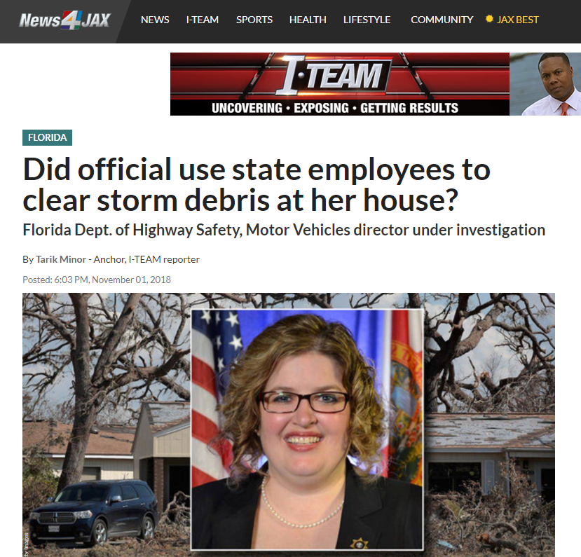
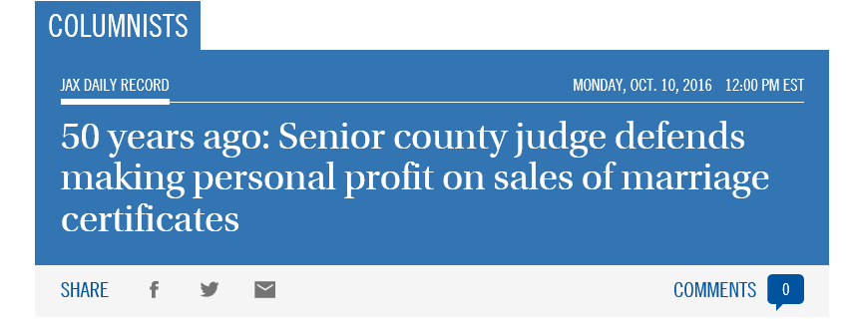
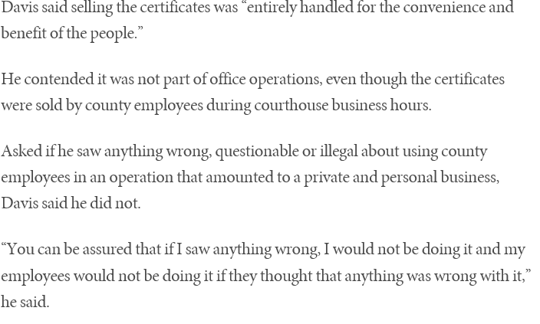
Notes:
These scenarios may sound crazy, but they happened here in Duval County and in another Florida county. These situations are not limited to just these two . . . other situations have occurred throughout Florid and our country. These situations have a common element . . . They involve people and thus human nature. If you think you would never do that or who would do that, consider why we have warning labels on products . . .
So, how can our society protect against human nature that might lead us astray? Partially through ethics rules designed to protect taxpayers, citizens and ourselves as government employees from putting our self interest above our government position. Look at quote in slide . See whose interest the judge is putting first.

Slide 5
What is Purpose of
Government Ethics?
Notes:
Before reviewing the ethics areas you are most likely to encounter in your JEA employment or as a member of the Awards Committee, it is important to understand the purpose and origins of government ethics laws.

Slide 6

Personal Ethics is NOT Same as Government Ethics
Personal Ethics
The Golden Rule
Government Ethics
Narrowly focused on public corruption
Notes:
We know you are all generally good people from a personal ethics standpoint by serving as a JEA employee and giving back to the community, AND you all want to do the right thing, but we need to educate you about government ethics so you can succeed as a JEA employee and protect yourself because the right thing in government isn’t always the same as personal ethics. Sometimes, it is apples & oranges. Relying on personal ethics can sometimes lead to wrong decision for government ethics issue.
Personal ethics is the Golden Rule (“treat others as you want to be treated”)--what we learned in school, family, church—how to get along with others and basic values
Government ethics on the other hand are the ethics of the institution, they are what promotes a fair government. Prevent government officials from personally benefitting from government position & hold government officials accountable to people

Slide 7
Personal Ethics is NOT the same as
Government Ethics
Helping a Relative Find a Job
Discussing Ideas with Board Outside Meeting
Personal Ethics
Good
Good
Government Ethics
Trouble with Nepotism Law
Trouble with
Sunshine Law
Notes:
Government ethics can be counter-intuitive to personal ethics and how we interact as human beings, such as the Sunshine Law. May do something for a good or right reason from a personal ethics standpoint, but it very well may violate governmental ethics rules , and sometimes the answer it is not obvious at all….
Here are a couple examples:
Helping a relative find a job is personally a good ethical thing to do, but in government this could violate anti-nepotism and misuse of position laws.
Sunshine Law and discussing bids/committee business with fellow Awards Committee members outside a noticed meeting
Unfortunately, this means your instincts on what to do in a government situation may not be right!

Slide 8












Top Government Ethics Danger Areas

Slide 9
Ethical Decision Guide
ASK FIRST, ACT SECOND:
Is it legal -- does it violate state law or City ordinance? If you’re not sure, consult with your Department Ethics Officer, OGC or the Ethics Office.
Does it comply with JEA policy? The law may not prohibit it, but JEA policy may.
Could this create a problem for JEA or the citizens you serve? Even actions that are legal or in the “gray area” can destroy public trust and ultimately hurt your career.
Notes:
We will begin most of the substantive ethics areas with an initial scenario to test your current knowledge of the specific ethics area. We will then discuss the applicable law and then finish the topic with additional scenarios to engage you and gauge your learning.
To help guide you in your answer for each scenario we are going to discuss, here is a decision guide.
Before answering each scenario, think about this:
Is it legal?
Does it comply with JEA policy?
Will this get me or JEA in the paper?
Does it seem ok to you?
And know that if you have any questions we are unable to address now, we would love for you to reach out to us anytime – we will leave our contact information on the final slide for a few moments so you can write our email and phone number down.

Slide 10
Danger Area #1
SUNSHINE
MEETINGS
Notes:
Number one area likely to encounter – so we are going to spend the most time on this…

Slide 11

Knowledge Check
What is the purpose of the Sunshine laws?
Notes:
Type answer in Chat . . . PUBLIC TRUST and Transparency! This is why ethics laws exist at the state and local levels, such as the Sunshine Law, Public Records, conflicts of interest, gift prohibitions, etc.

Slide 12
Scenario
JEA recently put out a bid for interior design for the new HQ. You are a member of the Awards Committee and the chair invites you to lunch “to get your thoughts” on the bidders.
Can you go? What topics can you discuss?
Notes:
You can go to lunch, but you cannot discuss the bidders or any matters/business that could come before the Awards Committee. If you don’t feel comfortable about going to lunch or drawing a boundary on the topics discussed at lunch, it is a safe/best practice to politely decline the lunch invitation to avoid any appearance of impropriety.

Slide 13
Sunshine Law—General
What is the Sunshine Law?
Any communication
Between two or more members of the same board/committee
On a matter that could possibly come before your board/committee in the future
Has to be in a “noticed meeting” able to be heard by the public
Florida Statutes Chapter 286
Notes:
NOTE: Broad use of word “communication.” Not just limited to meetings.
Applies gavel to gavel—no conversations walking into/leaving room and no sidebar communications. Misperception of ok to discuss after vote is over.
How do you determine what issues may come before Awards Committee? Look at duties of Awards Committee in JEA Procurement Code and other governing documents.

Slide 14
Sunshine Law—Application
All Meetings are Covered by Sunshine Law
Committees and Subcommittees
Workshops
Two or more Awards Committee members in a planning meeting
Florida Statutes Chapter 286
Notes:
Not just “main” or major meetings that are covered by Sunshine Law—this is sometimes a misperception. Have to be noticed and have minutes taken.
During a meeting of City Council, it was discovered that a board’s subcommittees were not taking minutes. Could be a Sunshine Law issue. Also, audio recording of meeting is allowed, but does not satisfy requirement of taking minutes under Sunshine Law.

Slide 15
Activities and Communications Prohibited by Sunshine Law
Phone, email, texting or other communication with Awards Committee members about committee outside noticed meeting
Tours
Using liaison or staff as go-between
Florida Statutes Chapter 286
Notes:
Includes social media (hot topic)
Tours are another Sunshine Law danger area. In prior cases, Florida courts have said a board that took tours to review prospective sites for board’s project violated the Sunshine Law because not all public can attend and hear what is being said.
Using liaison: cannot use another person to build consensus or pass information along to other Awards Committee members (Ex: I really like this bidder. See if the other Awards Committee members agree). Cannot do through someone else what you cannot do directly.

Slide 16

How do you know if you might be violating the Sunshine Law?
Notes:
Walk into a meeting and you know exactly what will happen. If there is an issue, especially one of great public interest, and there is no discussion before the Awards Committee votes on the issue, there will be questions about whether the Sunshine Law was violated (pay raise for CEO, etc.) There may even be an article in the paper.
If you have no idea what will happen in the meeting, then likely no Sunshine Law violation

Slide 17

Scenario
You are on Facebook and see that a fellow Awards Committee member has posted a great idea for a project JEA is bidding out. You like the idea. Can you comment or “like” the post?
Notes:
CHAT yes or no. Answer: cannot “like” or give “thumbs up/down” because these are communications about committee business outside of a noticed Awards Committee meeting. Danger area in responding to another Awards Committee member’s post.
1/25/2019 Miami Herald story “When Public Officials fight on Facebook, are they breaking the law?”
FB posts between 2 Miami Beach Commissioners after Commission meeting was over about disagreement and votes on proposed sign restriction ordinance. Could be a Sunshine Law violation because of the exchange of dialogue/communication about a matter outside a noticed meeting that could come back before the Commission. Danger area in responding to another board member’s post, even if vote is over.
In the case of the entrance sign, the City Commission had already voted to send the proposal to the city’s design review board, but the issue will likely come back to the Commission for another vote.
The Commissioner who posted the response to the original comment said he did not feel he was violating the Sunshine Law by commenting on his colleague’s post because commissioners had already voted to send the proposal to the design review board. “We had already voted on the matter and I basically reiterated what I said publicly at a meeting,” he said.
This could still be a Sunshine Law issue and people complained about the Commissioners’ FB interaction and raised questions.

Slide 18
Sunshine Law—Requirements
Meeting requirements:
Must be open and accessible to the public
Must properly notify the public in advance (best: 7 days prior)
Must take written minutes
                Always Include Opportunity for Public Comment (Preferably before major votes)
                Florida Statutes Chapter 286
Notes:
Open & Accessible means:
meetings must be held in a location with reasonable access to the public (can’t be in a location that discriminates, can’t have burdensome security procedures—can’t require identification or permission to enter meeting room
accessible to persons with disabilities
room sufficient size to hold number of persons anticipated to attend meeting. If know meeting will be heavily attended, cannot hold meeting in smaller room to decrease attendance.
Notice should be provided no later than 24 hours and preferably at least 7 days prior (Attorney General’s recommendation) to the meeting, unless an emergency or special meeting

Slide 19

Sunshine Law—Public Comment
Legally
Required to provide opportunity for public to speak on specific issues BEFORE official action is taken.
Public Opinion
Best to allow comment immediately before the vote on a controversial issue.
Best to allow general public comment during your meeting.
                Florida Statutes Chapter 286
Notes:
Awards Committee can set limitations on public comment , such as time limitations, requiring groups to select representative, etc.

Slide 20
Sunshine Law—Virtual Meetings
Virtual meeting requirements:
No cost for the public to access the meeting
Audio or video record the meeting and post to the website so public who cannot attend the meeting can later review what occurred
Prior to meeting, post to website meeting materials that will be discussed at meeting and normally would be distributed in person (such as agenda, packet, presentation, etc.)
Notes:
Awards Committee may hold virtual only meetings through 10/01/2020 per Governor DeSantis’s Executive Order. Meetings occurring on or after 11/01/2020 will require a quorum of the Awards Committee to be physically present in a location that has reasonable access for the public. Other Awards Committee members over a quorum number (2 of the 5) may attend virtually, so long as virtual access is also provided to the public and those attending the meeting in person at the location can hear the members attending virtually.

Slide 21
Sunshine Law—Virtual Meetings
Awards Committee members must take steps to help the public understand the proceedings when the public is participating virtually:
Each speaker should identify himself/herself by name before speaking or voting so remote observers can determine who is speaking
Each motion should be clearly stated and each vote tally clearly announced
Any documents being discussed should be identified.
Public comment must be accommodated through the appropriate technology for any final action board is taking on a matter.

Slide 22
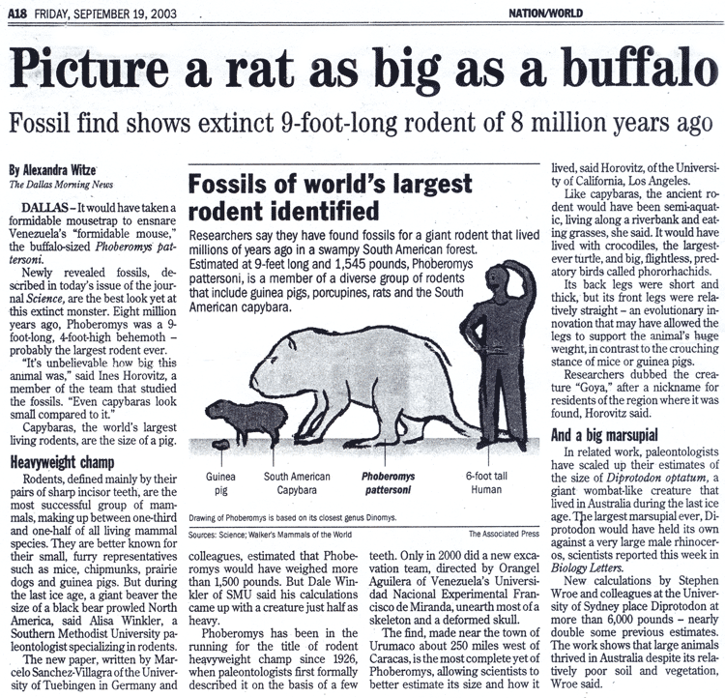
Sunshine Law—Activities and Communications Allowed
You CAN send articles or information to committee members if no response
Best Practice: Send through staff to avoid accidental response
You CAN talk about committee business anytime with staff or members of other agencies
You CAN talk to committee members about topics that NEVER could come up before your committee (sports, the weekend, your family, television …)
Notes:
One way communication is ok, but it is a huge Danger Area for Sunshine Law. So easy to inadvertently start discussing something that could come before the Awards Committee.
Related Danger Area: be careful of Reply to All

Slide 23
Scenario
The Awards Committee is voting on a controversial contract proposal and a member requests to vote by secret ballot... Can you vote by secret ballot?
Notes:
Chat yes or no. Answer: Cannot vote by secret ballot because Sunshine Law guarantees public has a right to hear all of the steps and discussions in decision making process. This is common question and a Sunshine Law no

Slide 24
Scenario
Two Awards Committee members run into each other at their kids’ soccer game….
Can they say hello & talk about the game or do they have to avoid each other?
Can they discuss the bid they are both scoring?
Notes:
We did not cover this scenario during training because it was partially covered by the introduction scenario in Slide # 12 and we needed to ensure we covered all the remaining material.
Answer: the Awards Committee members can say hello and talk about the soccer game—they don’t have to avoid each other. They cannot discuss the bids they are scoring or any matter that may come before the Awards Committee.

Slide 25

Danger Area #2
GIFTS
Notes:
This is another common ethics danger area. The gifts restrictions apply to JEA employees and Awards Committee members in the same manner.

Slide 26
Scenario
Your friend since Kindergarten has recently submitted a bid to JEA. He sees you and your spouse at Ruth’s Chris and offers to pay for your birthday dinner.
Can he pick up your tab?
Notes:
Chat yes or no.
Answer: No, your friend cannot pay for your dinner at Ruth’s Chris because he is a vendor/potential vendor of JEA and this could cause a violation of the gift rules that prohibit acceptance of gifts from lobbyists and vendors of JEA. Additionally, it will result in appearance of conflict of interest.
There is a commonly overlooked danger area that arises when government employees have long-standing relationships with friends/others that arose from connections unrelated to government work, but the friends/others are also lobbyists or vendors of the employee’s government agency. There is a tendency to only view the friends/others in a personal relationship capacity and not to view them/connect them in their relationship to the government employee’s agency.

Slide 27
“Settlement reached in Andrew Gillum ethics case”—News Service of Florida Article 4/24/19
[Gillum’s lawyer Barry] Richard said the settlement doesn’t specify which of the gifts Gillum agreed to have accepted, “but from Mayor Gillum’s standpoint it was the boat ride around the Statue of Liberty that he took with people that were his friends and it just didn’t occur to him that one of them was also a lobbyist and that he wasn’t supposed to accept the gifts.”
Notes:
We saw this play out in the 2018 Florida gubernatorial election where Andrew Gillum accepted tickets to Hamilton and other gifts given by his college friend who was also a lobbyist of Gillum’s governmental agency.
*** And be careful who is actually giving the gift….
Ask yourself, ask the giver, Where did that gift really come from?
We aren’t used to it, it isn’t natural to question gifts, but in this case it is much safer to ask first!

Slide 28
Gift Law
Do not accept gifts from anyone doing business with or lobbying JEA. Gifts over $100 at a time or $250 in a year are \prohibited.
Beware, even a gift under monetary restriction could end up on the front page!
        Florida Statutes section 112.3148 &
        Jacksonville Code section 602.701
Notes:
Have 90 days from date of receipt of gift to pay it down under $100.

Slide 29
Gifts to JEA
Gifts that come into JEA and are shared by everyone (or handed out by the CEO/SLT) get reported as “gifts to JEA”
        Jacksonville Code section 602.702
Notes:
There is a difference between gifts given to an individual JEA employee/Awards Committee member and one given for the benefit of JEA as an agency. Ex: If a business offers to donate lunch to the JEA line workers after a natural disaster, this is a gift to JEA as the agency. Jacksonville Ordinance Code requires gifts to JEA to be reported to the JEA Ethics Officer, Walette Stanford, and published on the website for transparency purposes.

Slide 30
Knowledge Check
If you are offered tickets to a Jaguars game, including access to a private suite, name one question you should be asking yourself and/or the giver BEFORE accepting the gift?
Notes:
CHAT Report top question/answer. See next slide for top answers.

Slide 31
Knowledge Check
#1 – What is the value?
#2 – Will I be influenced or does this person want something from me?
#3 – Is Giver lobbyist or vendor?
        Florida Statutes section 112.3148 &
        Jacksonville Code section 602.701
Notes:
Top Answers. Other questions to be ask include:
Will it look bad in the paper?
Can I reimburse the cost and how can I reimburse the cost?
Do members of general public get same offer?
Where did that gift really come from?

Slide 32
Scenario
An IT vendor of JEA invites you to attend a big IT conference in Jacksonville. They gave you a 2 day pass to go.
The speakers at the conference are great; it will help you do your job better.
Do you go? How would you handle this?
Notes:
Chat yes or no. Answer: You need to contact the Ethics Office and General Counsel’s Office to request permission for the vendor to pay for your conference attendance. You cannot accept the gift directly/individually yourself because it may violate the gift laws. There is an authorized legal process for vendors to donate conference/travel expenses to JEA as the agency and the process has to be followed.

Slide 33
Accepting Travel
Legally
Travel paid by someone other than JEA is a GIFT
(even if it’s good for JEA)
Policy
Must be approved in advance by Ethics Office & General Counsel
Public Opinion
Beware, it could end up on the front page!
        Jacksonville Code section 106.703
Notes:
Ex: employee in another agency asked 1 day before a conference if a third party could pay for her conference expenses. The third party had already paid the conference fee & hotel costs directly for the employee. It was determined that the third party was a vendor of the employee’s agency and it was a potentially illegal gift under the ethics laws. Must seek and obtain approval in advance from Ethics Office and OGC to protect yourself.

Slide 34
Danger Area #3
Asking for Things

Slide 35
Asking for Things
You shouldn’t ASK FOR anything of value from someone for you, your family, your business associates or your friends.
        Florida Statutes section 112.313(2)
Notes:
Solicitation of gifts may also be misuse of position danger area.
Ex: asking for tickets to premiere sporting event for relative or asking for legal advice on issue unrelated to Awards Committee from attorney who appears before Committee

Slide 36

Danger Area #4
DISCLOSING CONFIDENTIAL INFORMATION

Slide 37
Disclsoing Confidential Information
Do not share confidential information
Do not use JEA resources for the personal benefit of you or others
        Florida Statutes section 112.313(8) &
        Jacksonville Code section 602.401(b)
Notes:
Ex: complaint regarding employee posting confidential information about constituent on social media because the employee was mad that the constituent was dating the employee’s ex-boyfriend

Slide 38
Scenario
JEA is getting ready to put a job out to bid and your sister’s company would be perfect for the job (her company does great work, and this work is right in their wheelhouse).
However, because she is your sister, you decide to avoid any conflict of interest and not mention it to her.
While the two of you are out, however, she casually asks what you believe the low bid will be and if you would recommend her for the job…
What if she just asks you for a copy of the bid specs?
Notes:
Chat Can you tell your sister the lowest bid amount or give her the bid specs? Answer: No. It could be a violation of state and local ethics laws that prohibit the disclosure of confidential information and may also be a misuse of position.

Slide 39

Danger Area #5
MISUSE OF POSITION

Slide 40
Scenario
If you were running late for an Awards Committee meeting and got pulled over by a police officer, would it be okay to tell the officer that you are on JEA business and in a hurry?
Notes:
Chat yes or no. Answer: it is not okay to tell the officer you are on JEA business and in a hurry because it could be construed by the officer that you are trying to get out of the traffic stop/ticket because of your JEA connection.

Slide 41
Misusing Position
Legally
Using public position for personal gain of you, family, friends or business associates is prohibited
Follow the same process as every other citizen
Public Opinion
Avoid saying, “Do you know who I am?” or “I work with the City” in order to get special favors.
        Florida Statutes section 112.313(6) &
        Jacksonville Code section 602.401(a)
Notes:
Ex: Atlantic Beach Commissioner traffic stop case. Florida Ethics Commission found probable cause Atlantic Beach City Commissioner attempted to use his position as a public official to try to get preferential treatment during traffic stops when pulled over by Atlantic Beach police. At beginning of each traffic stop, the Commissioner would ask the officer “do you know who I am?”

Slide 42
Summary of New Local Laws Regulating
Misuse of Position--602.401 & 602.402
Local ethics laws prohibit:
  Misuse of City property for personal benefits or benefit of others
  Misuse of City employees’ time for anything other than official City business
  Misuse of City resources for campaigning, including property, employee time, computers, or Internet
  Involvement in matters against or appearances before a City board or commission of which the official is a member, and any City departments or agencies over which the official’s board or commission has jurisdiction

Slide 43

Scenario
You chair a non-profit board and the non-profit is hosting a festival to raise money. You frequently work with the head of Parks & Rec for the City and you want to call him to ask if your non-profit can borrow bleachers and a stage for the event. Can you do this?
Notes:
Chat yes or no. Answer: You cannot call the head of Parks & Rec at the City to request this favor for your non-profit. There is a City process that requires a permit application to be filed for events and use of bleachers/stage. Your non-profit cannot get special treatment and circumvent this process and avoid paying permit fees because you are the chair and work at JEA. This is a misuse of position to put the personal interests of your non-profit above the governmental process.

Slide 44

Danger Area #6
CONFLICTS
OF INTEREST

Slide 45
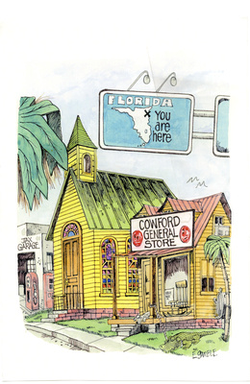
CONFLICTS OF INTEREST IN JACKSONVILLE
You likely will have conflicts
It is how you deal with them that is important
Notes:
CONFLICTS HAPPEN, especially in JAX, but that’s OK. It is how you deal with them that matters!
Graphic, small historical town labeled “Cowford” is seen under a Florida Highway sign with a X marking Jacksonville. This is to illustrate the small-town nature of Jacksonville that contributes to the certainty of overlap between personal and public life for local elected officials.
This is especially true in Jacksonville—big city (land mass wise) that feels like a small town. There are small degrees of separation and everyone seems to know everyone or someone connected to everyone. Example: misplaced wedding ring & UNF officer student of my mother-in-law
This means that you will likely have conflicts. It is not a bad thing and does not mean that it is catastrophic. Need to address them to protect yourself.

Slide 46
LITTLE CONFLICTS vs. BIG CONFLICTS
Voting Conflicts (Little): You can abstain from voting
Prohibitive Conflicts (Big): You either have to end private interest or your JEA employment
Notes:
How are voting conflicts and conflicts of interest different?
Conflicts of Interest occur when you have a personal interest that is at odds with your public position. Generally arise from connection of doing business with JEA or another part/agency of the consolidated City of Jacksonville.
The remedy is to quit either JEA employment or the personal interest.
A Voting Conflict occurs when you are acting in a voting capacity and you, your relatives, employer, clients, or business associates have a financial interest in a matter your committee will vote upon. Much broader than prohibitive conflicts of interest
The remedy is to declare a voting conflict and abstain from voting.

Slide 47
Conflicts of Interest
Legally:
You or your family may not do business with JEA or any part/agency of the City (some exceptions).
You may not have an employment or contractual relationship with a company doing business with JEA.
Public Opinion:
        If allowable, best to have OGC & Ethics Office OK first
Florida Statutes sections
112.313(3) & 112.313(7)
Notes:
Note that prohibitive conflicts of interest are not limited to only doing business with JEA. This is big misperception. It can be any part of the consolidated City of Jacksonville, including any City department, other independent authorities (JAA, JPA, JTA, etc.) or the elected constitutional officers (Sheriff, Supervisor of Elections, Tax Collector, etc.)

Slide 48
\
Scenario
JEA is getting ready to buy some supplies for an upcoming project and your family owns a business that sells those supplies. The business is willing to give a discount that JEA cannot get anywhere else… Can your family’s business sell to JEA?
Notes:
Chat yes or no. Answer: Maybe not, but it depends on the facts/circumstances. Need to have Ethics Office and General Counsel’s Office look at it. Your family selling to JEA directly may be a prohibitive conflict of interest under state ethics laws. However, there may also be an exemption that might apply.
Ex: JSO officer that owns a law enforcement equipment company and he manufactured a high visible badge holder for off-duty, plain clothes officers to wear. He wanted to sell the badge holder to JSO and his company was the only company in Jacksonville/Duval County that sold the badge holders. It is a prohibitive conflict of interest for the JSO employee to sell directly to JSO, but the Ethics Office helped the employee obtain an opinion from the State Ethics Commission that allowed him to sell the badge holders to JSO because his company was the sole source of supply for the badge holders (an exemption under the state conflicts laws).

Slide 49
\
Scenario
You own a consulting business and want to bid on a project managed by the City’s Public Works Department. Can you do this?
Notes:
Chat yes or no. Answer: It depends on the facts/circumstances. Need to have Ethics Office and General Counsel’s Office look at it. Your business selling your consulting services to a City department may be a prohibitive conflict of interest under state ethics laws. However, there may also be an exemption that might apply.

Slide 50

Voting Conflicts
You vote on any matter from which you, your family or your business associates might economically benefit or lose.
Florida Statutes section 112.3143
Notes:
Has to be economic in nature: special gain or loss (not just knowing someone)
Note that voting conflicts often arise from something unrelated to the business of committee or body of which you are a voting member. Ex: If a member of the Planning Commission is an attorney and the member’s legal partner represents an applicant in an unrelated family law issue, that is a voting conflict.

Slide 51
\
Scenario
The Awards Committee is getting ready to vote on a bid submitted by a client for whom you perform part-time consulting work.
Can you vote on that issue?
Notes:
Chat yes or no. Answer: No, you cannot vote on this bid award because it would financially benefit a client of yours and thus would be a voting conflict. It may also be a prohibitive conflict of interest if the bidder is currently a vendor or doing business with JEA.

Slide 52
HELPFUL HINTS
Create list of those with whom you have a connection:
  Spouse and Children
  Business Associates & Organizations
  Companies for which You Serve on Board of Directors
Ask them if they have any business with JEA & the City or want to do business with JEA & the City

Slide 53
Danger Area #7
PUBLIC RECORDS

Slide 54
Scenario
You’re working for JEA on a project that has recently received some attention from the press. A citizen calls and requests all of your information on the project. Should you give it to them?
Notes:
Chat yes or no. Answer: make sure you send the request to the JEA Public Records department for processing.

Slide 55

Public Records
EVERY document connected to public business is to be preserved and made available upon request for inspection and copying.
Florida Statutes Chapter 119
Notes:
That means EVERY document connected to JEA business

Slide 56
Public Records Law
Must preserve EVERY document created or received in relation to JEA business
Personal laptop/phone, emails, text messages, social media and handwritten notes
Do not ask who they are and why they want it or refer to website for requested information
Follow JEA’s policy for how to respond to requests
Florida Statutes Chapter 119
Notes:
It is the content of the document & what is in the document and whether it relates to JEA business that determines if it is a public record. It is not the location of the document that determines public record.

Slide 57

Scenario
You get an email on your personal email about your Awards Committee business … Is that a public record?
Notes:
Chat yes or no. Answer: It is a public record, even if it’s not sent to your JEA e-mail, because it relates to JEA business.
Note: Sometimes personal e-mail can be hacked and can lose e-mails. Be sure to forward any JEA related e-mails/documents to your JEA e-mail address or back them up if the e-mails/documents are located in your personal e-mail or on personal devices.

Slide 58
Scenario
You take a lot of handwritten notes during Awards Committee meetings...
Do those notes need to be saved as public records?
Notes:
Chat yes or no. Answer: personal handwritten notes related to your JEA business may be public records, particularly if they are later shared with anyone else. This is gray danger area in the Public Records laws. Be sure to protect yourself by saving any handwritten notes.

Slide 59

Danger Area #8
NOT ASKING QUESTIONS

Slide 60
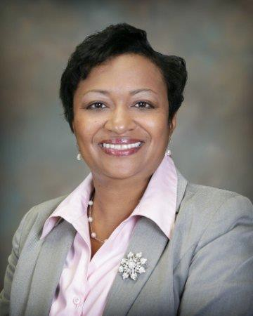
Does it Violate the Law?
Walette Stanford, JEA Ethics Officer
(904) 710-1788 - cell
(904) 665-4282 - office
Ethicsofficer@jea.com
stanwm@jea.com

Slide 61
Does it Violate the Law?
Office of General Counsel
255-5059 (Lawsikia Hodges)
255-5049 (Julia Davis)

Slide 62
Does it Violate the Law?
Office of Ethics, Compliance & Oversight
Carla Miller, Ethics Director
Kirby Oberdorfer, Deputy Director
255-5510 Hotline 630-1015

Slide 63
Questions?

