Slide 1


JEA Substation, T&D, and Underground
Site Specific Safety Training
Updated: December 2022

Slide 2
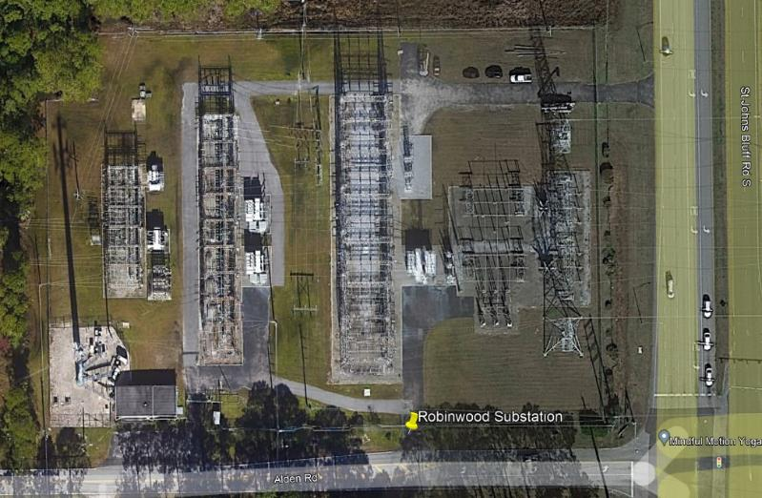


Substation Entry Training
Substation Entry Training is required for all personnel entering a substation, prior to entry.
Contact JEA’s Technical Utility Training Services (TUTs) at (904) 665-7243 or (904) 665-8899 for class schedule and registration.

Slide 3
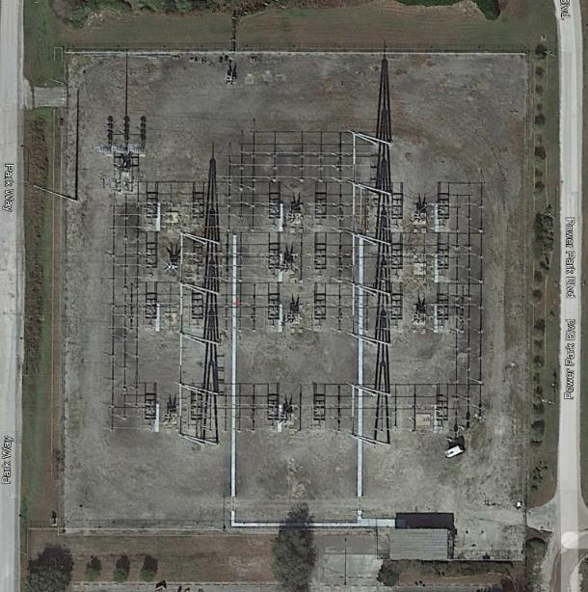
Substation Access
All substations have gates that require badge access for entry.
Substation Contractor supervisors, leadspersons, and foreman typically have the badges for access.
The remaining crew members will be badged in by one of someone that has a badge.
The person responsible for badging crewmembers in must notify Station 5 at (904) 665-7152) and provide requested information on each person entering the substation.

Slide 4
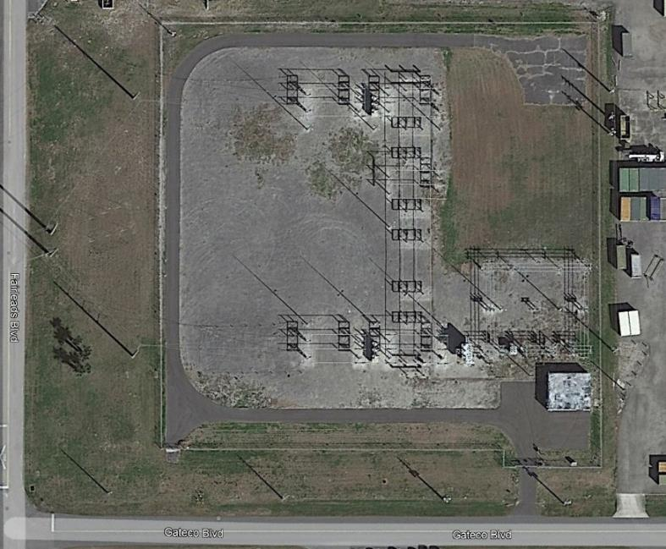
Substation Access on Military Property
Contractor access to substations on military property requires the JEA Inspector to go to the Base Commander, who communicates this permission to the Military Police to allow access.
Each pass is good for 8 hours only. If the job requires multiple days to complete, this process must be completed each day.
Once on the property, badge access to the substation is the same as all substations.
All personnel entering the substation must be reported to Station 5 at (904) 665-7152).

Slide 5
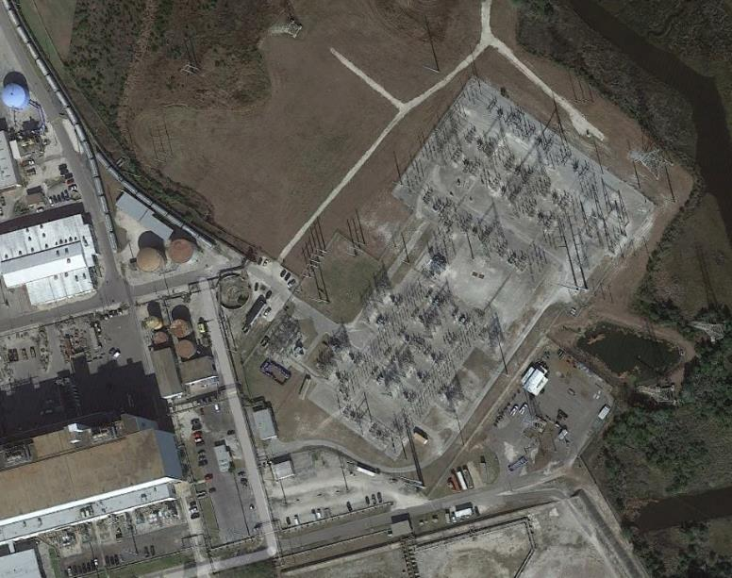
Substation Access in Generation Stations
Contractor access to substations inside generation stations will require an escort by either the JEA Inspector, or JEA security, to the substation entry point.
Once on the property, badge access to the substation is the same as all other substations.

Slide 6
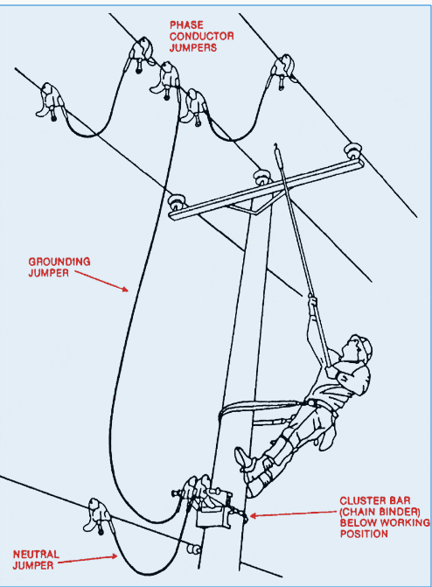
Grounding Requirements
When working on deenergized equipment, it must be disconnected and grounded or it is not dead.
Follow your company’s requirements, and/or OSHA 1910.269 requirements, when grounding equipment.

Slide 7
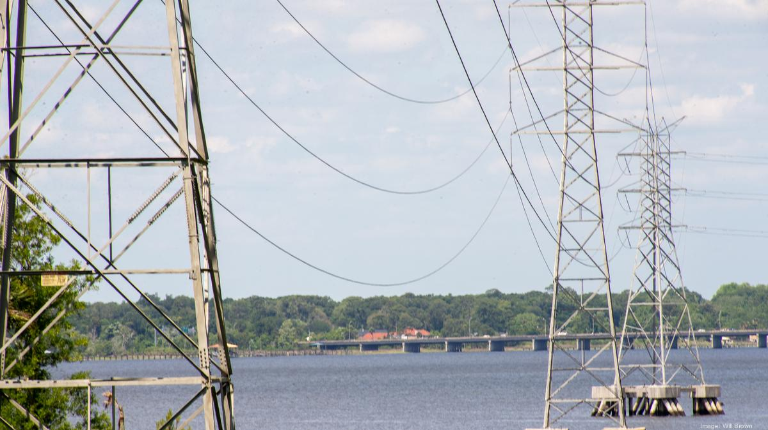
Working on Energized Equipment
When working on energize equipment use the proper insulating tools and PPE as per your company’s, and/or OSHA 1910.269, requirements

Slide 8
Security
No one shall be allowed into a substation without completing the JEA Substation Entry training first.
Access to substation control houses shall be limited to only those required to do work in them.
SIP Station control houses are limited to those with proper clearances and background checks.

Slide 9
PPE Requirements
SAFETY TOED WORK BOOTS, HARD HAT, AND PROTECTIVE SAFETY EYEWEAR ARE THE MINIMUM PPE REQUIRED TO BE WORN AT ALL TIMES ON JEA WORK SITES !!!
Hard Hats:
  ANSI approved
  Brim forward (except Welders when welding)
  No paint, holes or defects
  Contractor ID

Slide 10
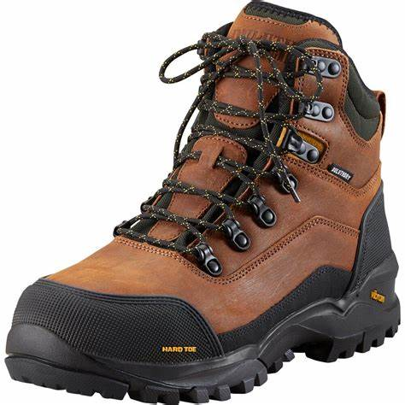
PPE Requirements, cont.
Safety Toed Boots:
  Leather or similar material
  Defined heel
  Electrical Hazard (EH) Rating
  Ankle support 5” upper (Line Maintainer 10”)
  No Slip-on styles for Line Maintainer boots
  Slip resistant soles
  Protective toe meets ASTM F2413 standard
  Rigid sole shank for Line Maintainers
  Other guards where required depending on the hazards

Slide 11

PPE Requirements, cont.
Safety Glasses:
  ANSI approved lenses
  Side shields
  Goggles where needed
  Prescription lenses OK if ANSI or inserted/covered by ANSI safety glasses
  Face Shields are required when exposed to over-spray, chemical splash, chipping, grinding, abrading, etc.
  Safety glasses must be worn under face shields
  Project/Task Specific PPE will vary from task to task

Slide 12
Emergency Response & Notification
For any incident requiring immediate emergency care call 911.
Supervisor, lead person, or foreman shall call the JEA Inspector, and/or the necessary emergency numbers as needed:
  Security emergencies (904) 665-6200
  Environmental emergencies (904) 620-9921
All injuries, incidents, and Near Misses shall be reported regardless of how minor they seem.

Slide 13
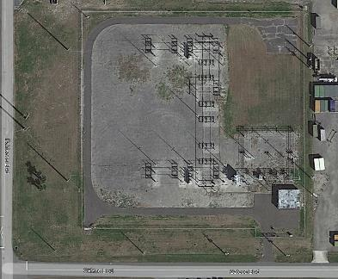
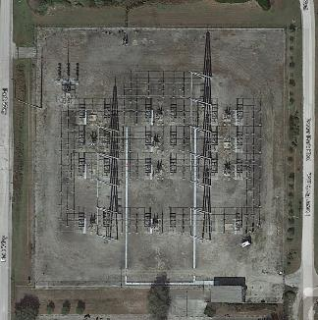
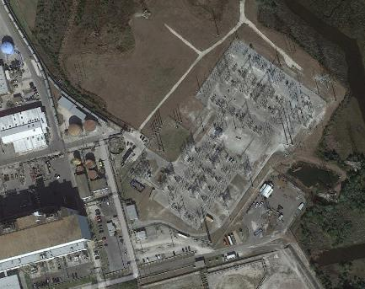
EVACUATION ROUTES
Depending on the property, any associated agencies, or surrounding environment, evacuation routes for emergencies can vary greatly.
On the first day of the project all personnel must be informed of evacuation scenarios and routes by the JEA Inspector for the job.
The supervisor, lead person, or foreman, will be responsible for covering this information with any additional personnel that come to the job site and at subsequent Job Safety Briefs.

Slide 14
Daily Safety Briefing
The supervisor, lead person, or foreman is required to conduct a Job Safety Briefing prior to beginning work with the crew to discuss the hazards that are present for the day’s tasks and the proper controls for each hazard identified.
Situational awareness, hazard recognition, and being in the moment should be a focus of daily briefing details since the hazards can change.
In the case of an evacuation, the contractor will be responsible for accounting for all their personnel and communicating this to Station 5 at (904) 665-7152, as well as their JEA Inspector.

Slide 15
High Injury Potential Areas/Activities
Slips, Trips, and Falls (STF)
Hot Work: Welding, torch cutting, spark generating work, etc.
Struck By: Moving machinery, vehicles, swinging supplies
Hazardous Energy: Electricity, pressure (water, air, hydraulics), steam, etc.
Housekeeping
Falls: Working at heights, ladders, etc.
100% Fall Protection at 4’ and over on ALL JEA projects.
Full body harness & fall arrest anchorage required.

Slide 16
Hold Tags and Clearances
All necessary hold tags and clearances will be obtained and placed by the JEA Inspector.
Any changes needed to clearances or hold tags must be communicated to the JEA inspector.
Any emergencies involving clearances should be communicated to Station 5 immediately at (904) 665-7152.

Slide 17
Scaffold Safe Work Practice
Follow all instructions given by the Competent Person.
Know how to inspect all parts of the scaffold and scaffold base.
Never climb on a scaffold that has not been cleared to use.
Look for scaffolding tags - Red, Yellow, & Green.

Slide 18
Questions?
If you have any questions, please contact your:
JEA Inspector
JEA Safety Specialist for Substation & Westside Service Center:
  Dwayne Daniel: (904) 676-4478
JEA Safety Specialist for Underground, SOCC, & Southside Service Center:
  Terry Vermaelen: (904) 874-0003
JEA Contractor Sponsor
Safety@jea.com

