Slide 1
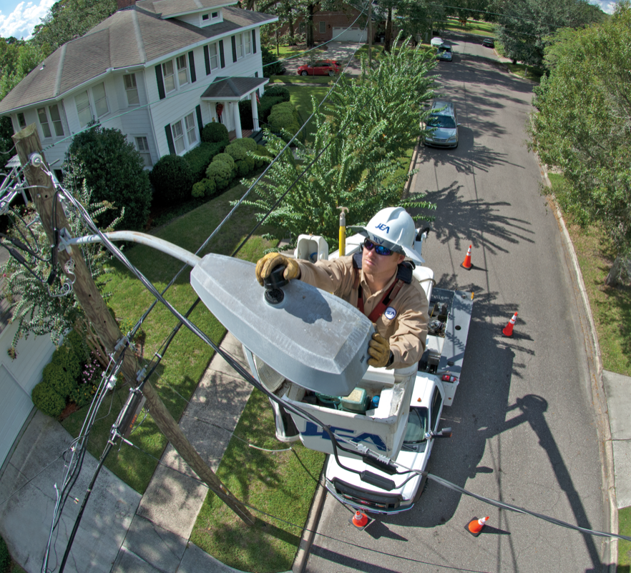


Contractor Safety Management Program
Revised

Slide 2
CSMP
The Contractor Safety Management Process (CSMP) was developed in the late 90’s to support the NGS repowering project.
Contained within the site
Check in/Check out process
New employee (contractor) training
Everything basically in house
Note: very successful in reducing risk and controlling hazards
CSMP was applied to the JAX Green Works project and Better Jax projects
All of these were very large construction projects- very successful
JEA Safety Team consisted of somewhere around 30 safety team members; some JEA Civil Service others were contractors
At some point it became a process applied to all “safety sensitive” work:
  Construction - Maintenance work
  Remodeling - Glass cleaners (Tower)
  Lawn Care - etc.
History

Slide 3
CSMP
The CSMP Consisted of 4 basic elements:
  Safety Qualification
  Training
  Drug and alcohol testing
  Worksite Assessments
Required one safety specialist dedicated to:
Evaluating contractor packages to determine if they meet the CSMP safety qualification requirement
Collect and maintain the database of contractor employee training
Collect and maintain a monthly list of contractors that meet the random drug testing requirements
Update and present JEA CSMP training material
Create an annual report for the local field office
Arrange for annual inspections with the USF inspector
Solicit for annual requalification from contractors
Required another safety team member:
Collect, track, and asses all of the worksite assessments
Send of registered mail notifications of worksite assessments to contractors.
Outside of a few tweaks, generally in formatting and process the CSMP was not updated since its inception and was applied to large construction companies and small JSEB companies the same.
History

Slide 4
New - CSMP
The new CSMP is designed to reduce paperwork, clear up word of mouth policies changes, modernize the material, and create an easier/smarter Contractor Safety Management Process.
The old CSMP worked and was a success. Because of that, we did not get rid of the entire program but looked at what worked and how could we make it better. The four elements remain as the cornerstone of the CSMP:
  Safety Qualification
  Training
  Drug and alcohol testing
  Worksite Assessments
S&HS personnel will still manage the CSMP but it will be focus more on the contractors activities in the field rather than paperwork.

Slide 5
New - CSMP
Contractor: Refers to a company performing work at or for JEA. May include common titles as:
Prime Contractor
General Contractor
Subcontractor
Tier Contractor
Contractor Sponsor: This is the JEA employee, department head, or designee, who brought a contractor onto a JEA facility, site, project, or activity and is the primary contact for the Contractor to ensure work is being performed, completed, etc. This may be a project manager, engineer, manager, mechanic, etc.
Intrinsically Hazardous Work (IHW): A naturally risky or dangerous activity, task, or job. Work that is IHW includes, but is not limited to:
Construction
Demolition
Working from heights
Working in confined spaces
Handling or working around hazardous chemicals
Operating machinery with rotating components
Working in or around excavation
Working on ladders or scaffolds
Glossary

Slide 6
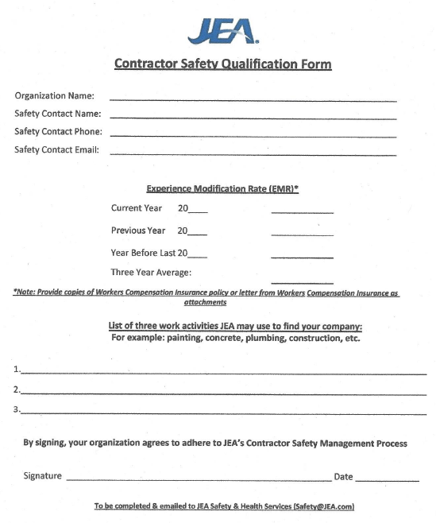
New - CSMP
JEA Safety Qualification:
This is a one-page document that the contractor fills out, signs, and returns with verification of Experience Modification Rate (EMR) provided by their workers compensation insurance provider.
Contractor Safety Qualification Forms should be sent to safety@jea.com prior to being awarded JEA contract.
If the average 3-year EMR is 1.0 or less, this company is added to the list of JEA Safety Qualified Contractors.
New companies will have an EMR of 1
This is available in the new CSMP and a digital fillable form on JEA.com.
Qualification

Slide 7
New - CSMP
JEA Safety Qualification:
JEA Safety Qualification is good for one year and expires when the workers compensation insurance expires.
JEA Safety and Health Services will attempt to inform Contractors that will be expiring in the next month, to ensure no overlap. Contractors are ultimately responsible to ensure they submit a Contractor Safety Qualification Form annually prior to their safety status expiration. Once a Contractor’s most current EMR expires, they will be removed from the list of JEA Safety Qualified Contractors.
Qualification

Slide 8
New - CSMP
JEA Safety Qualification:
If a Contractor does not have an average EMR of 1.0 or less, the Director of that department that wants to bring the Contractor aboard can have the Contractor submit a Safety Action Plan for the work they will be performing and if accepted by the Director and S&HS that Contractor may be permitted to perform that very limited job but will not be added as a JEA Safety Qualified Contractor.
Emergency situations may not have the time to evaluate the EMR. In those rare emergency situations, the Director of that department shall be engaged and send communication to Safety and Health Services Management detailing the emergency, why this Contractor was selected, what safety precautions are in place to ensure the work is performed safely, and that the Contractor has signed the JEA Hold Harmless Agreement. A copy of the hold harmless shall be included in the communication.
Qualification

Slide 9
CSMP
It is the contractor’s responsibility to ensure their employees are:
  Trained and/or certified according to the Safety Regulations (refers to all applicable Federal, State, local, industry, and JEA standards or regulations).
  JEA Safety Orientation (JEASO): Required for everyone
  Received site specific safety training: Required for the facility one is working on
  Task specific training (ie. Substation, LOTO, Hot Work, etc.): Activity based requirement.
Note: the JEASO and Site-Specific Safety Training presentations will be available on JEA.com. Other material such as Hot Work Training will be there as well as other material as appropriate. It is the Contractor Sponsor’s responsibility to verify their Contractors have completed this training and has verification in the form of a roster.
No more requirement for OSHA 10/CSSO and JEA 2hr or the Supervisor Leadership Development (SLD) training.
Training

Slide 10

CSMP
Testing requirements are:
Pre-employment (defined as before working on a JEA project or site but not greater than 30 days before starting the work)
For cause/suspicion
Post accident
Random (Most be performed monthly and include at least 10% of the employees working on a JEA project or site). Verification of random drug testing will be requested when a safety assessment is performed. Verification is that the company performed random substance abuse testing either in the current month or the previous month. If a contractor has been onsite less than one-month, random testing is not expected but if it is a multi-month/year service contract, it is expected monthly regardless if the company is present onsite each month or not (because they can be called in at any time.)
Drug and Alcohol Testing

Slide 11
CSMP
Field Safety Assessments (FSA) are conducted by JEA Safety and Health Services, Contractor Sponsors, and other representatives of JEA.
A list of any discrepancies will be left with the Contractor at the completion of the assessment and a final assessment form will be emailed to the address provided during the assessment and to the JEA Contractor Sponsor.
Contractors may be subject to a Contractor Administrative Audit if the amount of or type of discrepancies are determined to be of significant concern. The administrative audit will examine training records, substance abuse records, compliance with the CSMP, and other administrative functions that may not be available at a field site.
Contractors that continuously score four (4) or more discrepancies, score poorly on the Contractor Administrative Audit, or fail to respond with acceptable corrections to the FSA or Administrative Audit may be found in breach of contract and be subject to additional worksite assessments, be required to develop a Safety Action Plan or contract termination.
Worksite Assessments

Slide 12
CSMP
Contractors that have their worksite shut down for unsafe working conditions will need to provide a written detailed Safety Action Plan (SAP) to JEA Safety and Health Services. Upon receipt of the SAP, JEA S&HS management will review the Contractors SAP to ensure the unsafe condition(s) is/are sufficiently addressed and that actions have been taken to ensure a safe working environment for all workers on the job site.
Contractor Review Meeting: Contractors that have experienced more than one shut down for unsafe conditions within 12 months will not be permitted to return to work until a formal review of the worksite conditions is reviewed by the Director of Safety and Health Services, the Contractor Supervisor, JEA procurement supervisor (or delegate), Contractor Sponsor, members of JEA S&HS, and others as appropriate. During the review, the Director will make a recommendation to terminate the contract or permit the work to continue under the guidelines of an accepted SAP.
Assessments

