Slide 1


Brandy Branch Generation Station
Site Specific Safety Training
Updated: September 2022

Slide 2
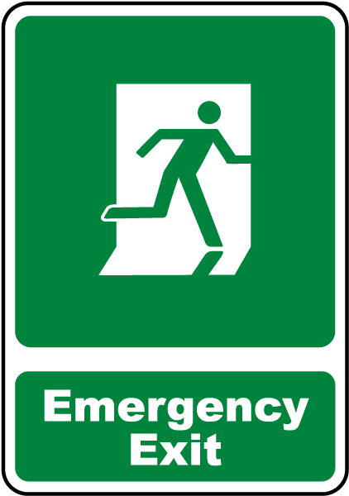


Safety Breifing
Emergency Notifications
Evacuation Routes
Check Surroundings
Hazard & Situational Awareness
Be in the Moment!
Be Prepared!!!

Slide 3
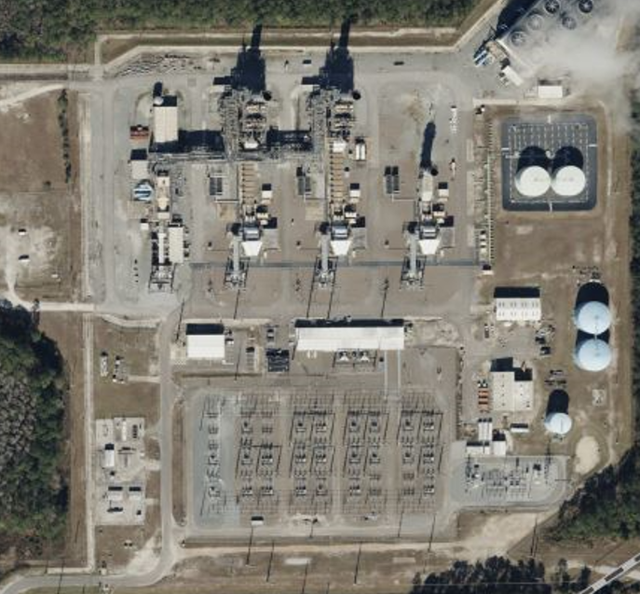
Brandy Branch Generating Station
15701 W. Beaver St.
Jacksonville, FL 32234
Ensure you know who your Contractor Sponsor is, prior to starting work!

Slide 4
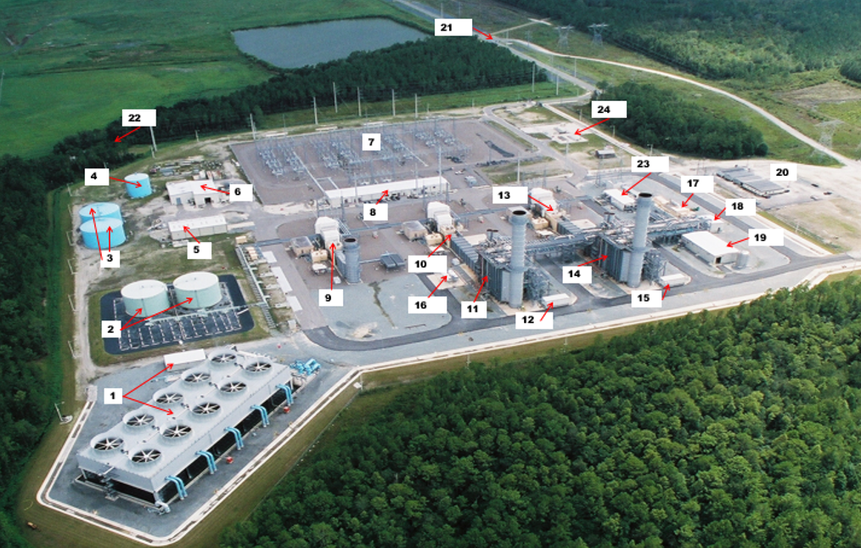
Other Considerations at BBGS, cont.
COOLING TOWER & CHEMICAL BLDG
DIESEL STORAGE TANKS
DEMINERALIZED WATER STORAGE TANKS
WATER STORAGE TANK
WATER PROCESSING BLDG
MAINTENANCE SHOP
SUBSTATION
SHARED SVCS BLDG & CONTROL ROOM
UNIT 1 GT (CT1 GE7FA SIMPLE CYCLE)
UNIT 2 GT (CT2 COMB CYCLE)
UNIT 2 HRSG (HR2)
UNIT 2 CEMS BLDG
UNIT 3 GT (CT3 COMB CYCLE)
UNIT 3 HRSG (HR3)
UNIT 3 CEMS BLDG
AMMONIA STORGE TANKS
UNIT 4 STEAM TURBINE
UNIT 4 LUBE OIL BLDG
BOILER WATER CHEMISTRY BLDG
CONTRACTOR PARKING
MAIN GATE (GUARD)
BACK GATE (LOCKED)
UNIT 4 POWER DISTRIBUTION CENTER
GAS YARD (SNG & TECO)

Slide 5
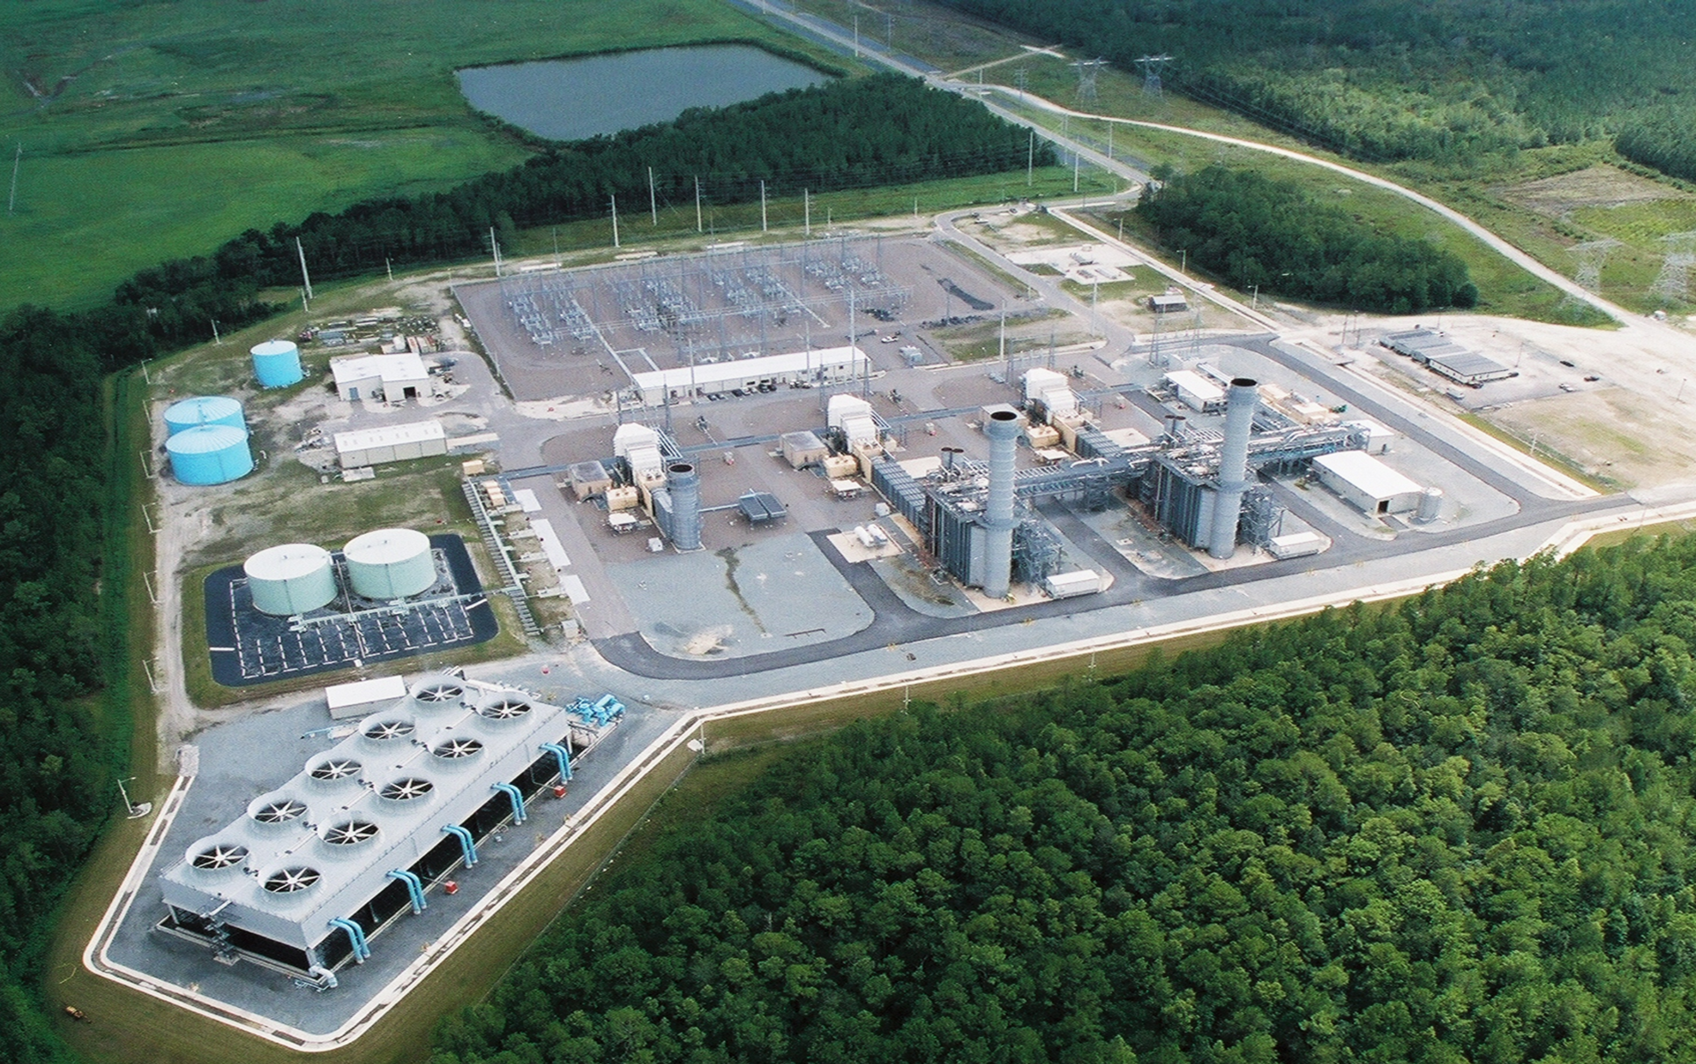
EVACUATION ROUTE
Area 2
Unit 4
Unit 3
Unit 2
Area 1
Area 3
Unit 1

Slide 6
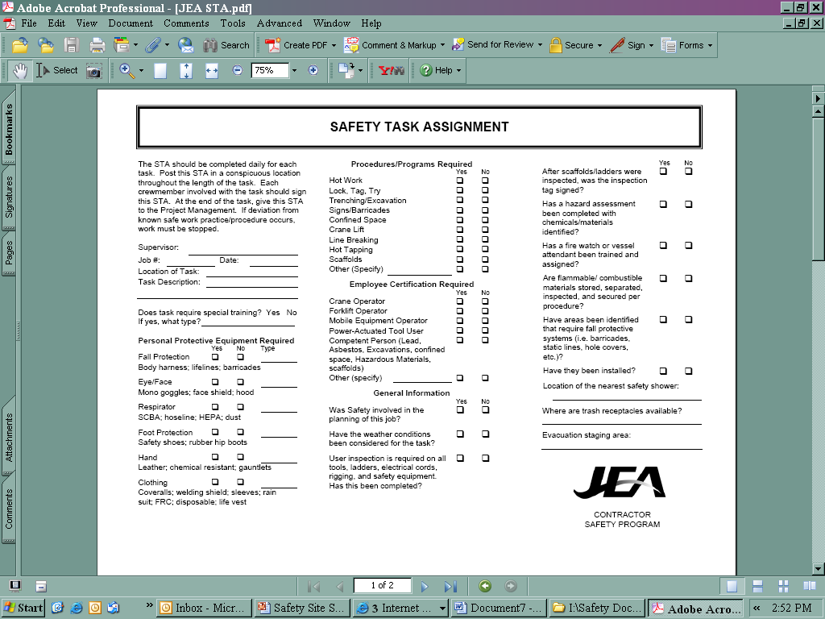
JEA Safety Rules
Use of JEA equipment by contractors is strictly prohibited
Including but not limited to heavy equipment, ladders, miscellaneous shop equipment, etc.
Contractor employees are prohibited from JEA shops & buildings unless accompanying JEA employee
Perform a Safety Task Assignment (STA) before work begins, each day

Slide 7
Emergency Response
Evacuation Route is dependent on wind direction (assemble upwind):
  Assemble in SE corner of plant near Maintenance Bldg (Area 1)
  Assemble at Main Gate for Contractors…assemble at the gate they entered (Area 2)
  Assemble at NW corner of plant (gate on back access road) (Area 3)
It is the contractors’ responsibility to notify the JEA contact that all their personnel are accounted for and in the appropriate assembly area, or exited the plant site
Emergency Notification - ext. 6602 (in house phones), or (904)665-6602 outside lines/cell phones, then 911 if necessary

Slide 8
Emergency Response, cont.
Report all incidents to JEA Management
Staging Area will be dependent on wind direction: Southeast corner, Northwest corner or Main Gate
Emergency Alerts
  Evacuation Alarm- (sounds like air raid siren that winds up and continues)
  Combustion Turbine starting alarm- (alternating police siren)
  Contractor responsible to inform their employees of both JEA and Contractor’s Emergency Response Procedures (ERP)

Slide 9
Security
All Contractor vehicles on site:
Must have a company placard/signage
Name and contact information on the dashboard
All personal vehicles (non-placard/signage) shall park where directed by the Contractor Sponsor or BBGS Operations
No firearms or other weapons are permitted at the worksite

Slide 10
High Injury Potential Areas/Activities
Slips, Trips, and Falls (STF)
Caught-in: Confined Spaces
Hot Work: Welding, torch cutting, spark generating work, etc.
Struck By: Moving machinery, vehicles, swinging supplies
Hazardous Energy: Electricity, pressure (water, air, hydraulics), steam, etc.
Housekeeping
Falls: Working at heights, ladders, etc.
100% Fall Protection at 4’ and over on ALL JEA projects.
Full body harness & fall arrest anchorage required.

Slide 11
Confined Space Entry
All Confined Spaces shall be Permitted Entry only.
Prior to entering Confined Spaces, the entry supervisor, entry attendant, and entrants shall be trained in accordance with OSHA standards.
Permits shall be posted at the permitted spaces entry point.
Contractors shall use their Confined Space Entry Permit.
Full body harness shall be worn in all confined spaces.
Contractors shall ensure a rescue plan is in place and readily available.
Fall Protection/Fall Arrest use and care training is required for entrant(s) and attendant.

Slide 12
Hot Work Permit
Hot Work Types included, but is not limited to:
Welding
Brazing
Flame or Plasma cutting
Hot Riveting
Any type of work that can create:
    Sparks!
    Heat!
    Flames!

Slide 13
Hot Work Permit, cont.
Hot Work Permit Authorization
Hot Work Permit complete
Ensure JEA Contactor Sponsor is notified of work
Fire precautions are in place
    Fire Watch assigned
    Fire extinguisher in place

Slide 14
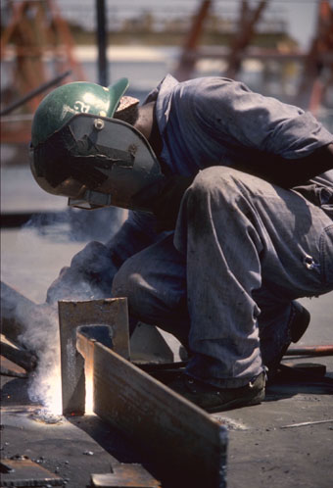
Hot Work Permit, cont.
Hot Work Fire Watch Requirement
Required for every hot work permit
Employee(s) assigned to watch hot work for fire potential
Trained in use of fire extinguishers
Note JEA requirements monitoring of the hot work area to ensure no hot spots spark a fire:
  1 hour of continuous monitoring after the last hot work has been extinguished.
  3 hours of periodic monitoring there after.

Slide 15
Hot Work Permit, cont.
Hot Work Confined Spaces
The Confined Space Supervisor has full responsibility for:
Fire precautions being followed
CSE permits & Hot work permits
When done, the space shall be cleared of used electrodes, leads are disconnected, and other hot work equipment and debris is cleaned.
Before the space is cleared for use!

Slide 16
Scaffold Safe Work Practice
Follow all instructions given by the Competent Person.
Know how to inspect all parts of the scaffold and scaffold base.
Never climb on a scaffold that has not been cleared to use.
Look for scaffolding tags - Red, Yellow, & Green.

Slide 17
PPE Requirements
SAFETY TOED WORK BOOTS, HARD HAT, AND PROTECTIVE SAFETY EYEWEAR ARE THE MINIMUM PPE REQUIRED TO BE WORN AT ALL TIMES ON JEA WORK SITES !!!
Hard Hats:
  ANSI approved
  Brim forward (except Welders when welding)
  No paint, holes or defects
  Contractor ID
Safety Toed Boots:
  ANSI approved toe
  At least 5” high for lace up
  Slip-ons are allowed
  Leather w/defined heel
  NO open toes or athletic style
  Other guards where required

Slide 18

PPE Requirements, cont.
Safety Glasses at ALL TIMES:
  ANSI approved lenses
  Side shields
  Goggles where needed
  Prescription lenses OK if ANSI or inserted/ covered by ANSI safety glasses
  Face Shields are required when exposed to over-spray, chemical splash, chipping, grinding, abrading, etc.
  Safety glasses must be worn under face shields
  Project/Task Specific PPE:
  Will vary from task to task
  The Contractor shall ensure employees are aware of any project/task specific PPE requirements before work begins

Slide 19
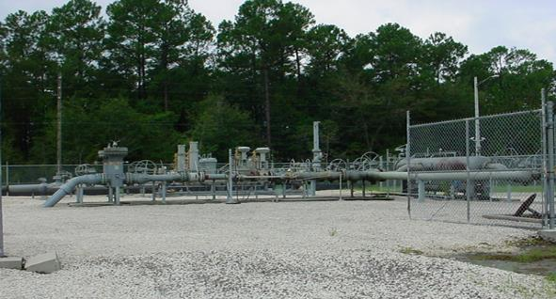
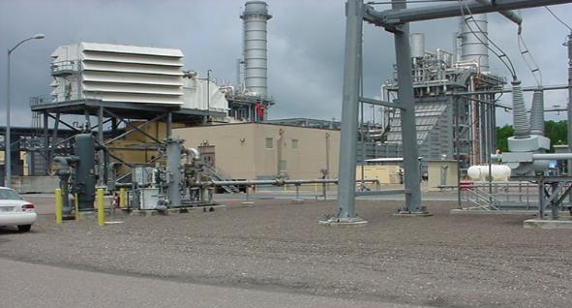
Other Considerations at BBGS
Natural Gas Yard and Skids Yard is in Southwest corner & skids are in front of each combustion turbine
Special precautions need to be taken for hot work
.

Slide 20
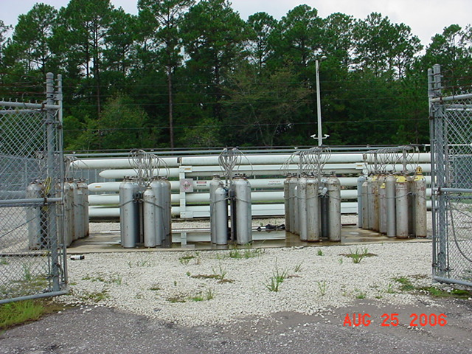
Other Considerations at BBGS, cont.
Hydrogen, Carbon Dioxide and Nitrogen Storage
H2 and CO2 storage in the Southwest corner of plant next to the gas yard

Slide 21
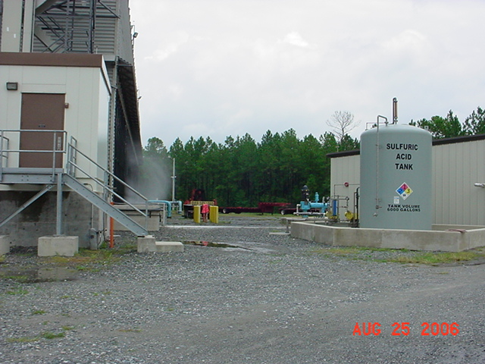
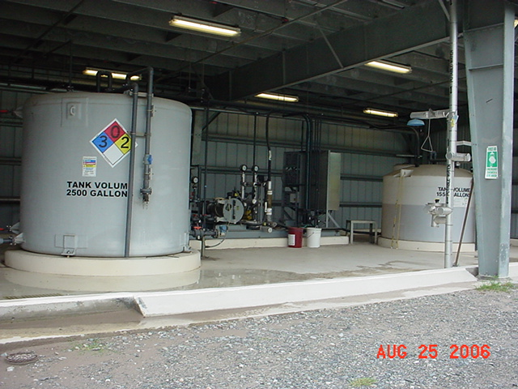
Other Considerations at BBGS, cont.
Sulfuric Acid Storage Tank, Sodium Hypochlorite Tank and Scale Inhibitor Storage
Northeast corner, near Cooling Tower
Sulfuric Acid Tank

Slide 22
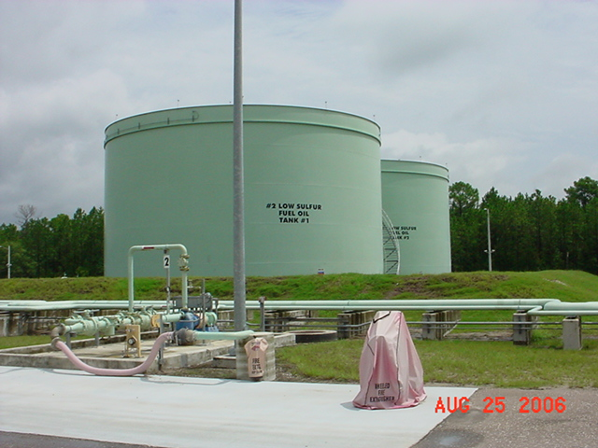
Other Considerations at BBGS, cont.
Diesel Storage is located on the east side of the plant by the cooling tower

Slide 23
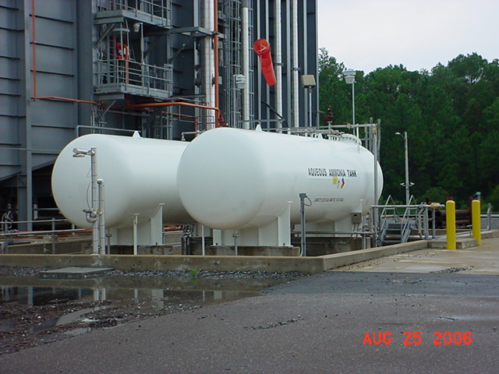
Other Considerations at BBGS, cont.
Ammonia Storage Tank
East side of Brandy Branch Unit 2 HRSG

Slide 24
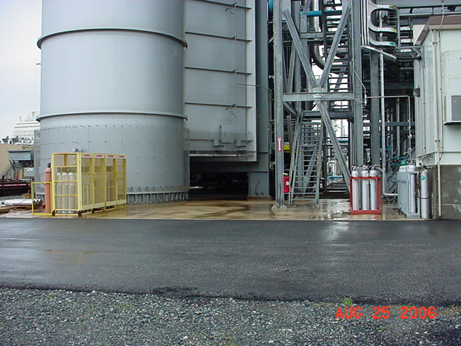
Other Considerations at BBGS, cont.
CEMs calibration gas storage behind HRSG 2 stack and at each HRSG CEM bldg.
.
CEMs gas
HRSG 2
CEMs gas storage

Slide 25
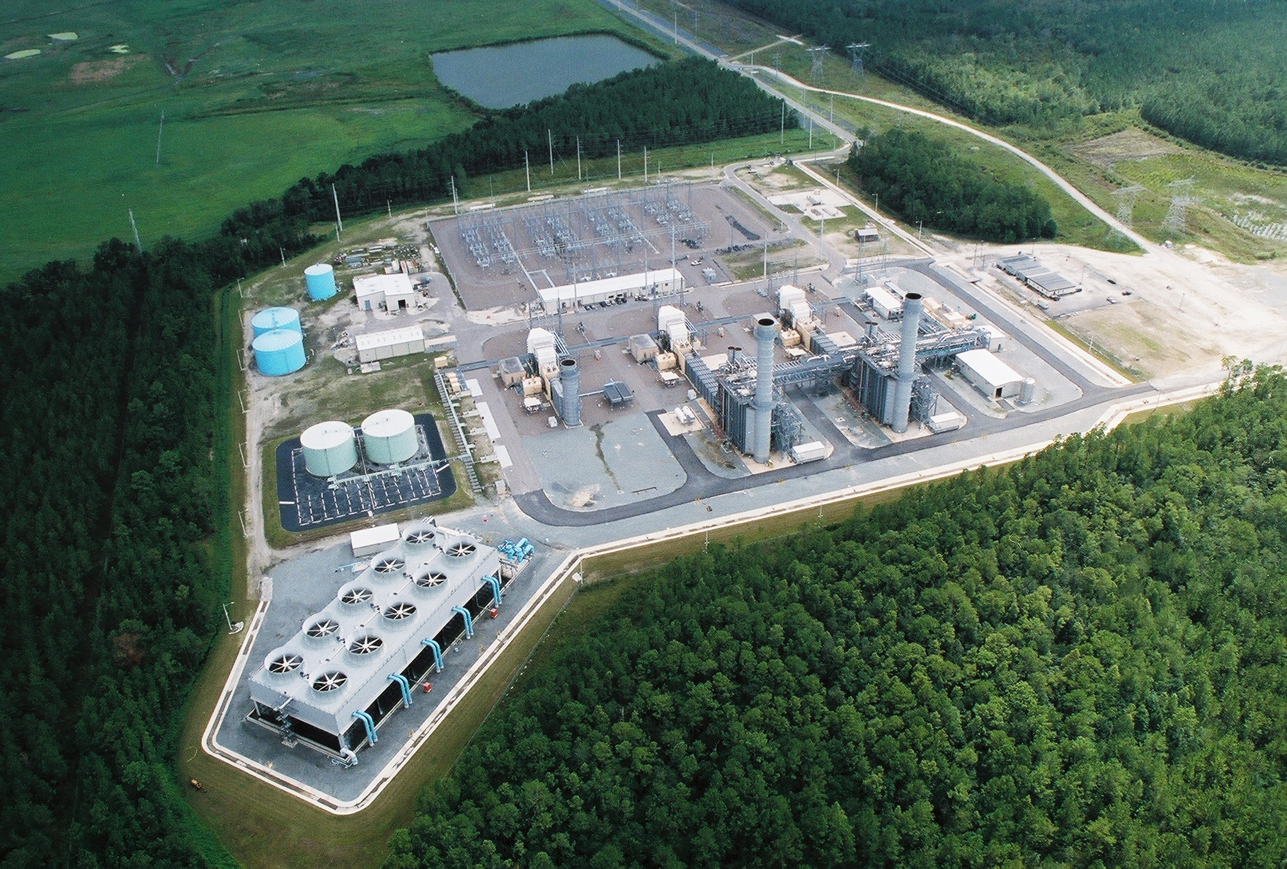
Other Considerations at BBGS, cont.
Demineralized Water building contains Sodium Hydroxide, Anti-Scalant, and Sodium Bisulfate
Miscellaneous Services building contains Ammonium Hydroxide and Anti-Scalant

Slide 26
Other Considerations at BBGS, cont.
Jacksonville Baldwin Rail to Trail Crossing (on access road prior to gate): Pedestrians / cyclist have the right of way, failure to yield will result in a citation from the local sheriff’s office
Entrance Roads: All posted traffic signs to be obeyed (Speed limit 35mph)
Plant speed limits are posted and shall be observed
Wetlands: Entering or disturbing the designated wetland area is prohibited
Work Safely
Wear your PPE

Slide 27
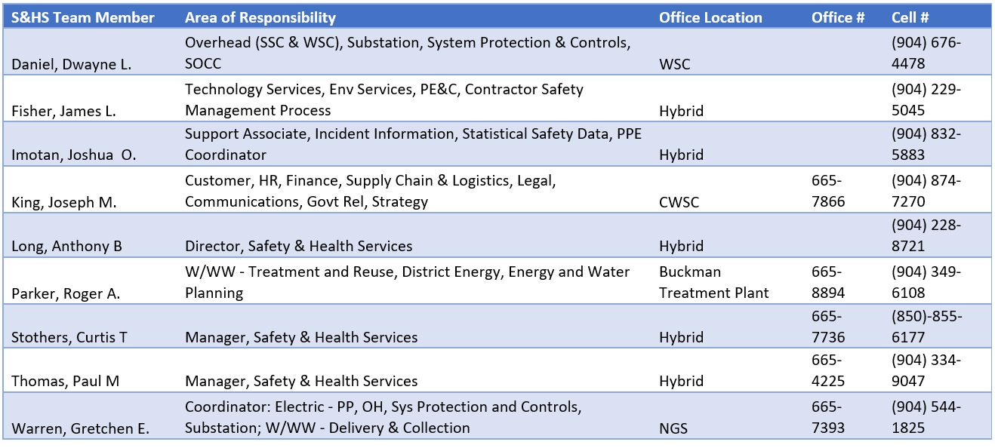
Questions Please Contact

