Slide 1
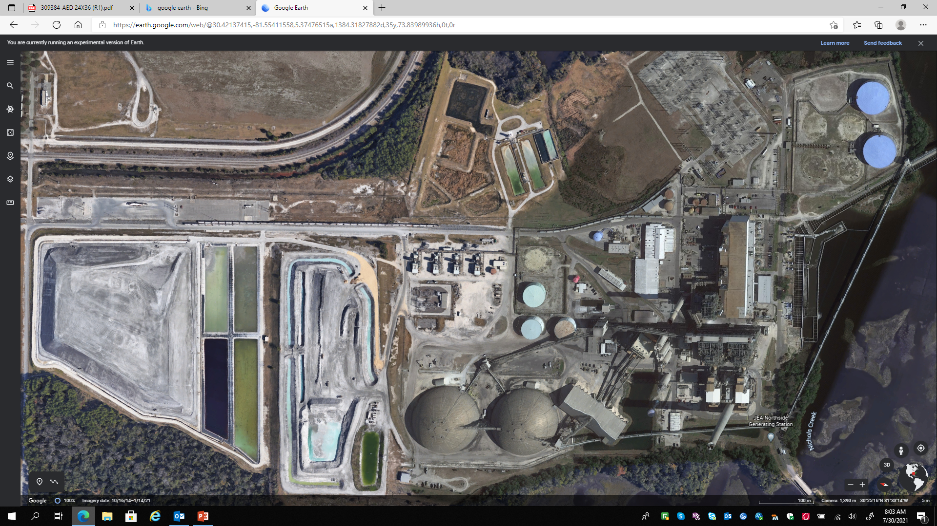


Northside Generating Station (NGS) site specific overview of safety procedures and related information.
2024

Slide 2
JEA Safety Objective
To create a seamless, interdependent safety and health promotion organization which promotes and ensures the core values and business strategies of JEA, regardless of actual employer, and maximizes resources and expertise to reduce injury and illness within JEA and the community.

Slide 3
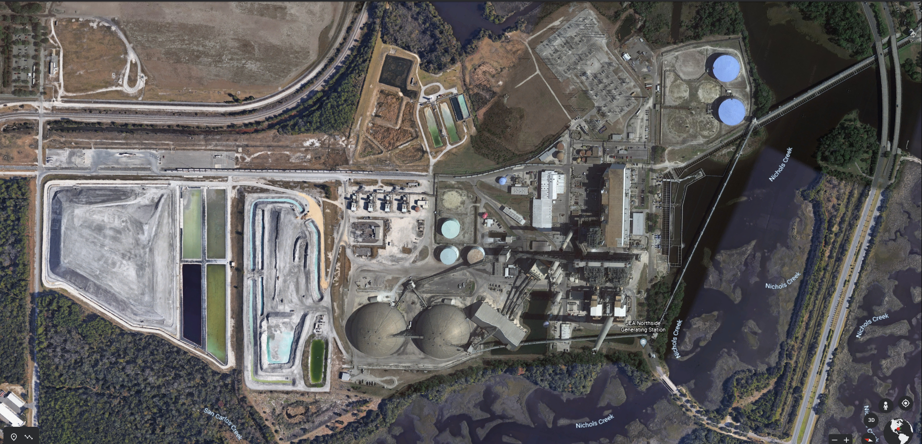
Northside Generating Station (NGS)

Slide 4


NORTHSIDE GENERATING STATION SITE RULES
Plant-wide speed limit of 15 mph (except where otherwise indicated)
All contractor access and deliveries through rear gate (4433 William Ostner Rd)
Security requirements:
  employees must have picture ID in their possession at all times
  hardhats have company name/logo visible on hat

Slide 5
NORTHSIDE GENERATING STATION SITE RULES
Plant-wide use of any wireless communication device (cell phones, etc.) is prohibited by operator of any moving vehicle, including golf carts, forklift, scissor lift.
  To use these devices, vehicle should be pulled over to a safe location and brought to a complete stop.
  Hang up & drive…or pull over & talk.

Slide 6
NORTHSIDE GENERATING STATION SITE RULES
No Smoking!!
Smoking or the use of tobacco products (including, but not limited to, cigarettes, cigars, pipes, smokeless tobacco, e-cigarettes, or other tobacco products) is:
  Prohibited in all interior space owned, rented, utilized or leased by JEA
  Prohibited on all outside property or grounds owned by JEA, including surface and garage parking areas – this applies to private vehicles while they are on JEA property
  Prohibited in JEA vehicles/equipment
  Prohibited on all JEA work sites!

Slide 7
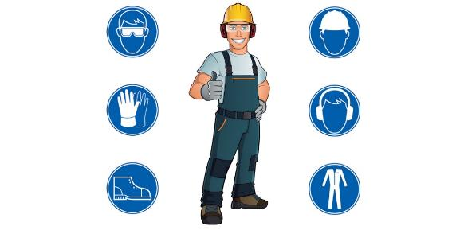
NGS PPE Rules
Hard Hats
Steel-Toed Boots
Safety Glasses
THE MINIMUM PPE REQUIRED TO BE WORN AT ALL TIMES ON JEA WORK SITES !!!

Slide 8
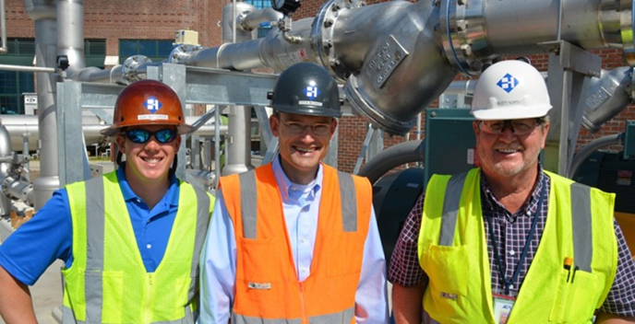
NGS PPE Rules
Hard Hats
  ANSI approved
  Brim forward (except welders when welding) unless approved hard hats doesn’t have a brim from manufacture
  No paint, holes or defects
  Contractor identification with company name/logo and employee name visible on hat
  Hard hats must be “E” rated,
  Class E (Electrical) hard hats protect from impacts, penetration, and high voltage shocks up to 20,000 volts.

Slide 9

NGS PPE Rules
Safety-Toed Boots
  All areas require 100% safety toe shoes. Safety-toe shoes may be either lace up or slip-on type, at least Fives (5) inches tall with a defined heel. Safety toed shoes will meet current ANSI standards. Footwear such as steel toed sneakers etc. are not acceptable.

Slide 10
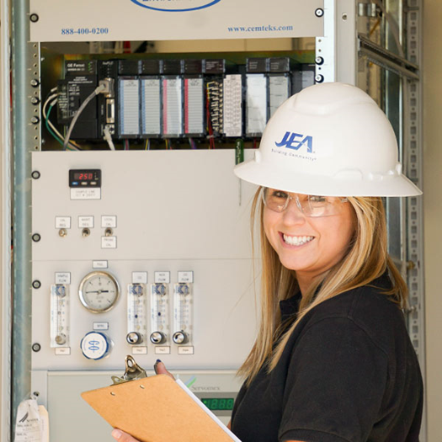
NGS PPE Rules
Safety Glasses at ALL TIMES
  ANSI approved lenses
  Prescription lenses OK if ANSI approved lenses with side shields or covered by safety glasses
  Goggles where needed

Slide 11
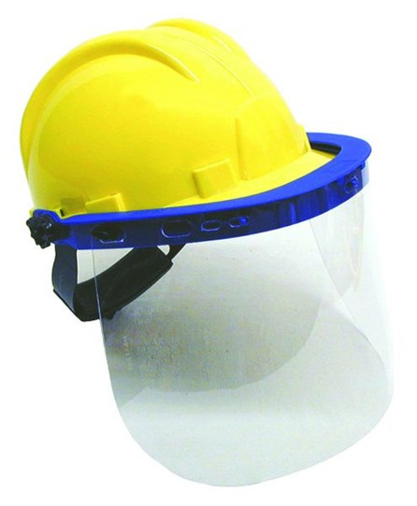
NGS PPE Rules
Project Specific PPE Requirements
Face Shields:
  Required when exposed to over-spray, chemical splash, chipping, grinding, abrading
  Safety glasses must be worn under the shield!

Slide 12
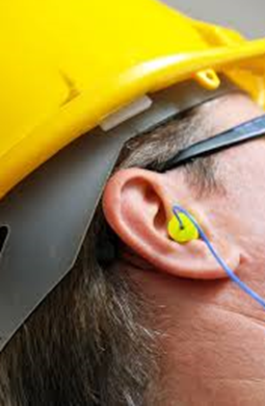

NGS PPE Rules
Project Specific PPE Requirements
Hearing Protection
  Mandatory in boiler and other high noise areas (85+dB)
Gloves
  Minimum leather palms for minor cut/scrape protection
  Task specific as required

Slide 13
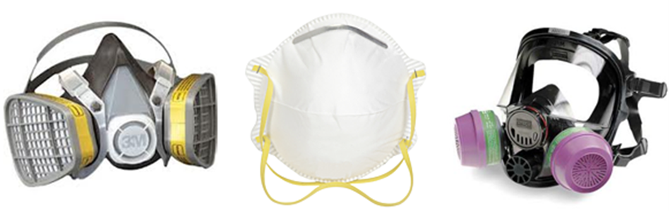
NGS PPE Rules
Project Specific PPE Requirements
Respirators
  Meet or exceed atmospheric hazard
  Half-face/ Full-face
  Task specific as required
    Example: P100 cartridges for Bag House
    Example: Chemical cartridges for ammonia vapors
  Fit test and maintain daily

Slide 14
In Case of Emergency…
Notify NGS Main Control Room of all incidents:
  Call 904-665-6701 from any phone
  Do NOT dial 9-1-1 directly
  Know your evacuation routes
  Account for all personnel
  Main Control Room will coordinate notification and response to all emergencies AND escort responders to location of incident

Slide 15

NGS Emergency Alarm Sounds
Know the Emergency Alarm Sounds
Click on speakers to hear each tone
# | Tone | Description
1 | Evacuation Tone | 20 sec of Wail Tone
2 | Plant Emergency Condition Tone | 20 sec of Alternating Steady Tone
3 | Security Alert Tone | 20 sec of Whoop Tone

Slide 16
NGS Emergency Alarm Sounds
Know the Emergency Alarm Sounds
Emergency Alert (click on speakers)
    Level 1: Evacuation Tone - slowly alternating siren (Wail Tone)
      Evacuate to designated staging area, contractors' stage at rear entry gate parking area in front of the Scale house. Account for all your workers and then check in with a JEA Project Manager (see map on next slide)
    Level 2: Plant Emergency Condition Tone – rapidly alternating steady tone
      Notification of the nature and location of the emergency announced over plant-wide PA system and by plant radio
      Please standby for further instruction
    Level 3: Security Alert Tone – whoop tone
      Report any suspicious persons or activity to the main control room
      Please standby for further instruction
Alarms are tested weekly on Thursdays between 11:30am - 12:00pm (noon).

Slide 17
Northside Generating Station (NGS)
Contractor Evacuation Site

Slide 18

Weather Safety
Make a Safety Plan:
  Plan ahead, that includes knowing where you’ll go for safety
  Listen to the forecast and monitor weather conditions
  Cancel or postpone activities if thunderstorms are in the area
  Take action early so you have time to get to a safe place
  Get inside a substantial building with doors & windows closed
  If building not available, get into an enclosed, hard-topped metal vehicle
  Stay away from windows, sinks, toilets, showers, electrical boxes, outlets, and appliances
This Photo by Unknown Author is licensed under CC BY-SA-NC

Slide 19

Lightning Safety
Lightning Safety Best Practices
Outdoors, with no time to reach shelter:
  Do not stand underneath a natural lightning rod such as tall isolated trees, towers, power lines, telephone poles.
  Avoid all unsafe structures: metal objects such as power poles, wire fences, gates, small sheds, partial shelters, electrical equipment, open vehicles (mowers, golf carts, forklifts, etc.).
  Avoid solitary trees, open water, open fields, and high ground.
  Stay away from metal pipes, rails, railroad tracks, and other metallic paths which could carry lightning toward you.
  Put down tools that could make you a target.
  Do not be or be near the tallest objects in the area.
  Do not stand in puddles even if you are wearing rubber boots.
  If with a group, ensure there are several meters between individuals to avoid lightning from jumping from person to person.

Slide 20

Railway Safety
JEA Policy requires that all independent contractors and their employees who are workers on railroad track & system must receive annual On-Track Safety Training
A worker is anyone whose duties include:
  Inspection, construction, maintenance or repair of:
    Track
    Bridges
    Roadway
    Signal and communications systems
    Electrical traction systems
    Roadway facilities or roadway maintenance machinery on or near track or with the potential for fouling the track

Slide 21

Railway Safety
JEA Policy states that you must have On-Track Safety Training if:
  You will be “ON” or near track, within a minimum of 4’ from the outside of the rail
  OR
  With the potential of fouling the track

Slide 22

Railway Safety
Notification of hazards to equipment or people:
  Notify railroad worker wearing a marked R.R. vest of hazards or violations of signage
  Report these issues to JEA point of contact if R.R. worker not available
  Posted signs to be aware of:
  Close Clearance
  No Passing Over, Under, Between Railroad Cars - Violation will result in removal from site!
  Do NOT drive around lowered railroad arms! Violation will result in removal from site!

Slide 23
What do you do if you see an unsafe act…
Employees should immediately stop the violation and must promptly report any non-compliance as follows:
First, inform a railroad worker wearing a RR vest
Second, notify:
  Material Handling Control Room
    904-665-4284 from cell phone
    4284 from house phone
    Radio channel 10-A
  Main Control Room
    904-665-6701 from cell phone
    1234 from house phone
    Radio Channel 11-A

Slide 24
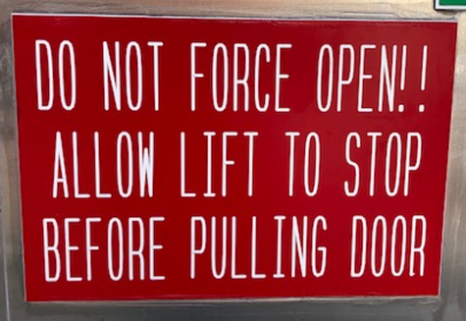
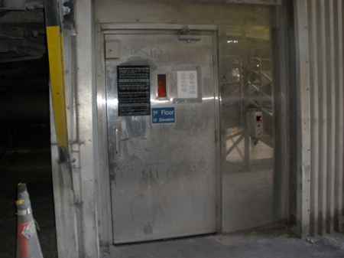
CFB Elevator Safety & Operation
Personnel only, NOT to be used for freight or heavy tools
Operator will be present during outages or heavy work times
Closely follow posted instructions for door operation
Attempting to open door prior to elevator coming to a COMPLETE stop, may result in breaking the safety hinge which keeps the door secure in the absence of the elevator car. Use extreme caution when opening the door and be sure the elevator is at the landing before stepping forward to enter the space
  Before entering:
    When elevator arrives at desired landing (seen through window), wait a few seconds, listen for “click,” then the first door can be pulled open
    The second (elevator) door then slides open by hand
    Do NOT attempt to open the first door until the elevator has come to a complete stop!!
  Before exiting:
    Wait for the elevator to come to complete stop and listen for the “click”
    The first (elevator) door then slides open by hand
    The second (outside) door can then be pushed open
    Do NOT attempt to open the elevator door until it has come to a complete stop!!

Slide 25
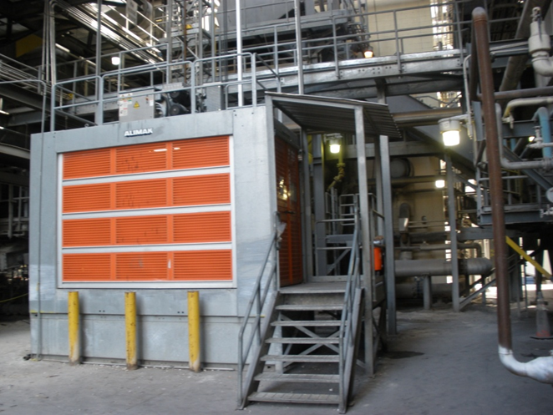
CFB Boiler Lift Safety
Used for tools, materials, and heavy items
Operator will be present during outages or heavy work times
Closely follow posted instructions for door operation

Slide 26
NGS Site Hazards
Highest Injury Potential Areas…
Caught-in/Entrapment (i.e. Confined Space Entry)
Hot Work/Fire Risk
Struck-by Moving Machinery
Control of Hazardous Energy (LOTO)
Fall Protection
Slips, Trips, Falls

Slide 27
Confined Space Entry Permitting and Signs
All spaces shall be considered permit-required confined spaces until the space has been evaluated and the atmosphere has been found to be safe for entry via proper testing, evaluations, and visual inspections. The applicable sections (Parts I-V) of the Confined Space Entry Permit, including atmospheric checks, shall be completed and documented for all spaces to determine if acceptable entry conditions exist.
Refer to JEA Confined Spaces Policy
Permits must be placed at entry point(s) of the space.

Slide 28

Hot Work in Confined Spaces
The Confined Space Supervisor has full responsibility for:
Fire precautions being followed
Confined Space Entry Permits
Hot Work Permits
Space is clear of used electrodes and leads are disconnected after work is complete
Types of Hot work include:
Welding
Brazing
Flame or Plasma Cutting
Hot Riveting
Any type of work that can create:
  Sparks
  Heat
  Flames

Slide 29
Hot Work in Confined Spaces
Includes:
    Tanks
    Drums
    Vessels
    Pipes
    Other Containers
Preparation of all vessels, tanks, etc. shall be purged and cleaned free of:
  Flammable and Combustible
      Liquids & Solids
      Gases & Dusts
  Chemicals (i.e., Ammonia, Acid, Caustic)

Slide 30
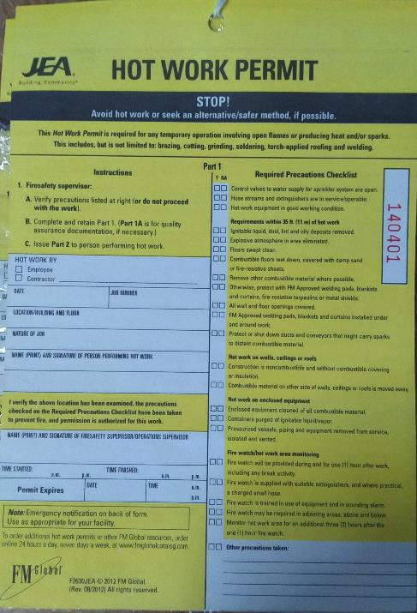
Hot Work Permit Authorization
JEA Project Representative is notified of Hot Work
Complete Hot Work Permit
Fire precautions are in place:
  Fire Watch assigned
  Fire extinguisher in place

Slide 31
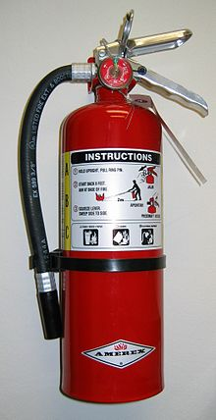
Fire Watch Requirements
Fire Watch required for every Hot Work Permit
Employee(s) assigned to watch hot work for fire potential must have no other duties!
Trained in use of fire extinguishers

Slide 32
Barricades
Use proper color tape or barrier to properly identify all hazardous areas:
  Red = IMMEDIATE DANGER: permission required to enter area
  Yellow = CAUTION: entry permitted following survey of area to note hazard
  Magenta (Purple) & Yellow = IMMEDIATE DANGER-RADIATION: permission required to enter area
  ALL BARRICADES MUST BE PROPERLY TAGGED TO IDENTIFY HAZARD AND OWNER OF AREA & REMOVED WHEN WORK COMPLETE!

Slide 33
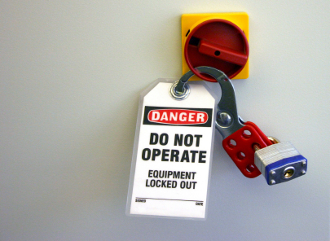
Control of Hazardous Energy JEA Hold Tag Clearance
Responsibility for Clearance lies with the:
JEA Tagging Authority, Operating Engineer (OE)
JEA Operations Outage Manager
JEA Project Manager or Representative

Slide 34

Control of Hazardous Energy JEA Hold Tag Procedures
Work Permits are required that specify the:
Equipment and process to be tagged
Procedures to follow to secure the equipment and process
People doing the work

Slide 35
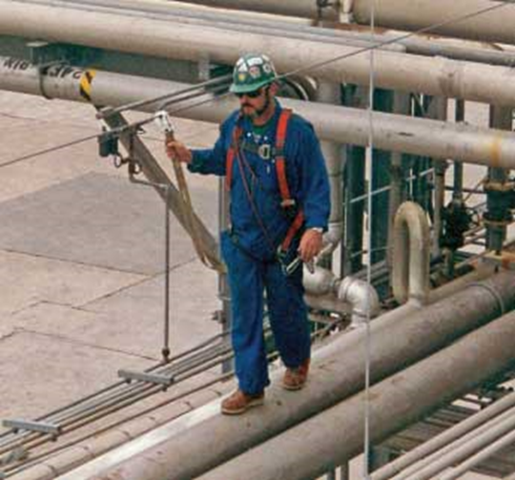
Fall Protection & Fall Arrest
Required on all JEA NGS projects 4’ and above.
Full body harness, fall arrest, & suitable anchorage point is required.
Daily inspections of the harness, lifelines, ties and anchorage points required!
Know your fall clearance!
One strike & you’re out! This training is your first warning.

Slide 36
Scaffold Safe Work Practices
DAILY inspections must be performed on all scaffolding.
Climb to your work platform by attached ladder, stairway or ramps ONLY!
The scaffold frame, system members, and cross braces are not designed to be climbed.
Follow all instructions given by the Competent Person
Know how to inspect all parts of the scaffold and base
Never climb on scaffolding that has not been cleared to use!

Slide 37
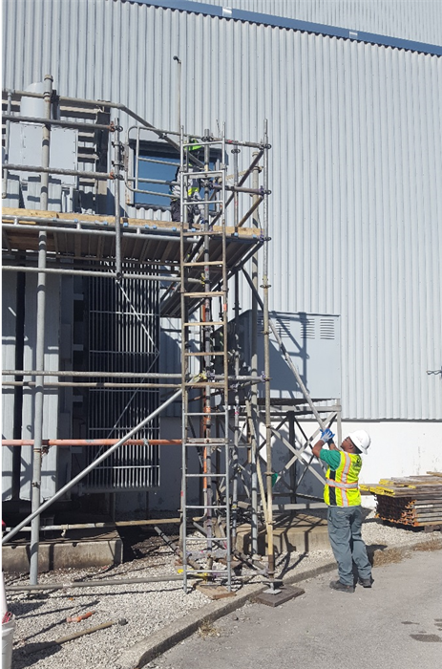

Scaffold Safe Work Practices
Look for tags:
  Yellow - Caution
  Red - DANGER
  Green – Clear for usage

Slide 38
Scaffold Safe Work Practices
ALWAYS…
Stay alert to the hazards around you
Be quick to see and tell others of unsafe conditions or acts
Use fall protection
NEVER …
Become overconfident on a scaffold
Make foolish mistakes or take shortcuts because you are tired
Cross from one platform to another unless both platforms are level and properly joined

Slide 39
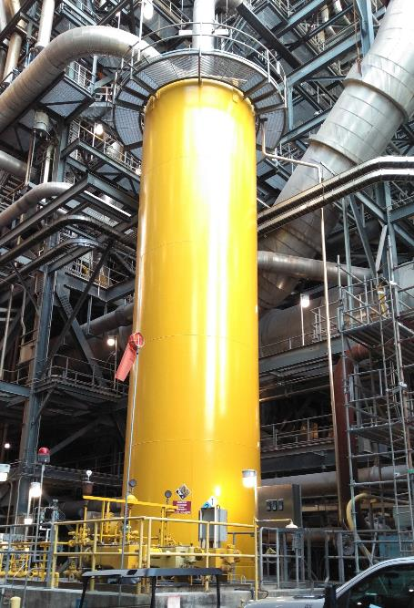
Additional Site-Specific Considerations
40,000-gallon tank of ammonia is located at the west end of plant between the CFB boilers
Pipe insulation, gaskets, expansion material, and flooring may contain asbestos. Check with your JEA Project Manager before disturbing material.
Painted surfaces may contain lead paint. Check with your JEA Project Manager before disturbing material.
If you are not sure…ASK!
If you do not understand…ASK!

Slide 40

NORTHSIDE GENERATING STATION SITE RULES
ALWAYS…
Work Smart
Wear your PPE
Follow job safety procedures
Be alert
Report unsafe acts & conditions
Help your co-workers
Know your evacuation location

Slide 41
Questions
If you have any questions, please ask your Project Manager or Safety & Health Team Member.
Thank you!

