Slide 1

Contractor Safety
A site-specific overview of safety procedures and related information for Kennedy Generating Station

Slide 2

JEA Safety Objective:
To create a seamless, interdependent safety & health promotion organization which promotes and ensures the core values and business strategies of JEA, regardless of actual employer; and maximizes resources and expertise to reduce injury/illness within JEA and in the community

Slide 3


Slide 4

JEA Electric Production, Combustion Turbines
Kennedy Generating Station
4215 Talleyrand Ave.
Jacksonville, FL 32206

Slide 5
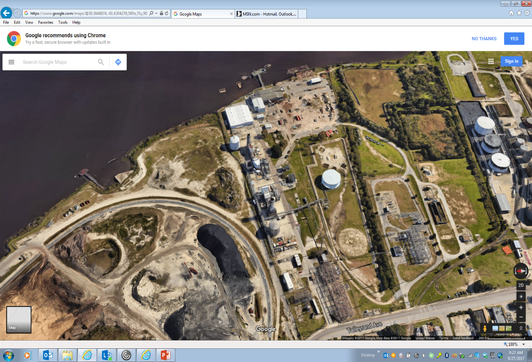




Site Overview
North

Slide 6
All contractor vehicles on site must have a company placard/sign - name and contact information displayed on the dash in case the vehicle needs to be moved
All personal, or non-placard, vehicles will be parked in the contractors parking area south of the plant site

Slide 7
JEA Electric Production Facilities
Highest Injury Potential Areas
Caught in - example: Confined Space Entry
Hot Work
Struck-by
Control of Hazardous Energy
Fall Protection

Slide 8
Ground Fault Circuit Interrupter (GFCI)
Don’t assume outlets are protected - check it or use pig tails

Slide 9
Confined Space Entry
Permitting and Signs
All confined spaces will be permit entry only
no non-permit spaces!
Permit shall be posted at entry point(s)
Contractor to issue their permit

Slide 10
Confined Space Entry
Fall Protection & Fall Arrest
Full body harness shall be worn in all confined spaces
Rescue equipment - readily available
FP/FA use and care training required for entrant & attendant

Slide 11
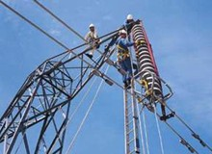
Fall Protection
Fall Protection & Fall Arrest
100% Fall Protection at 4’ and over on ALL JEA projects.
One strike & out!
Full body harness, fall arrest, anchorage, and suspension trauma straps are required.

Slide 12
Hot Work
Types included
Welding
Brazing
Flame or Plasma cutting
Any type of work that can create:
    Sparks!
    Heat!
    Flames!

Slide 13
Hot Work
Hot Work Permit Authorization
Hot Work Permit complete
Ensure JEA Contact is notified of work
Fire precautions are in place
    Fire Watch assigned
    Fire extinguisher in place
FIRE

Slide 14
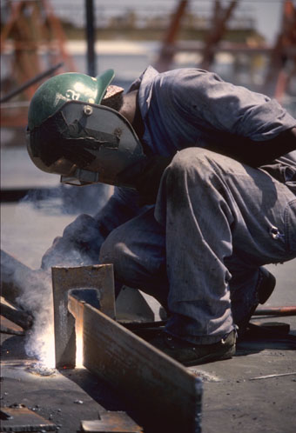
Hot Work Fire Watch Requirement
Required for every hot work permit
Employee(s) assigned to fire watch can’t have collateral duties. “Watch” ends 1 hour after work is complete
“Monitoring Period” – 3 hours after fire watch
Trained in use of fire extinguishers

Slide 15
Hot Work
Confined Spaces
The Confined Space Supervisor has full responsibility for:
Fire pre-cautions being followed
CSE permits & Hot work permits
When done the space is clear of used electrodes & leads are disconnected
Before the space is cleared for use!

Slide 16
Emergency Response
JEA Emergency Response Plans
Staging Area will be : Just inside main guard house.
Evacuation Route is heading west down the main road to the main gate
It is the contractors’ responsibility to notify JEA’s contact that their personnel are accounted for and in the appropriate assembly area, or exited plant site
Emergency Notification – ext. 4891, or, (904) 665-4891 outside lines/cell phones, then 911 if necessary
Accounting for Personnel
Report all incidents to JEA Management

Slide 17
Emergency Response/
Emergency Evacuation Procedures
ERP on file with Site Safety
Contractor responsible to inform their employees of ERP procedures

Slide 18
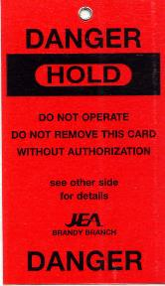
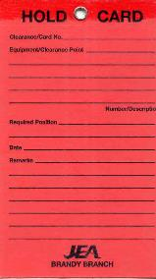

Control of Hazardous Energy
Hold Tag Policy for Electric Production
OSHA regs. apply + JEA Safety & Health

Slide 19
Control of Hazardous Energy
JEA Hold Tag Procedures
Responsibility for Clearance lies with the:
JEA Operations Manager (OM)
JEA Operations Outage Coordinator (OOC)
Project Management

Slide 20
Scaffold Safe Work Practice
Follow all instructions
given by the Competent Person.
Know how to inspect all parts
of the scaffold and scaffold base.
Never climb on a scaffold that has not
been cleared to use.
Look for tags - Red, Yellow & Green
Tags should inspected and be signed by
competent person every shift.

Slide 21
Project Specific
PPE Requirements
Hard Hats
ANSI Z89.1 approved
Class G or E
Brim forward (except Welders when welding)
No paint, holes or defects
Contractor ID

Slide 22
Project Specific
PPE Requirements
Safety Toed Boots
  Leather or Similar Material
  Defined Heel
  EH Electrical Rating
  5” Ankle Support
  Slip Resistant
  Protective Toe- Meets ASTM F2413

Slide 23

Project Specific
PPE Requirements
Safety Glasses at ALL TIMES
  ANSI approved lenses
  Side shields
  Goggles where needed
  Prescription lenses OK if ANSI or
  inserted/ covered by ANSI safety glasses

Slide 24

Project Specific
PPE Requirements
Face Shields
  Required when exposed to over-spray, chemical splash, chipping, grinding & abrading
  Safety glasses must be
  worn under the shield

Slide 25
Project Specific
PPE Requirements
REMEMBER :
  * HARD HATS, BRIM FORWARD,
  * SAFETY GLASSES &
  * ANSI APPROVED SAFETY TOE SHOES
  * THE MINIMUM PPE REQUIRED TO BE WORN AT ALL TIMES ON JEA WORK SITES !!!

Slide 26
Use of JEA equipment by contractors is strictly prohibited
Including but not limited to heavy equipment, miscellaneous shop equipment, etc.

Slide 27

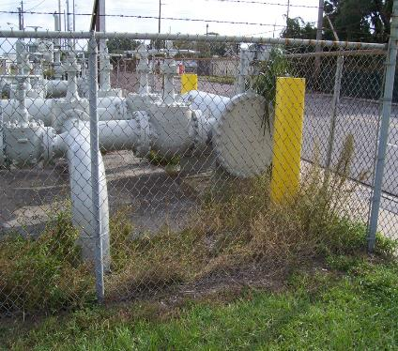
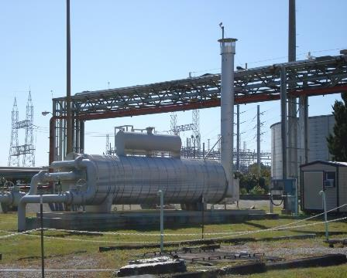
Special precautions need to be used when performing hot work near these areas.
Plant Specific
Other Considerations
Natural Gas Yard and gas heater

Slide 28
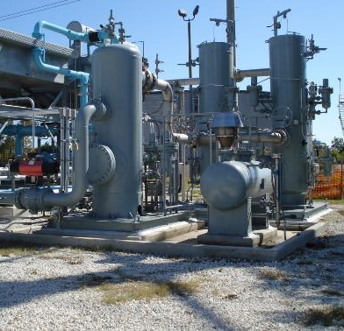
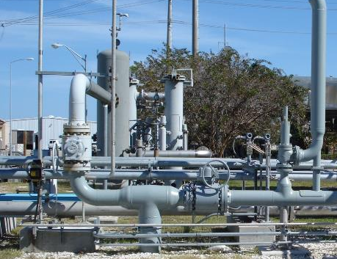
Plant Specific
Other Considerations
Natural Gas Skids KCT8
KCT7

Slide 29
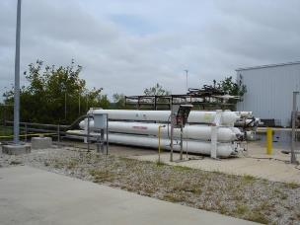
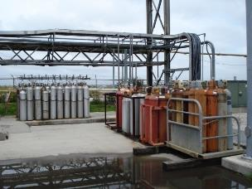
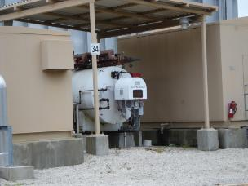
Plant Specific
Other Considerations
Hydrogen & Carbon Dioxide Storage KCT7

Slide 30
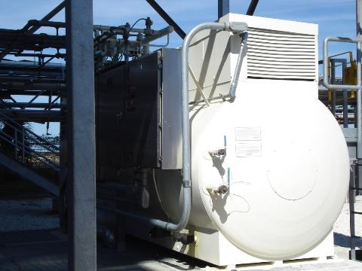
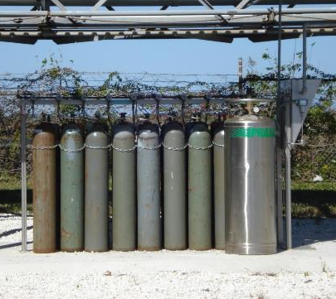
Plant Specific
Other Considerations
Carbon Dioxide Storage KCT8

Slide 31
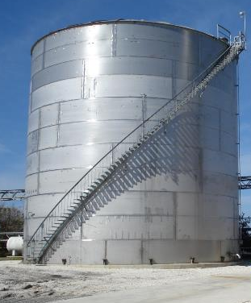
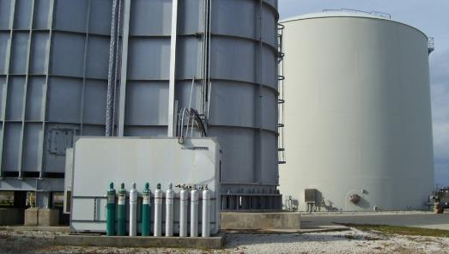
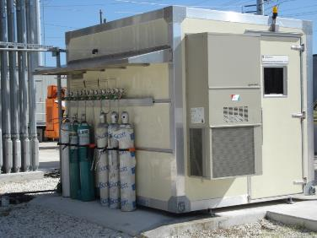
KCT8
Demineralized water storage
CEMS equipment calibration gases
KCT7
Demineralized water
KCT8
CEMS

Slide 32
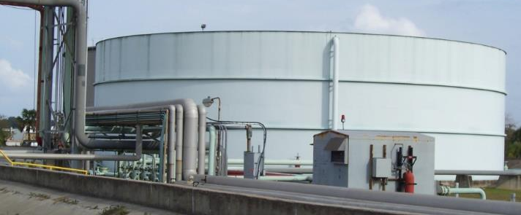
  Diesel Storage and Fuel Forwarding skids

Slide 33
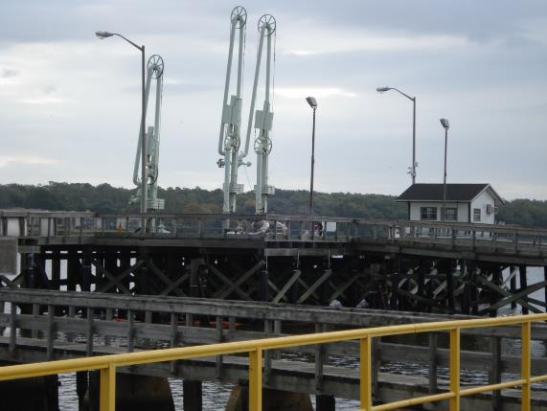
  Diesel Unloading Station (Dock) comes under MARSEC (Maritime Security) ruling, only authorized personnel allowed on dock and must have TWIC (Transportation Worker) identification, or TWIC escort.

Slide 34

Project Specific
Other Considerations
Work Smart . . .
Wear your PPE . . .
Follow safe job procedures . . .
Be alert - Report unsafe acts & conditions . . .
Help your co-workers . . .

