Slide 1
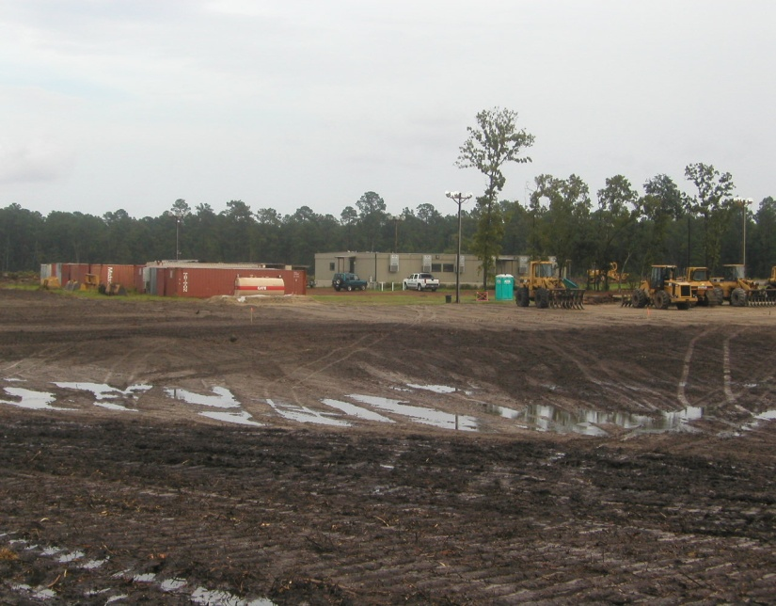

Site Specific Safety Training
for
Greenland Energy Center
(GEC)

Slide 2
Safety is success by purpose - Not Accident
JEA Safety Objective
To create a seamless, interdependent safety and health promotion organization which promotes and ensures the care values and business strategies of JEA, regardless of actual employer, and maximizes resources and expertise to reduce injury and illness within JEA and the community.

Slide 3
JEA Electric Production Facilities
Northside Generating Station
Kennedy Generating Station
Brandy Branch
Greenland Energy Center

Slide 4
Greenland Energy Center (GEC)
Location
  12121 Philips Hwy (US 1), about ½ south of 9A
Nearest Fire Station (EMS)
  11026 Philips Hwy, 2.9 north on US1
AED on site – in the JEA offices

Slide 5
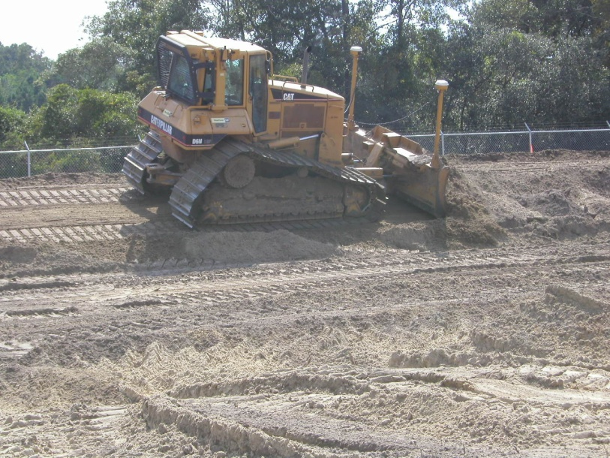

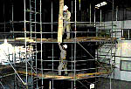
JEA Electric Production Facilities
Highest Injury Potential
Falls
Caught In/Struck By
Hot Work
Control of Hazardous Energy
Scaffolding

Slide 6
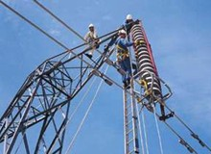
Fall Protection & Arrest
100% Fall Protection at 4’ and over on ALL JEA projects.
Full body harness, fall arrest anchorage, and suspension trauma straps required.
  Scaffolding reviewed later

Slide 7
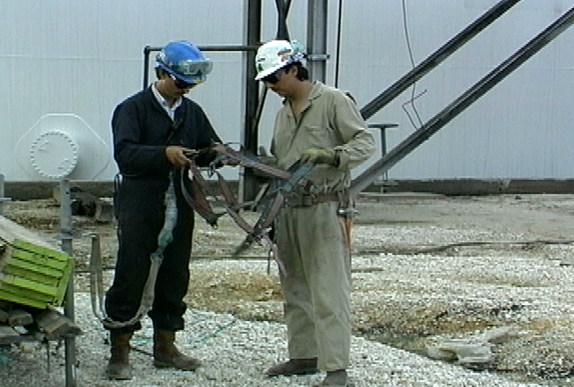
Fall Protection & Arrest
Daily inspections of:
  Harnesses
  Lanyards & lifelines
  Anchor points
Do not tie off to conduit, valves, piping.

Slide 8



Caught In/Struck By
Be alert
Communicate with operators & spotters
Wear high visibility clothing as needed

Slide 9
Caught In/Struck By
Conduct pre-trips
  Are horns, alarms, lights working?
Use tag lines – at least 4’
  Don’t stand under loads
Inspect hooks, latches & rigging

Slide 10
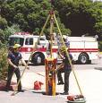


Caught In - Confined Spaces
Rescue from Confined Spaces
Full body harness shall be worn in all confined spaces
Rescue equipment - readily available
FP/FA use and care training required for entrant & attendant

Slide 11
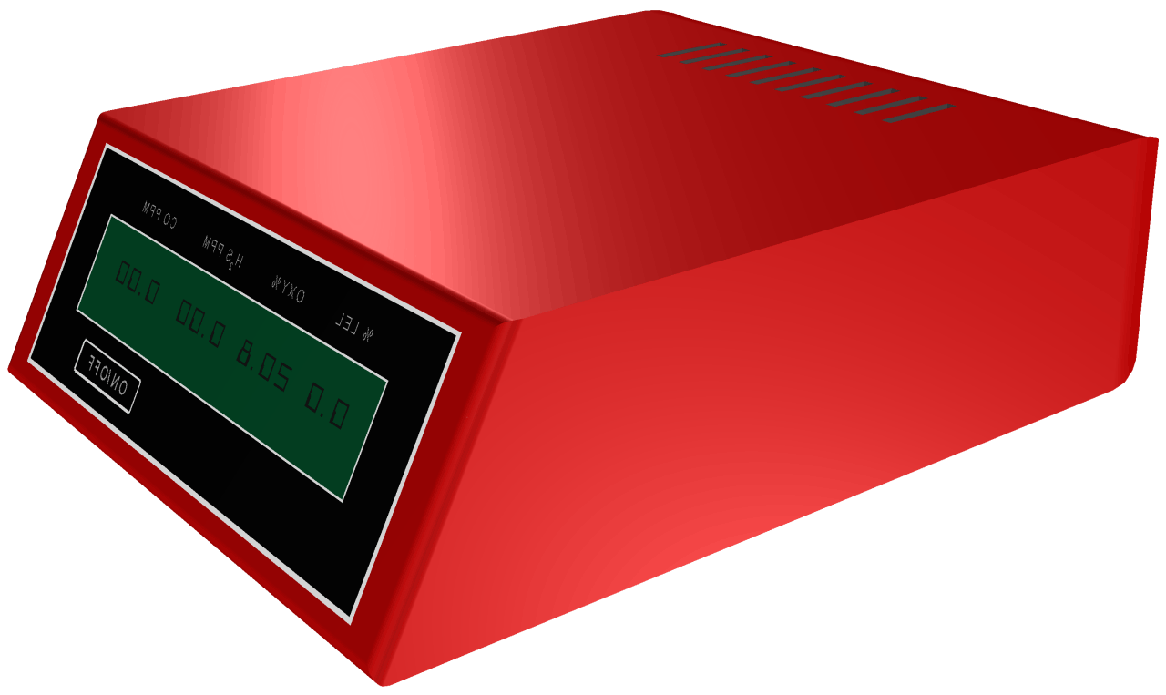
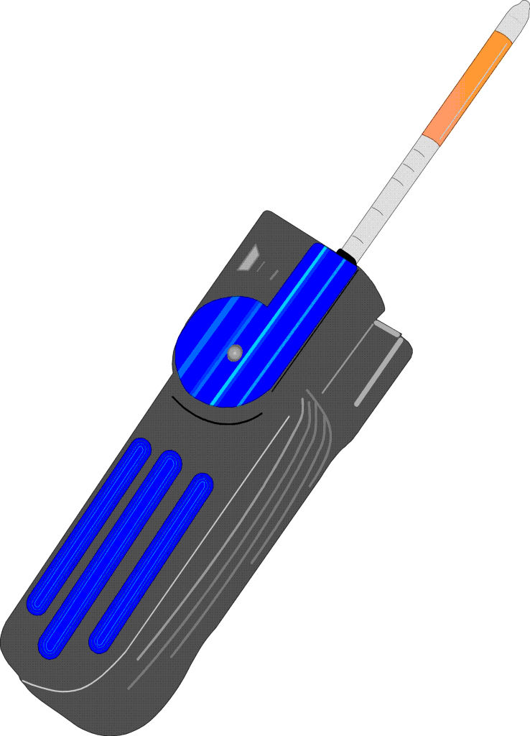
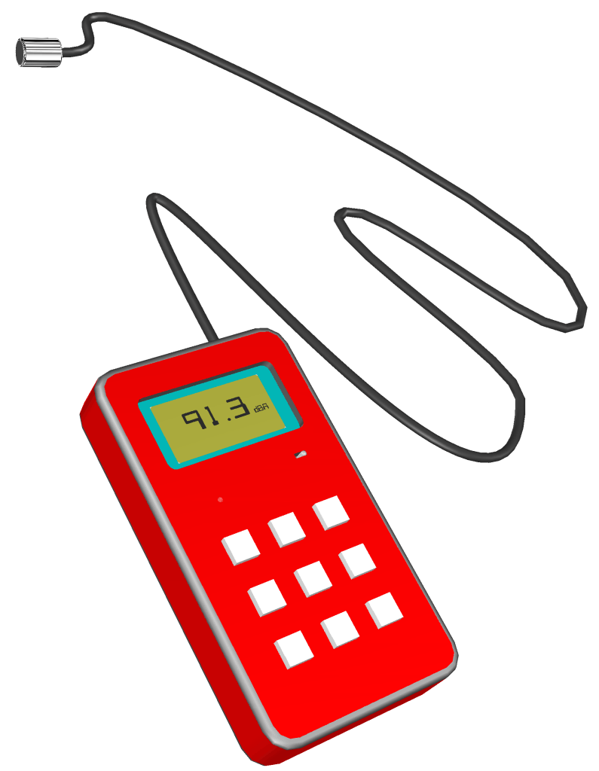
Caught In - Confined Space
Atmospheric Monitoring
Air monitoring is required before entry
Minimum checks for O2, toxic & flammable
Specific gases as required by site safety

Slide 12
Caught In - Confined Space Entry
Entrant & Attendant
Trained in atmospheric & physical
hazards
Attendant required for every CSE.
Attendant = trained & competent
+ CPR/First Aid
Complete permit & post at entry point

Slide 13
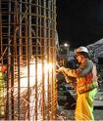
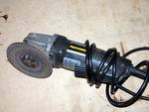


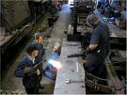
Hot Work
Welding
Brazing
Flame or Plasma Cutting
Hot Riveting
Any type of work that can create
sparks! heat! flames!

Slide 14

Hot Work Permit Authorization
Hot Work Permit complete
Ensure JEA Project Mgr is notified of work. Obtain proper signatures.
Fire precautions are in place
    Fire Watch assigned
    Fire extinguisher in place

Slide 15
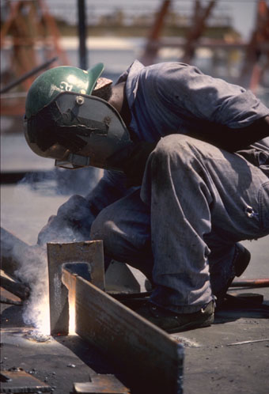
Hot Work – Fire Watch & Monitoring Period
Required for every hot work permit
Employee(s) assigned to fire watch can’t have collateral duties. “Watch” ends 1 hour after work is complete
“Monitoring Period” – 3 hours after fire watch
Trained in use of fire extinguishers

Slide 16
Hot Work - Tank & Pipe Safety Preparation
Includes:
    Vessels
    Tanks
    Drums
    Pipes
    Other Containers

Slide 17
Hot Work - Tank & Pipe Safety Preparation
All Vessels shall be purged (cleaned) free of flammables and combustibles such as:
    Gases
    Liquids
    Solids (including dusts)
before the hot work starts!

Slide 18
Hot Work - Confined Spaces
The Confined Space Supervisor has responsibility for:
Fire precautions being followed
Confined Space Entry & Hot Work Permits
Ensure the space is clear of used electrodes & leads are disconnected when the work is complete
before the space is cleared for use!

Slide 19
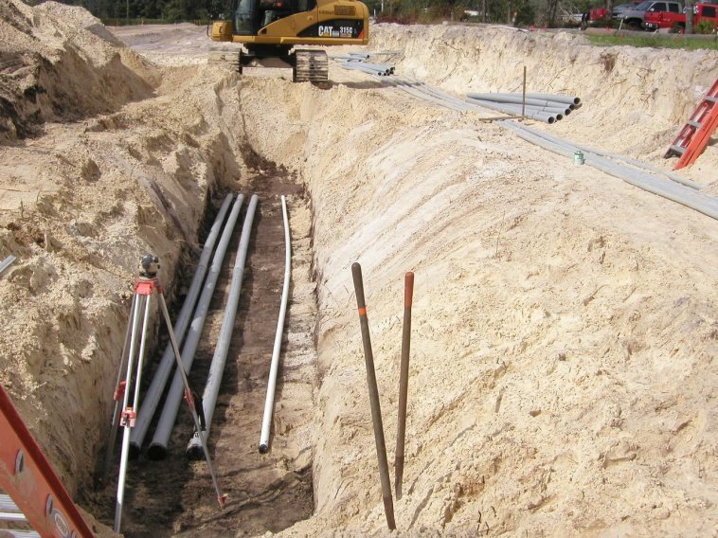
Control of Hazardous Energy
Hold Tag Policy for Electric Production
OSHA regulations apply + JEA policies and procedures
Utilities in the ground already – call before you dig

Slide 20
Control of Hazardous Energy
JEA Hold Tag Procedures
Responsibility for Clearance lies with the:
JEA Tagging Authority (Ops Shift Coordinator)
  Until units at GEC come online, check with JEA Project Management
JEA Operations Outage Coordinator (OOC)
Project Management

Slide 21
Control of Hazardous Energy
JEA Hold Tag Procedures
Work Permits are required that specify the:
Equipment and process to be tagged
Procedures to follow to secure the equipment and process
People doing the work

Slide 22

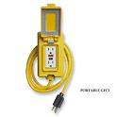
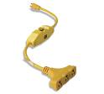
Control of Hazardous Energy
Ground Fault Interrupters
  required on all electrical tools unless plugged into facility
Elevate or protect all cords
Energy can be mechanical, hydraulic etc
  Lock out, release, block, secure all energy sources prior to work

Slide 23

Scaffold Safe Work Practices
User training required
Climb to your work platform by attached ladder, stairway or ramps ONLY !
The scaffold frame, system members or cross braces are not designed to be climbed.

Slide 24
Scaffold Safe Work Practices
ALWAYS . . .
Stay alert to the hazards above and below
Verify daily inspection on scaffold tag before use
  Red – don’t use
  Yellow – incomplete, fall protection may be required
  Green – safe to use
Know how to inspect all parts of the scaffold and scaffold base.

Slide 25
Scaffold Safe Work Practices
NEVER . . .
Become overconfident on a scaffold
Make foolish mistakes or take shortcuts because you are tired
Cross from one platform to another unless both platforms are level and properly joined.

Slide 26
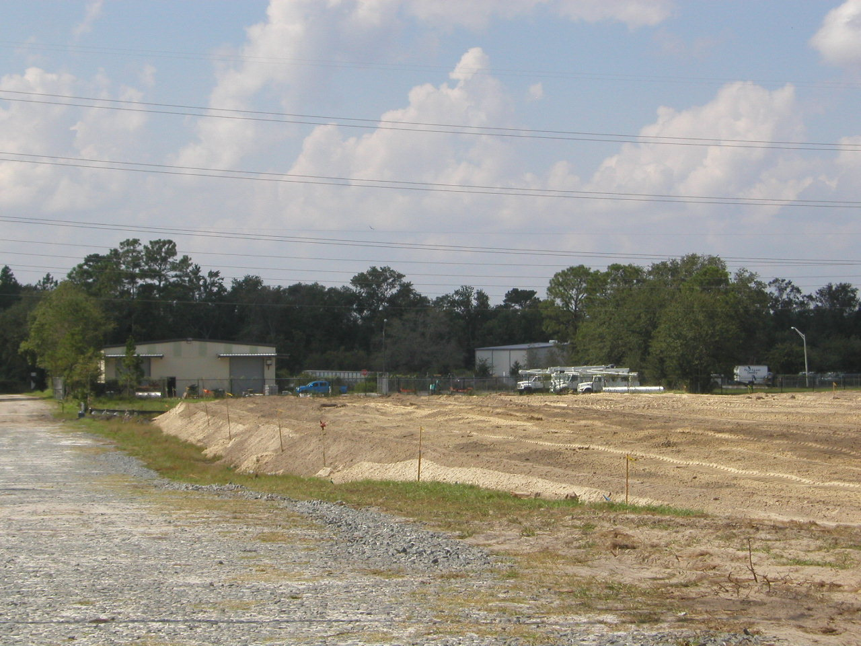
Emergency Response
Emergency Notification – air horn at GEC currently
  One long blast – be alert, emergency condition may exist
  Two long blasts – proceed to assembly area
Supervision: keep a current head count (twice per shift)
Assembly Areas
  Main gate – west end of entry road at fence line
  Alternate – office trailers
  Evacuation routes is out the Main Gate

Slide 27


Emergency Response
Contractor responsible for informing their employees of Emergency Response Plan procedures
Emergency Response Plan on file with project / outage management personnel.

Slide 28
Project Specific PPE Requirements
Hard Hats
Must meet the current ANSI standard Z89.1
and be Class G or E Rated

Slide 29
Project Specific PPE Requirements
Safety Toed Boots
  Leather or Similar Material
  Defined Heel
  EH Electrical Rating
  5” Ankle Support
  Slip Resistant
  Protective Toe- Meets ASTM F2413

Slide 30

Project Specific PPE Requirements
Safety Glasses at ALL TIMES
  ANSI approved lenses w/side shields
  Goggles where needed
  Prescription lenses OK if ANSI or
  inserted/covered by ANSI safety glasses

Slide 31
Project Specific PPE Requirements
Face Shields
  Required when exposed to over-spray, chemical splash, chipping, grinding, abrading …
  Safety glasses must be worn under the faceshield

Slide 32
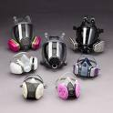
Project Specific PPE Requirements
Respirators
  Get the right mask and filter cartridge for the task. (ex P100 for lead, asbestos, cadmium, arsenic)
  Meet or exceed atmospheric hazard
  Medical Approval, fit test and inspect/maintain daily

Slide 33
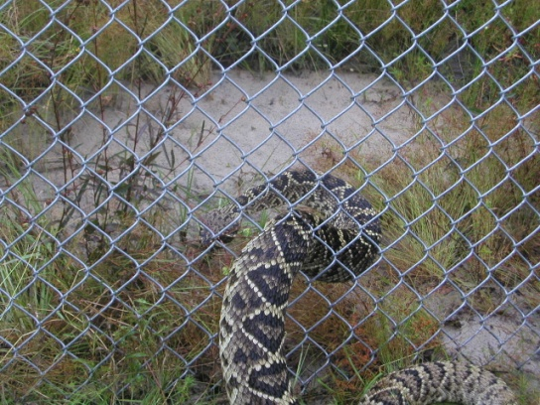

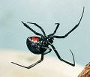
Other Considerations:
Wild animals & reptiles
Insects – spiders
Others
Eastern Diamond-back – found on site
Brown Recluse
Black Widow

Slide 34


In summary
Ask if you are not sure
Good housekeeping
Wear your PPE & follow safety procedures
Be alert – report or fix unsafe acts & conditions
Help your co-workers

