Slide 1

Site Specific Safety Training
for
Blacksford WRF

Slide 2
Safety is success by purpose - Not Accident
JEA Safety Objective
To create a seamless, interdependent safety and health promotion organization which promotes and ensures the care values and business strategies of JEA, regardless of actual employer, and maximizes resources and expertise to reduce injury and illness within JEA and the community.

Slide 3
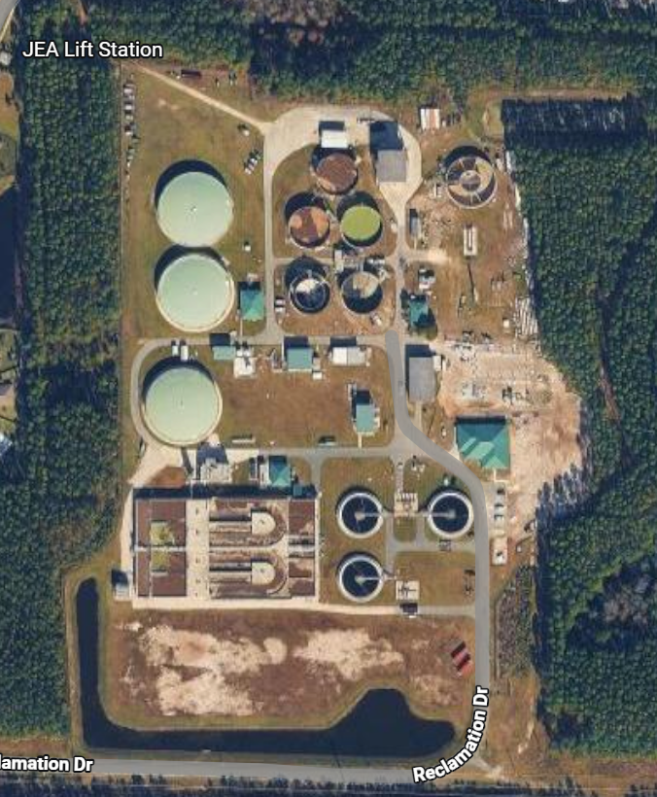
Blacksford Water Reclamation Facility
Notes:
This should be right Curtis!

Slide 4
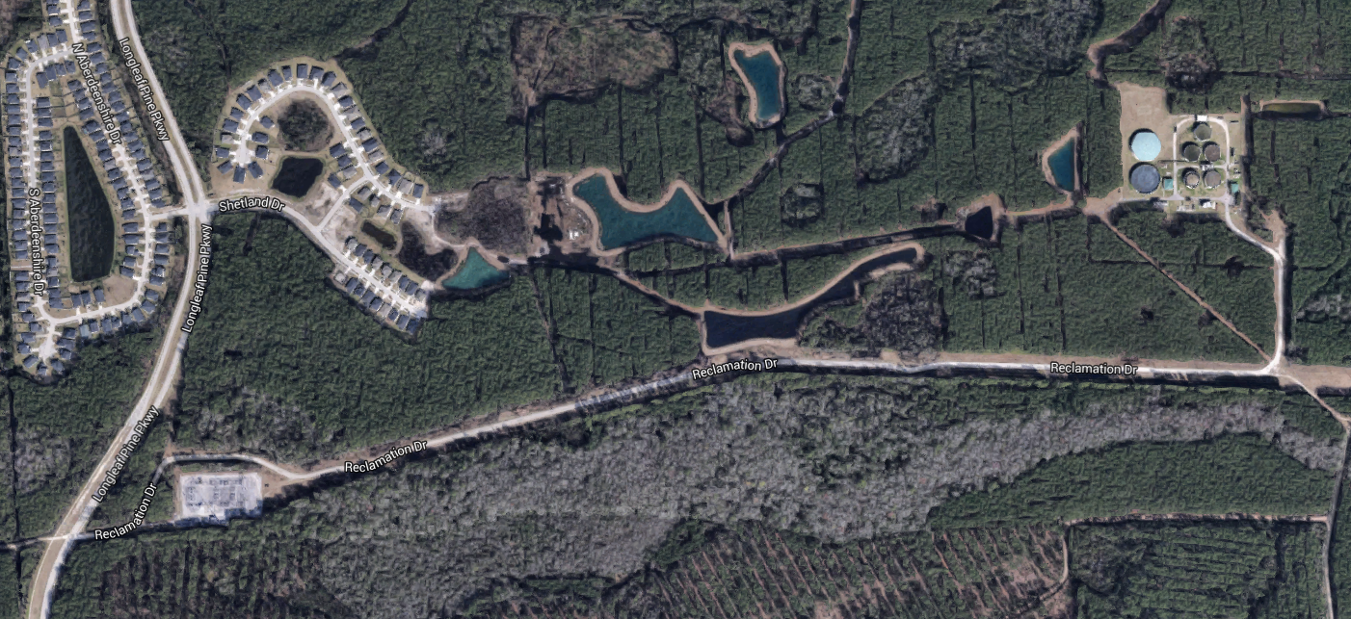
Blacksford WRF
Location
  5145-2 Longleaf Pine Parkway, Northern St. Johns Co
Nearest Fire Station (EMS)
  Station #2; 1120 Sheffield Rd Switzerland
    4.9 miles distance to plant

Slide 5
Plant personnel will respond to any alarms
Parking in designated area only
Speed limit
  Access road- 20mph
  Plant- 15mph

Slide 6
Chemicals on site:
    Sodium Hypochlorite
    Glycerin
    Aluminum Sulfate
    Ferrous Chloride
    Hydrogen Peroxide
    SDS are available using the SDS link.

Slide 7
Emergency eyewash/shower
  Near UV trenches
  Near Peroxide Tanks
  Inside Operations Building
  Do not look at UV light. UV light exposure may cause blindness and other eye illnesses!

Slide 8
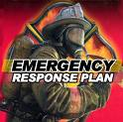

Emergency Response
Contractor responsible for informing their employees of Emergency Response Plan procedures
Contractor will provide
  First Aid Kit
  Fire Extinguisher
  CPR/First Aid

Slide 9
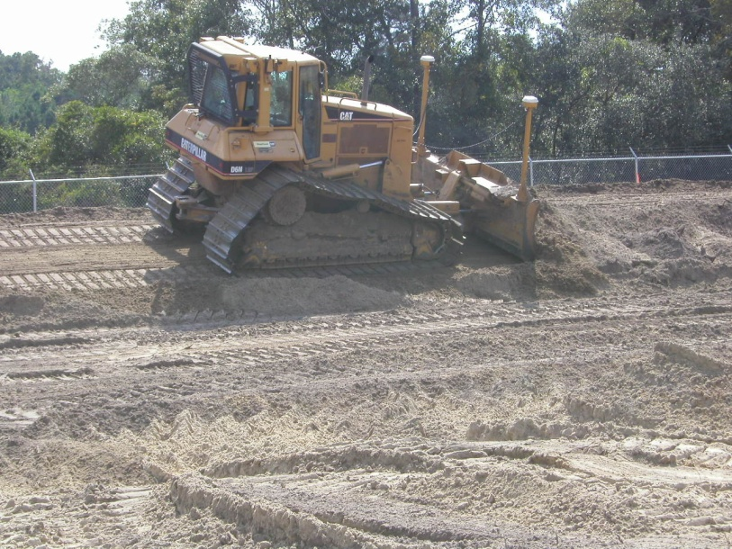

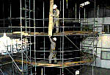
Highest Injury Potential
Falls
Caught In/Struck By
Hot Work
Control of Hazardous Energy
Scaffolding

Slide 10
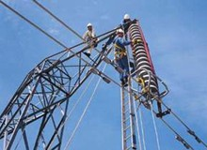
Fall Protection
100% Fall Protection at 4’ and over on ALL JEA projects.
Fall Prevention – work positioning, work restriction or guardrail systems
Fall Arrest - full body harness, lanyard, anchor point and suspension trauma straps
Scaffolding reviewed later

Slide 11
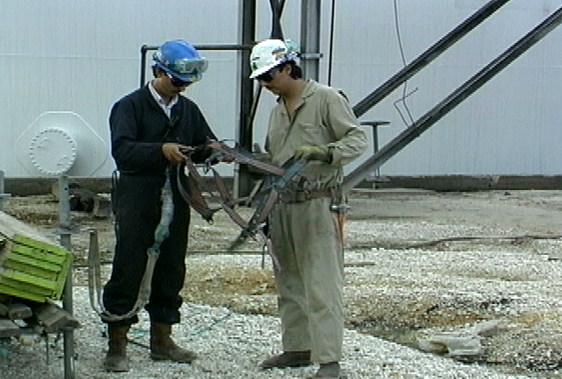
Fall Arrest
Daily inspections of:
  Harnesses
  Lanyards & lifelines
  Anchor points
  Work at <17-18’ in elevation will require other means of fall arrest (SRLs). Check with your supervisor.
Do not tie off to conduit, valves, piping.

Slide 12



Struck By
Be alert
Communicate with operators & spotters
Wear high visibility clothing as needed
Conduct pre-trips
  Are horns, alarms, lights working?
Use tag lines – at least 4’
  Don’t stand under loads
Inspect hooks, latches & rigging

Slide 13
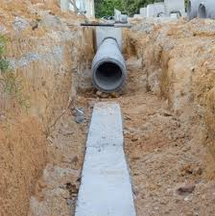
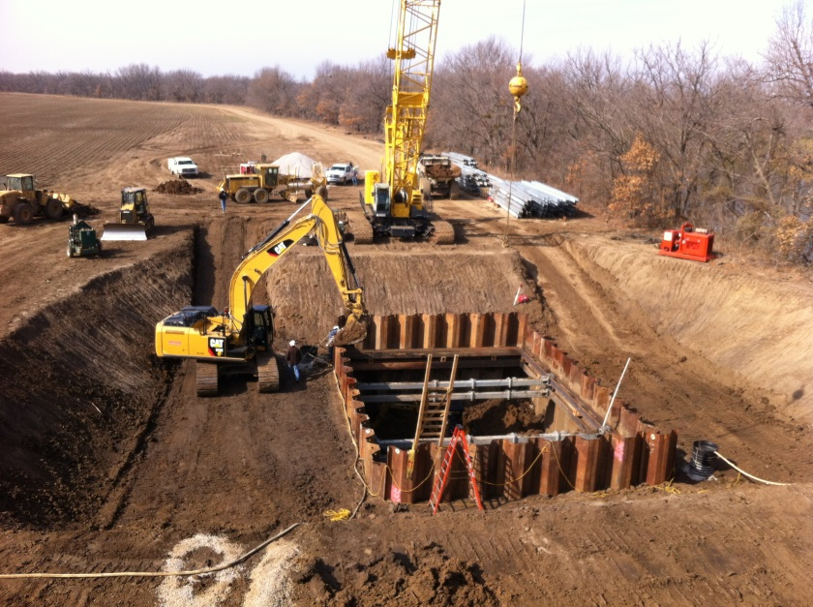
Caught In (trench/excavation)
Know your soil type (Type C)
Slope, shore or box >5’ in depth
Spoil pile >2’ from edge of excavation or trench
Access/egress every 25’ of lateral movement
Maintain barricades around open holes
Monitor conditions regularly

Slide 14
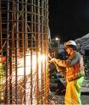
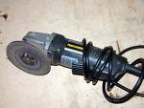

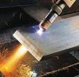
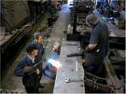
Hot Work
Welding
Brazing
Flame or Plasma Cutting
Hot Riveting
Get the JEA HOT WORK PERMIT PRIOR TO WORK.
Sparks! Heat! Flames!

Slide 15

Hot Work Permit Authorization
Hot Work Permit complete
Ensure JEA Project Mgr is notified of work. Obtain proper signatures.
Fire precautions are in place
    Fire Watch assigned
    Fire extinguisher in place

Slide 16
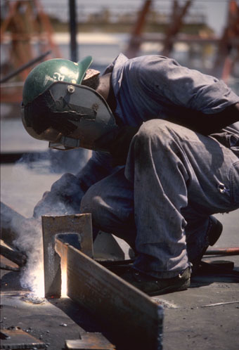
Hot Work – Fire Watch & Monitoring Period
Required for every hot work permit
Employee(s) assigned to fire watch can’t have collateral duties. “Watch” ends 1 hour after work is complete
“Monitoring Period” – 3 hours after fire watch
Trained in use of fire extinguishers

Slide 17
Hot Work - Tank & Pipe Safety Preparation
All vessels, tanks, drums, pipes and other containers shall be purged (cleaned) free of flammables and combustibles such as:
    Gases
    Liquids
    Solids (including dusts)
Before the hot work starts!

Slide 18
Hot Work - Confined Spaces
The Confined Space Supervisor has responsibility for:
Fire precautions being followed
Confined Space Entry & Hot Work Permits
Ensure the space is clear of used electrodes & leads are disconnected when the work is complete
Before the space is cleared for use!

Slide 19
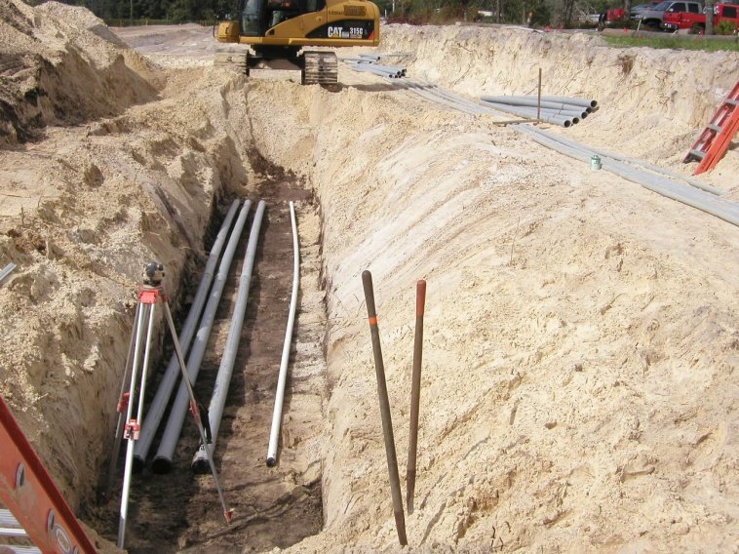
Control of Hazardous Energy
Plant personnel will attach locks and tags on all plant equipment.
OSHA regulations apply + JEA policies and procedures
Utilities in the ground already – contact JEA Project Manager before digging.

Slide 20
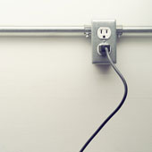
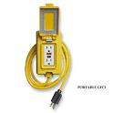
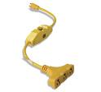
Control of Hazardous Energy
Ground Fault Interrupters
Elevate or protect all cords
Energy can be mechanical, hydraulic, etc
  Lock out, release, block, secure all energy sources prior to work

Slide 21

Scaffold Safe Work Practices
User training required
Climb to your work platform by attached ladder, stairway or ramps ONLY !
The scaffold frame, system members or cross braces are not designed to be climbed.

Slide 22
Scaffold Safe Work Practices
ALWAYS . . .
Stay alert to the hazards above and below
Verify daily inspection on scaffold tag before use
  Red – don’t use
  Yellow – incomplete, fall protection may be required
  Green – safe to use
Know how to inspect all parts of the scaffold and scaffold base.

Slide 23
Scaffold Safe Work Practices
NEVER . . .
Become overconfident on a scaffold
Make foolish mistakes or take shortcuts because you are tired
Cross from one platform to another unless both platforms are level and properly joined.

Slide 24
Project Specific PPE Requirements
Hard Hats (at all times)
  Class G or E ANSI approved are required
  Brim forward (except Welders when welding)
  No paint, holes or defects
  Contractor ID

Slide 25
Project Specific PPE Requirements
Safety Toed Boots (at all times)
  Leather or Similar Material
  Defined Heel
  EH Electrical Rating
  5” Ankle Support
  Slip Resistant
  Protective Toe- Meets ASTM F2413

Slide 26

Project Specific PPE Requirements
Safety Glasses (at all times)
  ANSI approved protective eyewear (lenses, frames and side-shields)
  Goggles where needed
  Prescription lenses are acceptable if covered by ANSI approved protective eyewear

Slide 27
Project Specific PPE Requirements
Face Shields
  Required when exposed to flying debris such as: over-spray, chemical splash, chipping, grinding, abrading etc.
  Safety glasses must be worn under the face shield

Slide 28
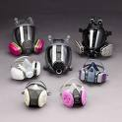
Project Specific PPE Requirements
Respirators
  Get the right mask and filter cartridge for the task. (ex P100 for lead, asbestos, cadmium, arsenic)
  Meet or exceed atmospheric hazard
  Medical Approval, fit test and inspect/maintain daily

Slide 29
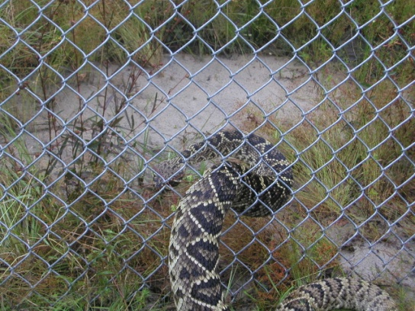

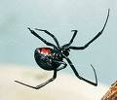
Other Considerations:
Wild animals & reptiles
Insects – spiders
Others
Eastern Diamondback – found on site
Brown Recluse
Black Widow

Slide 30


In summary
Ask if you are not sure
Good housekeeping
Wear your PPE & follow safety procedures
Be alert – report or fix unsafe acts & conditions
Help your co-workers

