Slide 1
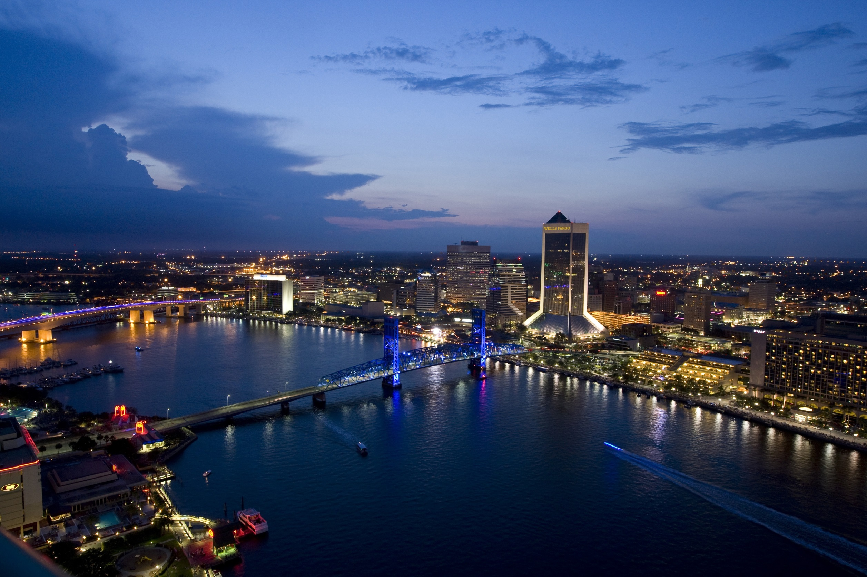
OCTOBER
LPPC Investor Forum
One on One Investor Presentation
2014

Slide 2
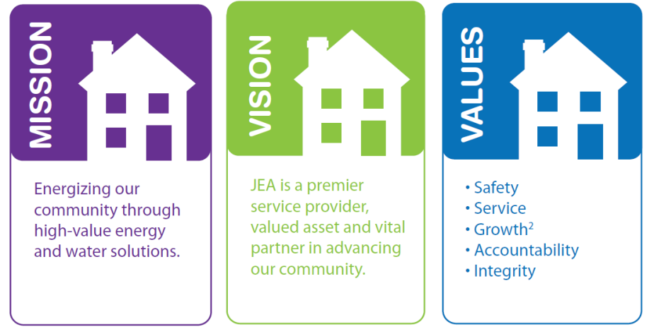

Disclaimer
This presentation is provided for general informational purposes only. It does not include every item which may be of interest, nor does it purport to present full and fair disclosure with respect to any of JEA’s bond programs within the meaning of applicable securities laws. These materials do not constitute an offer to sell, or the solicitation of an offer to buy, any security of JEA, nor are these materials a recommendation to buy, sell or hold any security. Any investment decisions regarding the securities of JEA should be made only after a careful review of the complete offering and disclosure materials with respect to such securities and consultation with your own advisors as to the suitability of such securities for your particular circumstances.
The information presented herein has been gathered from sources we believe to be reliable; however, we do not guaranty its accuracy or completeness. The information presented herein is subject to change without notice. There may have been events that occurred subsequent to the date hereof that would have a material adverse effect on the financial information presented herein. JEA has not undertaken any obligation to update this presentation or the information set forth herein.
This presentation contains statements which, to the extent they are not recitations of historical fact, constitute “forward looking statements.” In this respect, the words “estimate,” “project,” “anticipate,” “expect,” “intend,” “believe” and similar expressions are intended to identify forward-looking statements. A number of factors affecting JEA’s business and financial results could cause actual results to differ materially from those stated in the forward-looking statements.

Slide 3
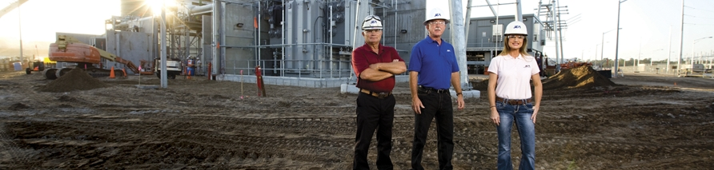
LPPC INVESTOR FORUM
**********************************************************************************************************************************************************************************************************************************************************************
ABOUT JEA
**********************************************************************************************************************************************************************************************************************************************************************
  Municipal electric system since 1895 and independent agency of the City of Jacksonville, Florida since 1968
  Water & Sewer System transferred from the City of Jacksonville to JEA in 1997
  Separately secured liens for:
    Electric enterprise
      Electric System
      St Johns River Power Park
      Bulk Power Supply System
    District Energy System
    Water and Sewer System
  Independent agency of the City of Jacksonville

Slide 4
LPPC INVESTOR FORUM
**********************************************************************************************************************************************************************************************************************************************************************
GENERATION FLEET
**********************************************************************************************************************************************************************************************************************************************************************
Existing Generation Capacity = 3,747¹ MWs
FY13 Dispatch Stack³
Facility | Primary Fuel Type | Generating Capacity (in MW) | Year in Service
Natural Gas: 2,084 MW (60%)
Brandy Branch | Natural Gas | 796 | 2001 – 2005²
Northside Gen Unit 3⁴ | Natural Gas/Oil | 524 | 1977
Kennedy | Natural Gas | 382 | 2000 – 2009²
Greenland Energy Center | Natural Gas | 372 | 2011
Trail Ridge/Girvin | Landfill Gas | 10 | 1997 – 2008²
Solid Fuel: 1,417 MW (40%)
SJRPP | Coal | 637 | 1987 – 1988²
Northside Gen Units 1 & 2 | Pet Coke | 586 | 2003
Scherer 4 | Coal | 194 | 1989
Peaking Reserve: 246 MW
Northside CTs | Diesel Fuel Oil | 246 | 1975
Grand Total: 3,747 MW
Plant Vogtle (future) | Nuclear | 206 | 2017/2018
Jacksonville Solar | Solar PV | 15 | 2010
NS3 (Gas)
$40.06/MWh
Simple Cycle CT (Gas)
$39.50/MWh
SJRPP (Coal)
$34.87/MWh
NS CFB (Pet Coke)
$34.47/MWh
Combined Cycle (Gas)
$29.19/MWh
Scherer 4 (Coal)
$25.41/MWh
JEA also has the ability to purchase power via The Energy Authority (TEA)
¹ Based on winter ratings and entitled capacity
² Multiple units and multiple in service dates
³ The average dispatch prices at maximum load for each unit from 10/1/2012 through 9/26/2013
⁴ Northside Unit 3 (NS3) will be placed into reserve storage by December 2015, approximately four years ahead of the unit’s scheduled retirement.

Slide 5
LPPC INVESTOR FORUM
**********************************************************************************************************************************************************************************************************************************************************************
POWER RESOURCE AND FUEL MIX
**********************************************************************************************************************************************************************************************************************************************************************
Capacity Mix (MW)
Fuel |  | FY10 |  | FY11 |  | FY12 |  | FY13
Natural Gas |  | 58% |  | 62% |  | 62% |  | 62%
Solid Fuel |  | 42% |  | 38% |  | 38% |  | 38%
Nuclear |  | 0% |  | 0% |  | 0% |  | 0%
Other |  | 0% |  | 0% |  | 0% |  | 0%
Fuel |  | FY10 |  | FY11 |  | FY12 |  | FY13
Natural Gas |  | 21% |  | 32% |  | 46% |  | 34%
Solid Fuel |  | 72% |  | 56% |  | 41% |  | 56%
Nuclear |  | 0% |  | 0% |  | 0% |  | 0%
Other |  | 7% |  | 12% |  | 13% |  | 10%
Fuel |  | FY10 |  | FY11 |  | FY12 |  | FY13
Natural Gas |  | 35% |  | 38% |  | 42% |  | 31%
Solid Fuel |  | 56% |  | 47% |  | 45% |  | 57%
Nuclear |  | 0% |  | 0% |  | 0% |  | 0%
Other |  | 9% |  | 15% |  | 13% |  | 12%
Energy Mix (MWh)
Fuel Cost (dollars)

Slide 6
LPPC INVESTOR FORUM
**********************************************************************************************************************************************************************************************************************************************************************
ELECTRIC CUSTOMER BREAKDOWN
**********************************************************************************************************************************************************************************************************************************************************************
Ten Largest Customer Accounts
June 30, 2014 YTD
Customer Accounts | Annual $ Billed | Percent of Revenues
Florida Public Utility Company | $40,086,020 | 3.2
US Navy Public Works Center | $26,525,320 | 2.1
City of Jacksonville | $23,028,592 | 1.8
Gerdau Ameristeel US Inc. | $20,154,962 | 1.6
Duval County School Board | $17,175,834 | 1.4
Rocktenn CP LLC | $13,944,857 | 1.1
Publix Supermarkets, Inc. | $9,320,063 | 0.7
Winn Dixie Stores, Inc. | $9,220,261 | 0.7
Baptist Health | $7,349,134 | 0.6
Mayo Clinic Jacksonville | $7,281,045 | 0.6
TOTAL | $174,086,088 | 13.8
Total = 433,727
Average Number of Accounts
Total = 8,645,540
System Sales (MWh)
Total = $933.6
Revenues ($ in millions)
Residential
Commercial & Industrial
Public Street Lighting
Wholesale

Slide 7
Debt Composition as of 9/30/13
Debt Composition as of 9/30/14
LPPC INVESTOR FORUM
**********************************************************************************************************************************************************************************************************************************************************************
ELECTRIC SYSTEM DEBT MANAGEMENT: SIGNIFICANT RISK REDUCTION
**********************************************************************************************************************************************************************************************************************************************************************
$3.5 Billion
$3.3 Billion
Total debt reduction in FY 2014:
$206 million
Risk reduction in FY 2014:
$65 million variable to fixed
  Figures includes JEA’s portion of SJRPP and Scherer

Slide 8
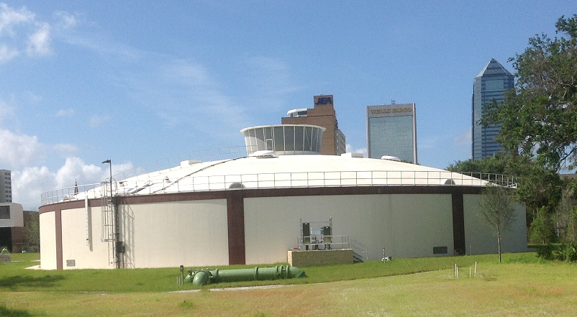
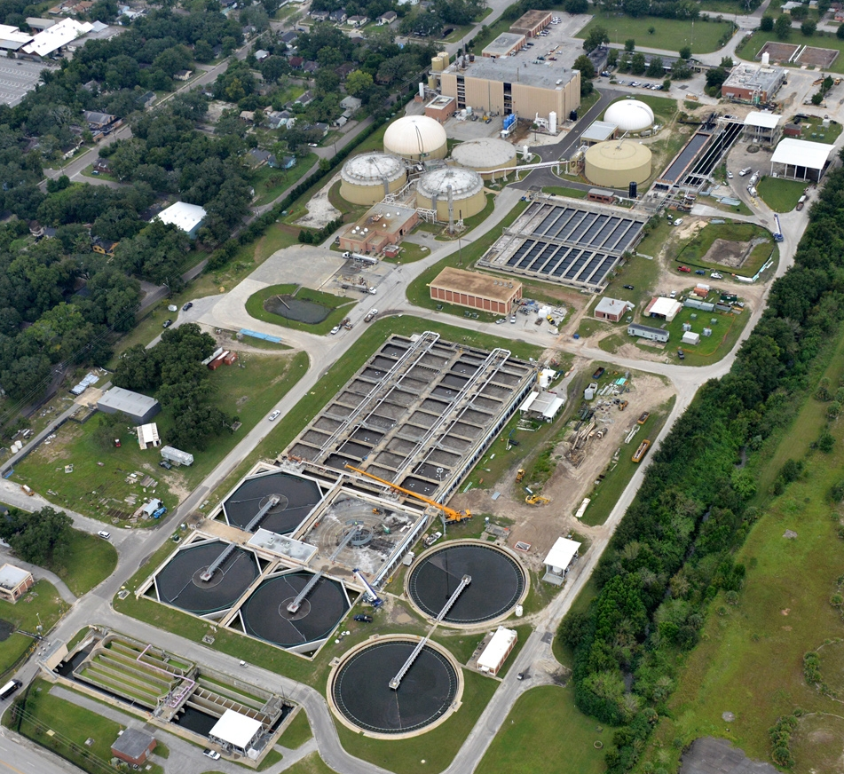
LPPC INVESTOR FORUM
**********************************************************************************************************************************************************************************************************************************************************************
WATER AND SEWER SYSTEM INFRASTRUCTURE
**********************************************************************************************************************************************************************************************************************************************************************
  Water System
  18 major and 18 small water treatment plants and two re-pump facilities
  134 active water supply wells, 4,306 miles of water distribution mains and total finished water storage capacity of over 69 million gallons
  Two major and four small distribution grids
  Sewer System
  Approximately 3,789 miles of gravity sewers and force mains
  1,313 pumping stations, about 700 low pressure sewer units, and 11 treatment plants currently ranging in rated average daily treatment capacity from approximately 0.2 to 52.5 MGD

Slide 9
LPPC INVESTOR FORUM
**********************************************************************************************************************************************************************************************************************************************************************
WATER AND SEWER CUSTOMER BREAKDOWN
**********************************************************************************************************************************************************************************************************************************************************************
Water System
June 30, 2014 YTD
Ten Largest Customer Accounts | Annual $ Billed | Percent of Revenues
City of Jacksonville | $2,083,510 | 1.3
Duval County School Board | $1,440,252 | 0.9
Baptist Health | $556,590 | 0.3
Mid-America Apartment Communities Inc. | $469,619 | 0.3
St. Johns County Utility | $416,807 | 0.3
Johnson & Johnson Vision Care Inc. | $389,318 | 0.2
St Vincent’s Health System Inc. | $373,434 | 0.2
D.R. Horton Inc. Jacksonville | $358,617 | 0.2
The American Bottling Company | $351,893 | 0.2
University of North Florida | $339,131 | 0.2
TOTAL | $6,779,171 | 4.1
Total = 317,860
Average Number of Accounts
Total = 23,505,018
System Sales (kgal)
Water
Water
Wastewater System
Ten Largest Customer Accounts | Annual $ Billed | Percent of Revenues
Duval County School Board | $2,475,345 | 1.1
City of Jacksonville | $1,840,464 | 0.8
Mid-America Apartment Communities Inc. | $1,112,303 | 0.5
The American Bottling Company | $948,478 | 0.4
St. Johns County Utility | $925,328 | 0.4
St Vincent’s Health System Inc. | $871,104 | 0.4
University of North Florida | $866,791 | 0.4
Renessenz LLC | $838,872 | 0.4
Mayo Clinic Jacksonville | $779,669 | 0.4
Florida Coca Cola Bottling | $758,319 | 0.3
TOTAL | $11,416,673 | 5.1
Total = $114.6
Revenues ($ in millions)
Water
Residential
Commercial & Industrial
Irrigation
9

Slide 10
Debt Composition
as of 9/30/13
Debt Composition
as of 9/30/14
LPPC INVESTOR FORUM
**********************************************************************************************************************************************************************************************************************************************************************
WATER AND SEWER SYSTEM DEBT MANAGEMENT: SIGNIFICANT RISK REDUCTION
**********************************************************************************************************************************************************************************************************************************************************************
$1.9 Billion
$1.8 Billion
Total debt reduction in FY 2014:
$104 million

Slide 11
LPPC INVESTOR FORUM
**********************************************************************************************************************************************************************************************************************************************************************
CONTACT INFORMATION
**********************************************************************************************************************************************************************************************************************************************************************
Conference attendees:
Paul McElroy
Managing Director & CEO
(904) 665-4396
mcelpe@jea.com
Melissa Dykes
Chief Financial Officer
(904) 665-7054
dykemh@jea.com
Joe Orfano
Treasurer
(904) 665-4541
orfaje@jea.com
JEA Information:
www.jea.com
JEA Investor Website:
www.jea.com/About_Us/Investors.aspx

